Slide 1
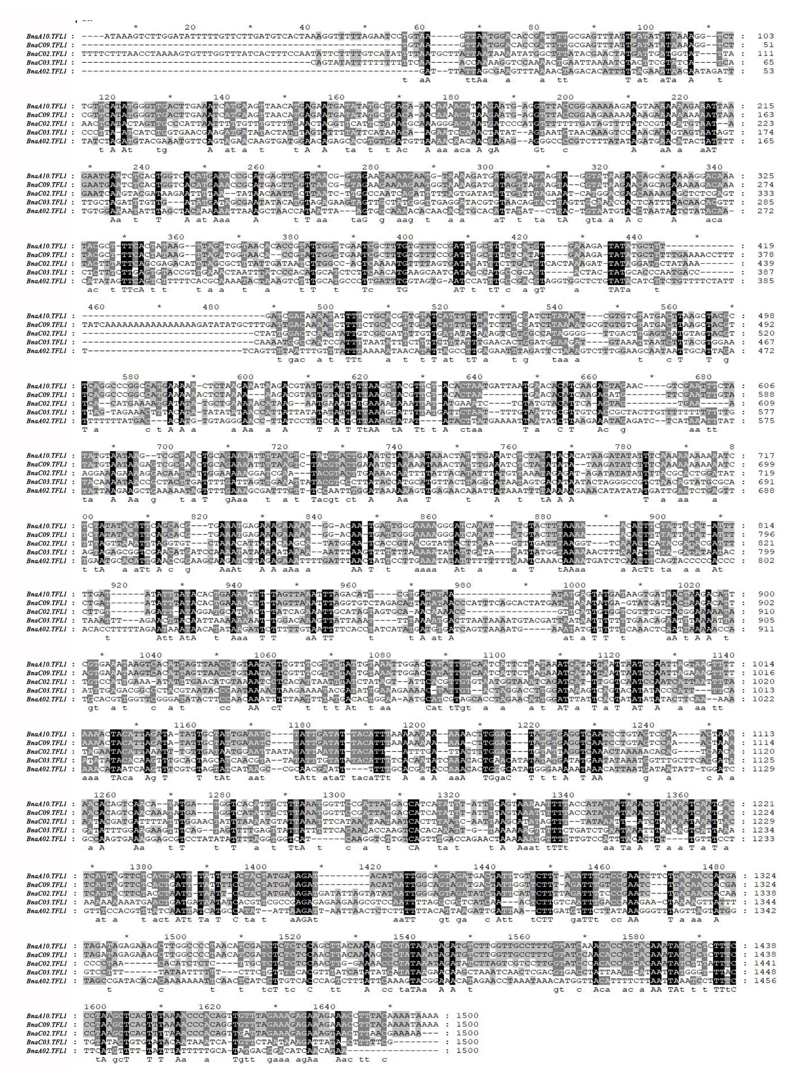
Fig. S1 The promoter sequences alignment between five BnaTFL1s; BnaTFL1.A02, BnaTFL1.A10, BnaTFL1.C02, BnaTFL1.C03 and BnaTFL1.C09.

