Slide 1
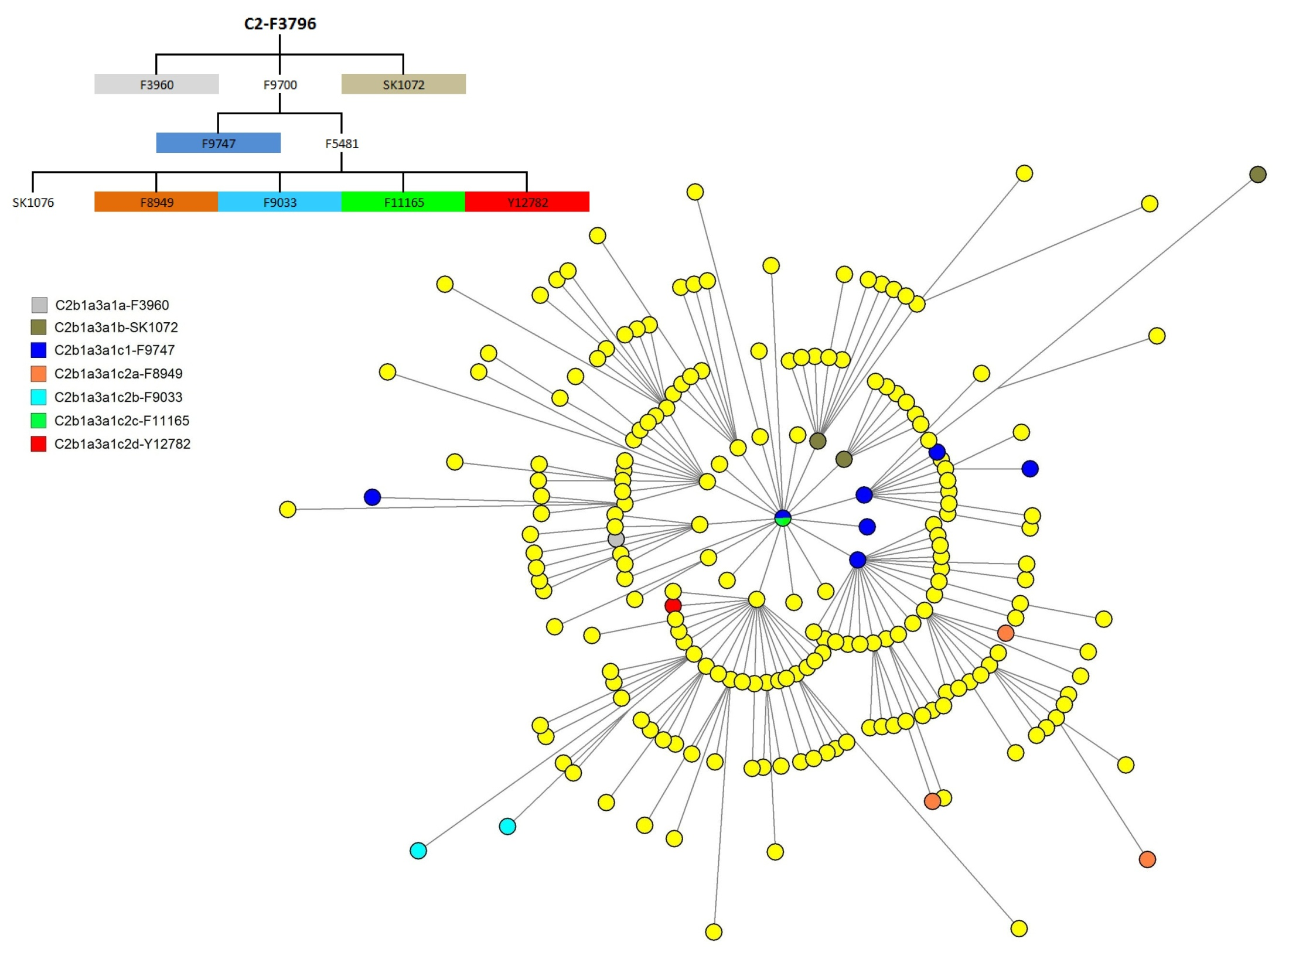
Figure S4. Comparison between STR network and SNP phylogenetic tree of Y chromosome

