Slide 1
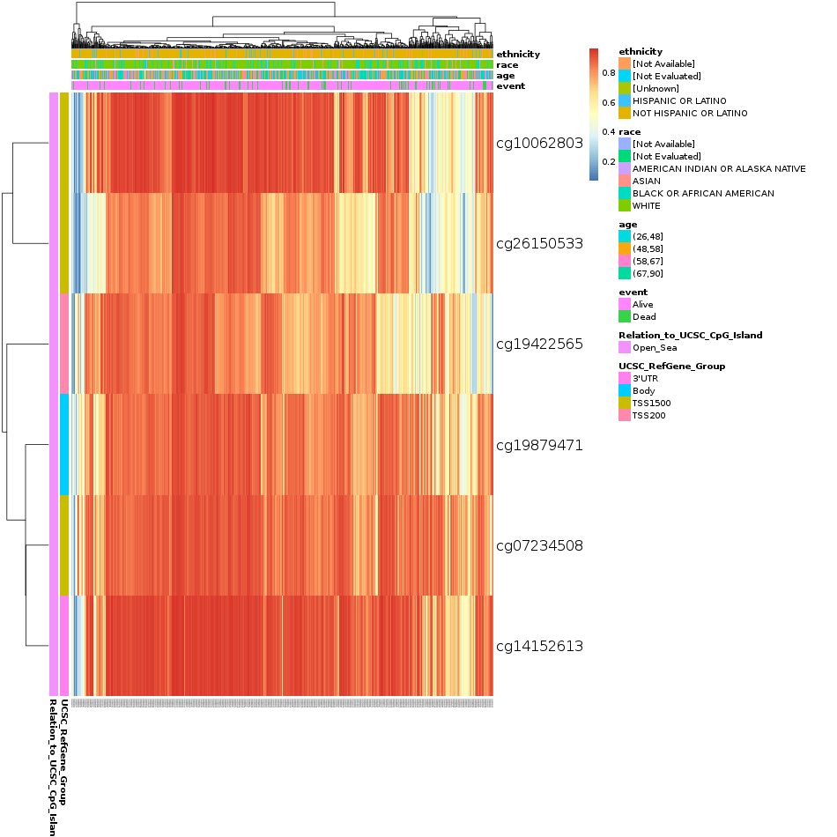
Supplementary Figure 1. Heatmap of FABP4, ADIPOQ, PPARG, PPARGC1A, CD36, and CREBBP DNA methylation expression levels in breast cancer cells using MethSurv database. The highest levels of DNA methylation in patients with breast cancer were as follow: cg10062803 and cg14152613 of FABP4; cg06842886, cg14584085, and cg21978128 of ADIPOQ; cg07895576 and cg16827534 of PPARG; cg09427718, cg06772578, and cg08550435 of PPARGC1A; cg05345249 of CD36; cg16560077, cg01963870, cg27390443, cg27318635, cg03140190, and cg05898629 of CREBBP.
FABP4

Slide 2
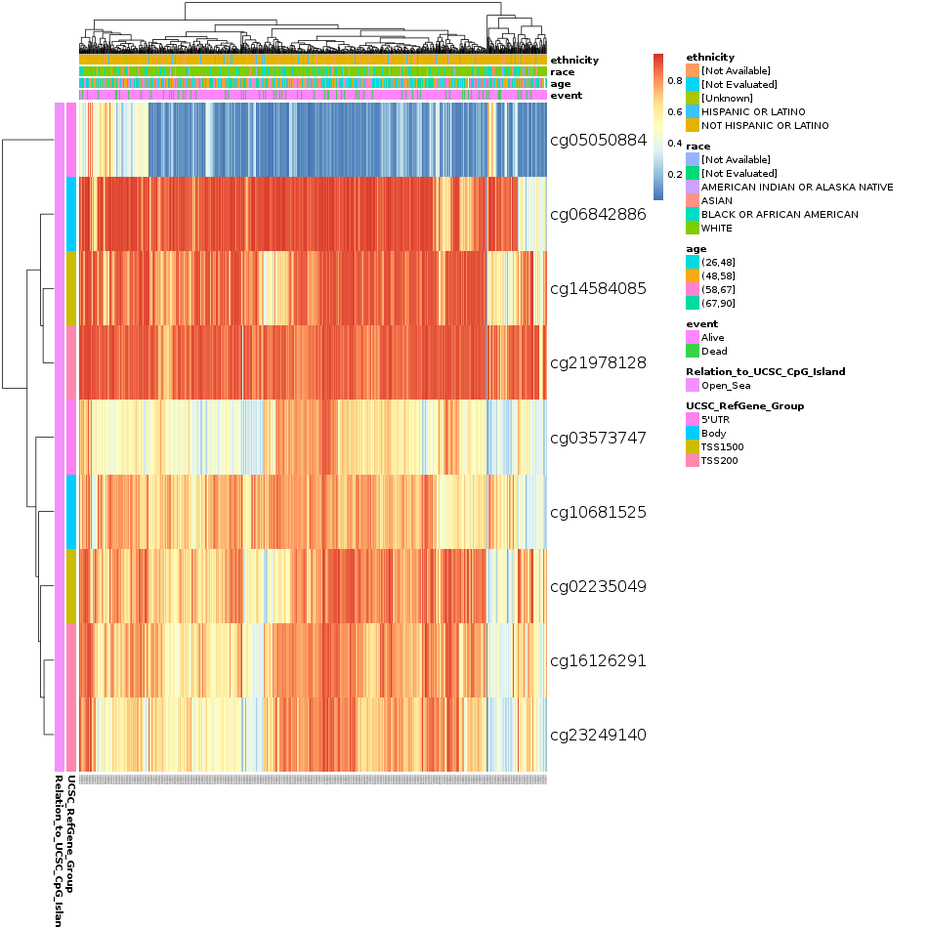
Supplementary Figure 1. Heatmap of FABP4, ADIPOQ, PPARG, PPARGC1A, CD36, and CREBBP DNA methylation expression levels in breast cancer cells using MethSurv database. The highest levels of DNA methylation in patients with breast cancer were as follow: cg10062803 and cg14152613 of FABP4; cg06842886, cg14584085, and cg21978128 of ADIPOQ; cg07895576 and cg16827534 of PPARG; cg09427718, cg06772578, and cg08550435 of PPARGC1A; cg05345249 of CD36; cg16560077, cg01963870, cg27390443, cg27318635, cg03140190, and cg05898629 of CREBBP.
ADIPOQ

Slide 3
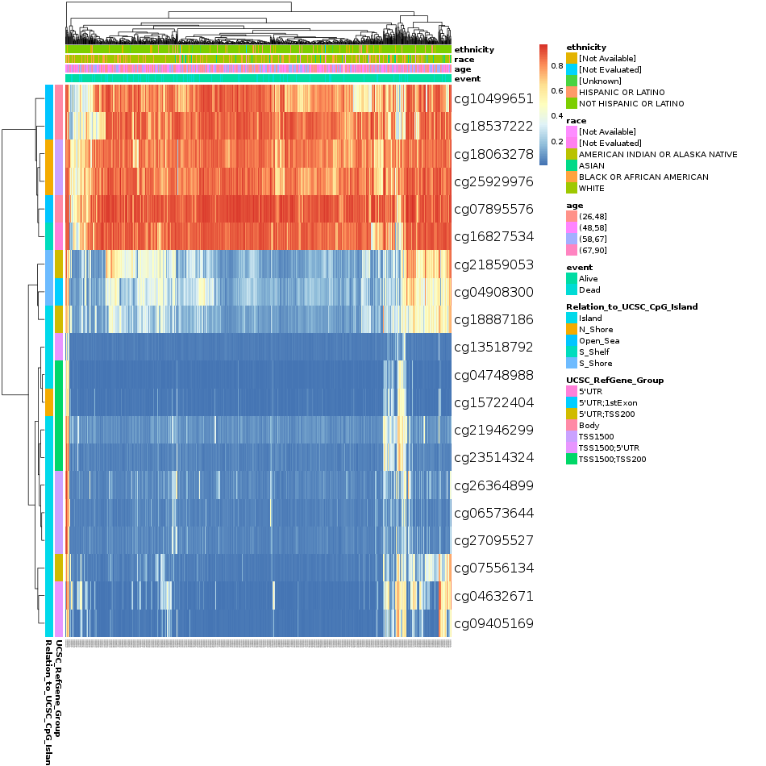
Supplementary Figure 1. Heatmap of FABP4, ADIPOQ, PPARG, PPARGC1A, CD36, and CREBBP DNA methylation expression levels in breast cancer cells using MethSurv database. The highest levels of DNA methylation in patients with breast cancer were as follow: cg10062803 and cg14152613 of FABP4; cg06842886, cg14584085, and cg21978128 of ADIPOQ; cg07895576 and cg16827534 of PPARG; cg09427718, cg06772578, and cg08550435 of PPARGC1A; cg05345249 of CD36; cg16560077, cg01963870, cg27390443, cg27318635, cg03140190, and cg05898629 of CREBBP.
PPARG

Slide 4
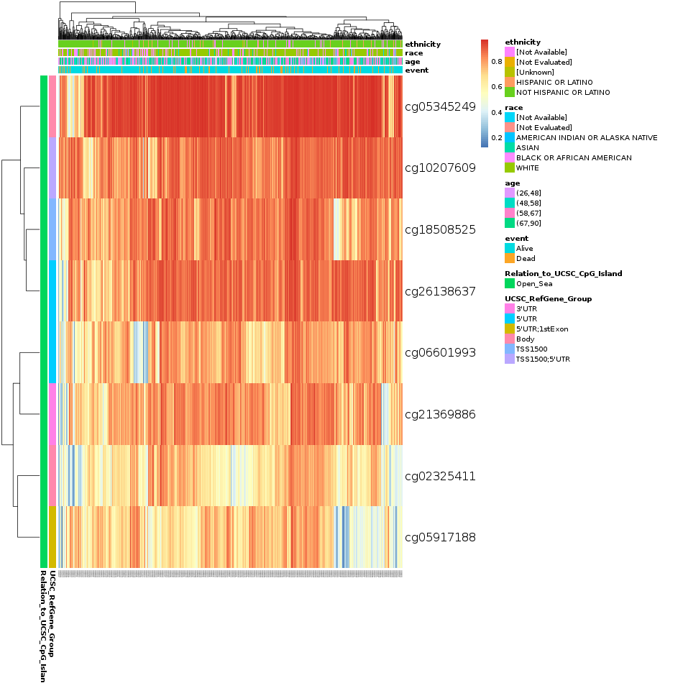
Supplementary Figure 1. Heatmap of FABP4, ADIPOQ, PPARG, PPARGC1A, CD36, and CREBBP DNA methylation expression levels in breast cancer cells using MethSurv database. The highest levels of DNA methylation in patients with breast cancer were as follow: cg10062803 and cg14152613 of FABP4; cg06842886, cg14584085, and cg21978128 of ADIPOQ; cg07895576 and cg16827534 of PPARG; cg09427718, cg06772578, and cg08550435 of PPARGC1A; cg05345249 of CD36; cg16560077, cg01963870, cg27390443, cg27318635, cg03140190, and cg05898629 of CREBBP.
CD36

Slide 5
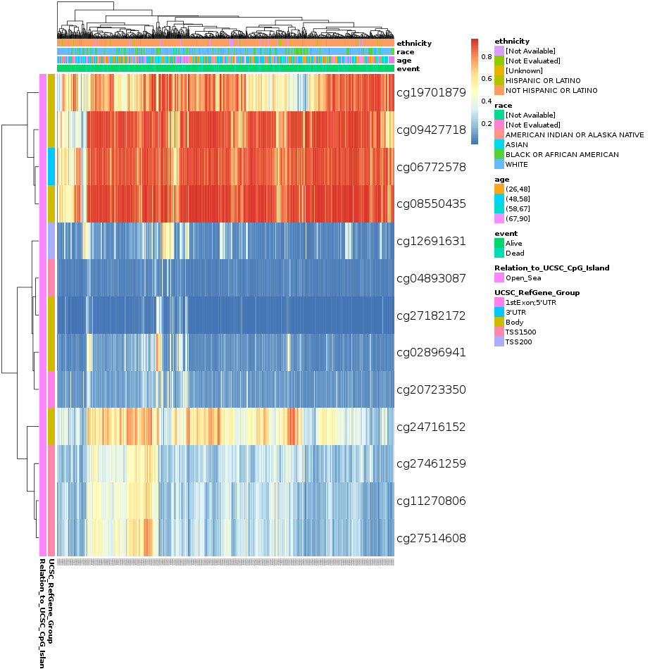
Supplementary Figure 1. Heatmap of FABP4, ADIPOQ, PPARG, PPARGC1A, CD36, and CREBBP DNA methylation expression levels in breast cancer cells using MethSurv database. The highest levels of DNA methylation in patients with breast cancer were as follow: cg10062803 and cg14152613 of FABP4; cg06842886, cg14584085, and cg21978128 of ADIPOQ; cg07895576 and cg16827534 of PPARG; cg09427718, cg06772578, and cg08550435 of PPARGC1A; cg05345249 of CD36; cg16560077, cg01963870, cg27390443, cg27318635, cg03140190, and cg05898629 of CREBBP.
PPARGC1A

Slide 6
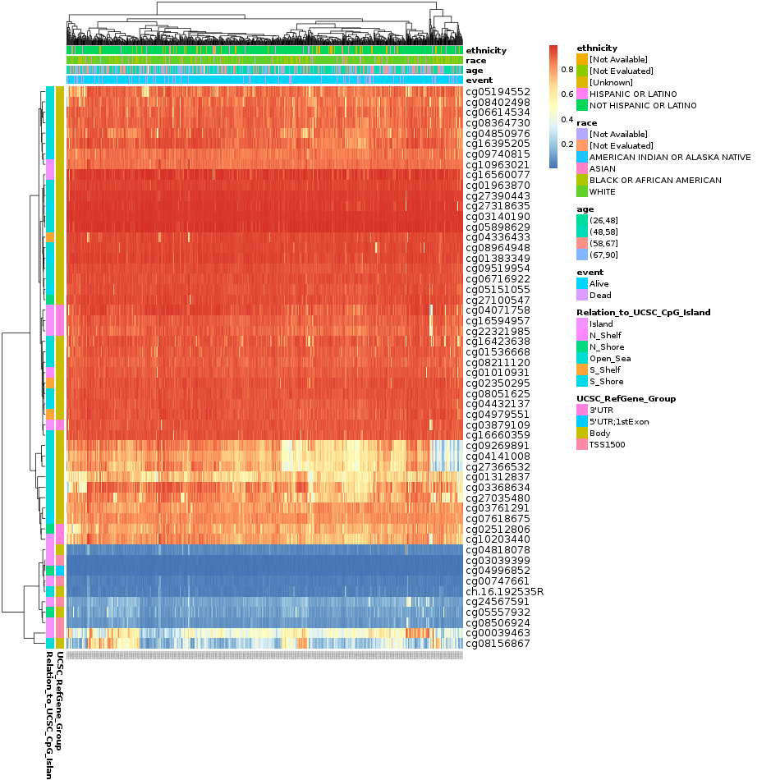
Supplementary Figure 1. Heatmap of FABP4, ADIPOQ, PPARG, PPARGC1A, CD36, and CREBBP DNA methylation expression levels in breast cancer cells using MethSurv database. The highest levels of DNA methylation in patients with breast cancer were as follow: cg10062803 and cg14152613 of FABP4; cg06842886, cg14584085, and cg21978128 of ADIPOQ; cg07895576 and cg16827534 of PPARG; cg09427718, cg06772578, and cg08550435 of PPARGC1A; cg05345249 of CD36; cg16560077, cg01963870, cg27390443, cg27318635, cg03140190, and cg05898629 of CREBBP.
CREBBP

Slide 7
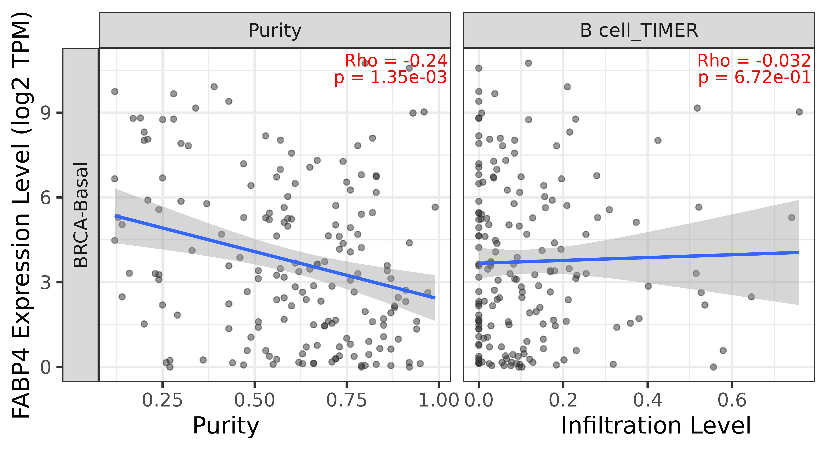
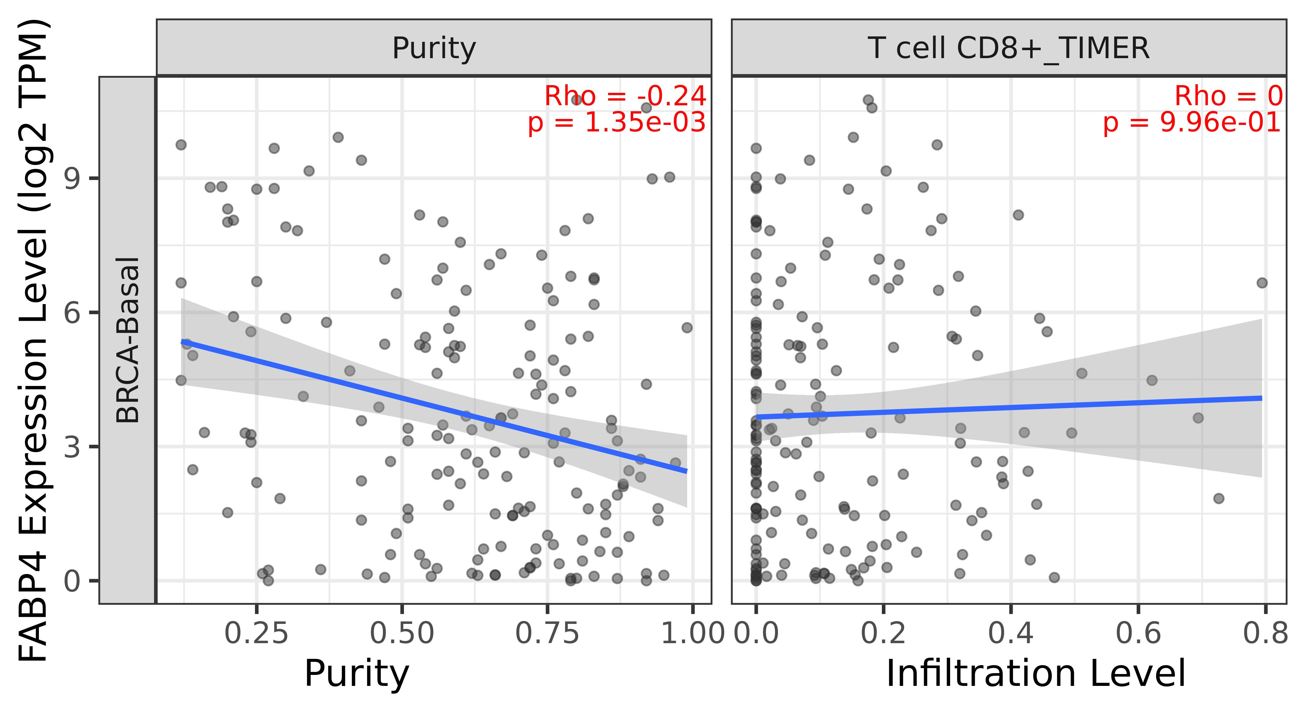
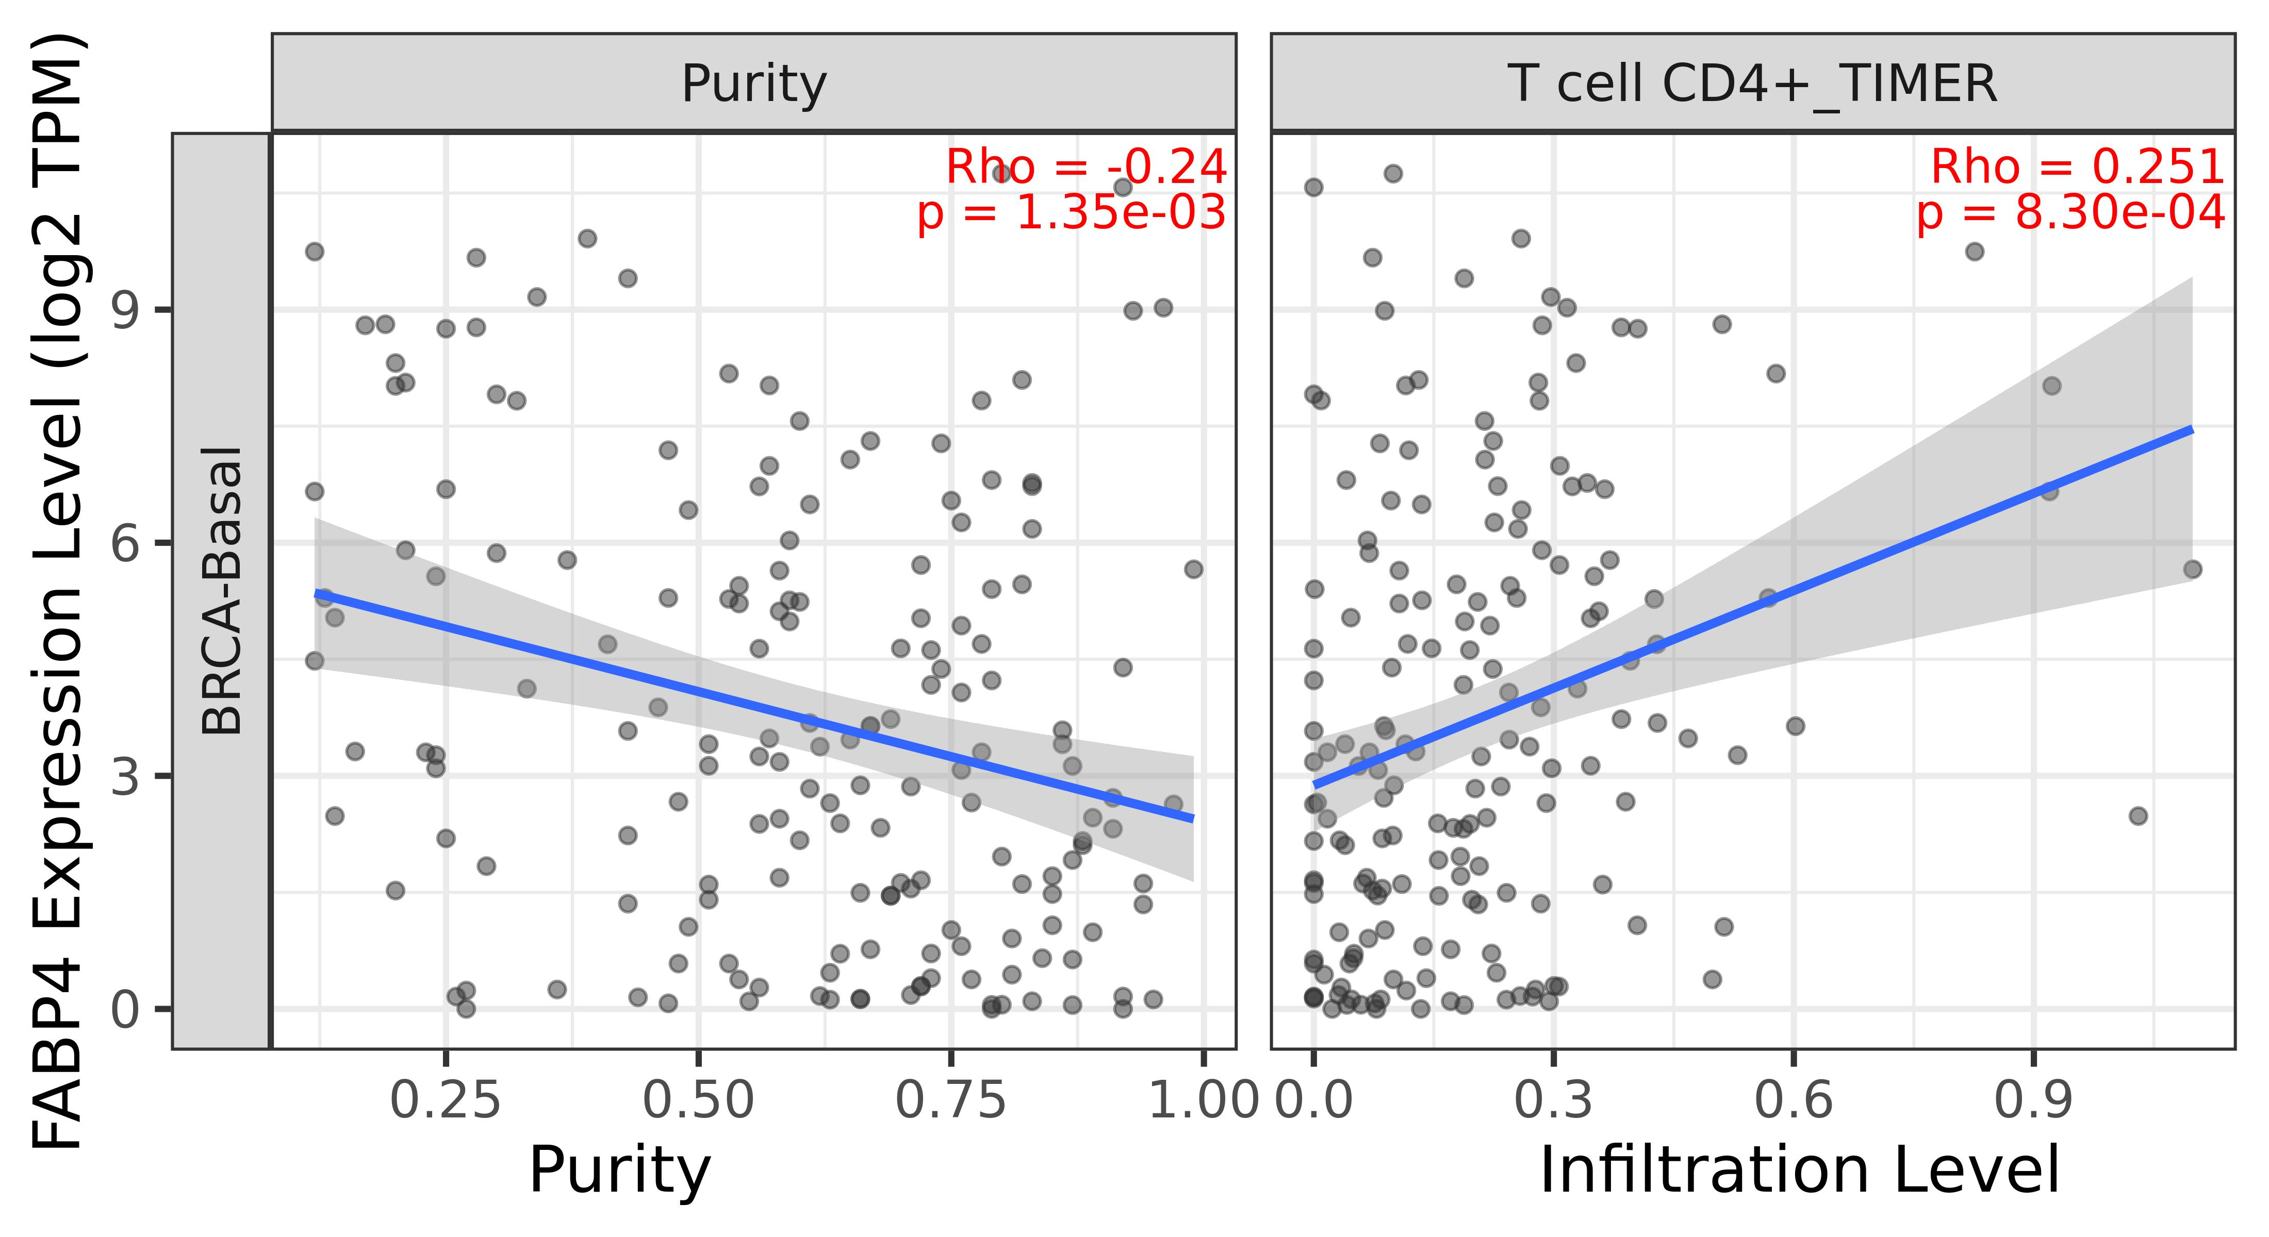

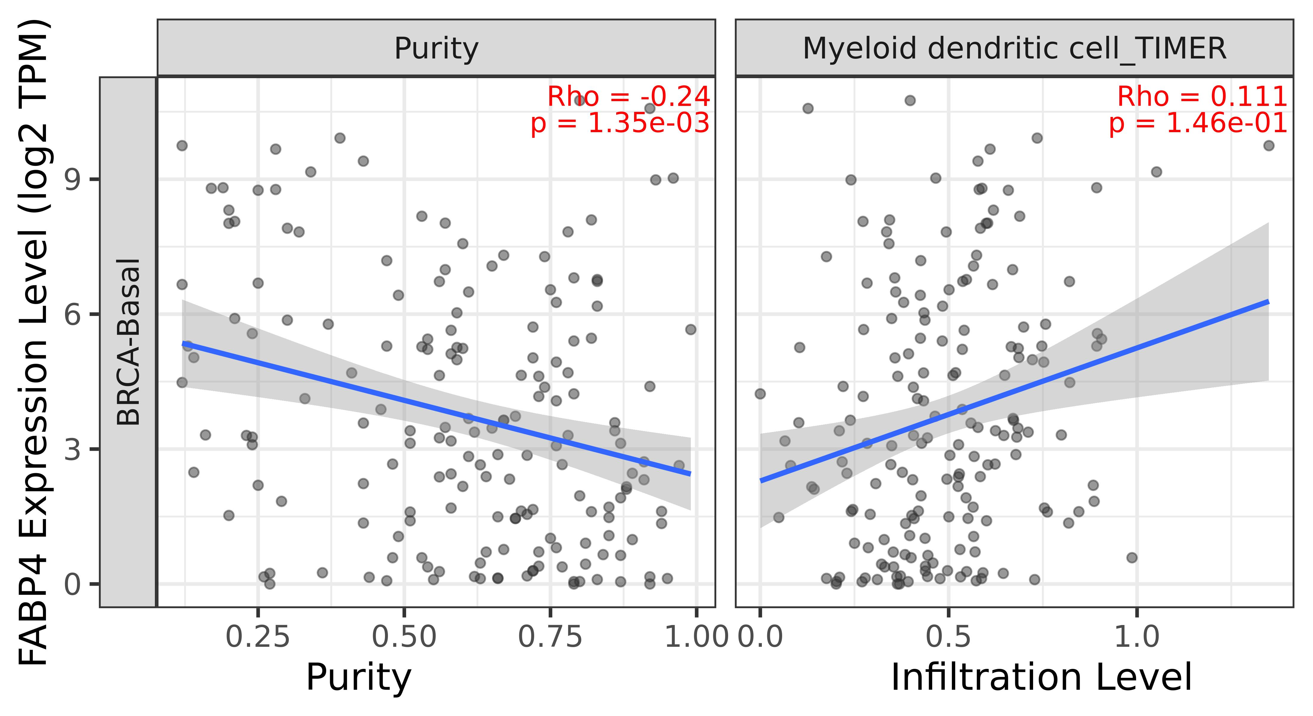
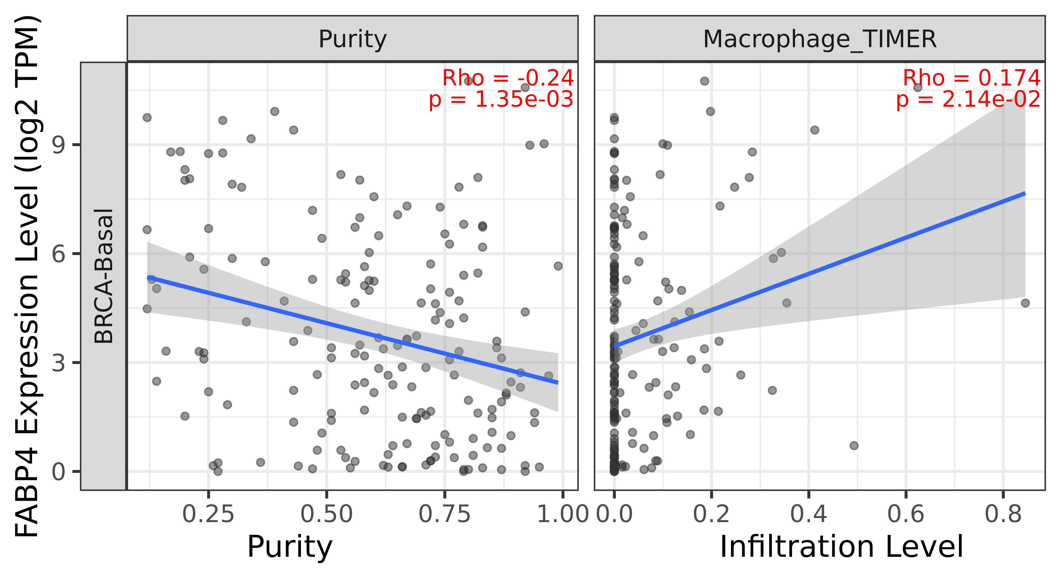
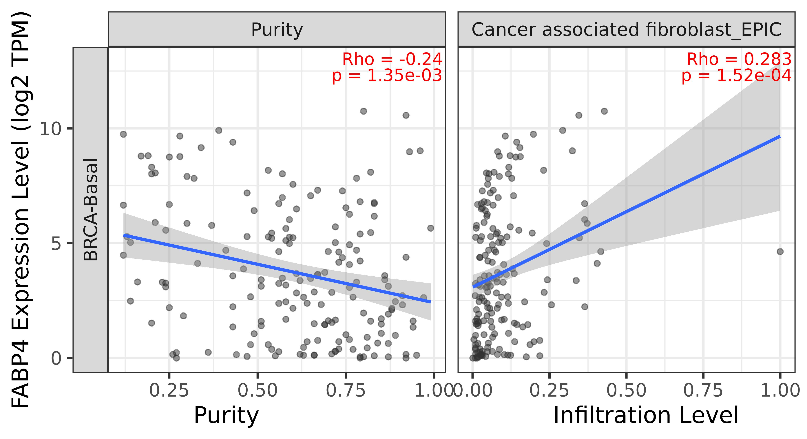
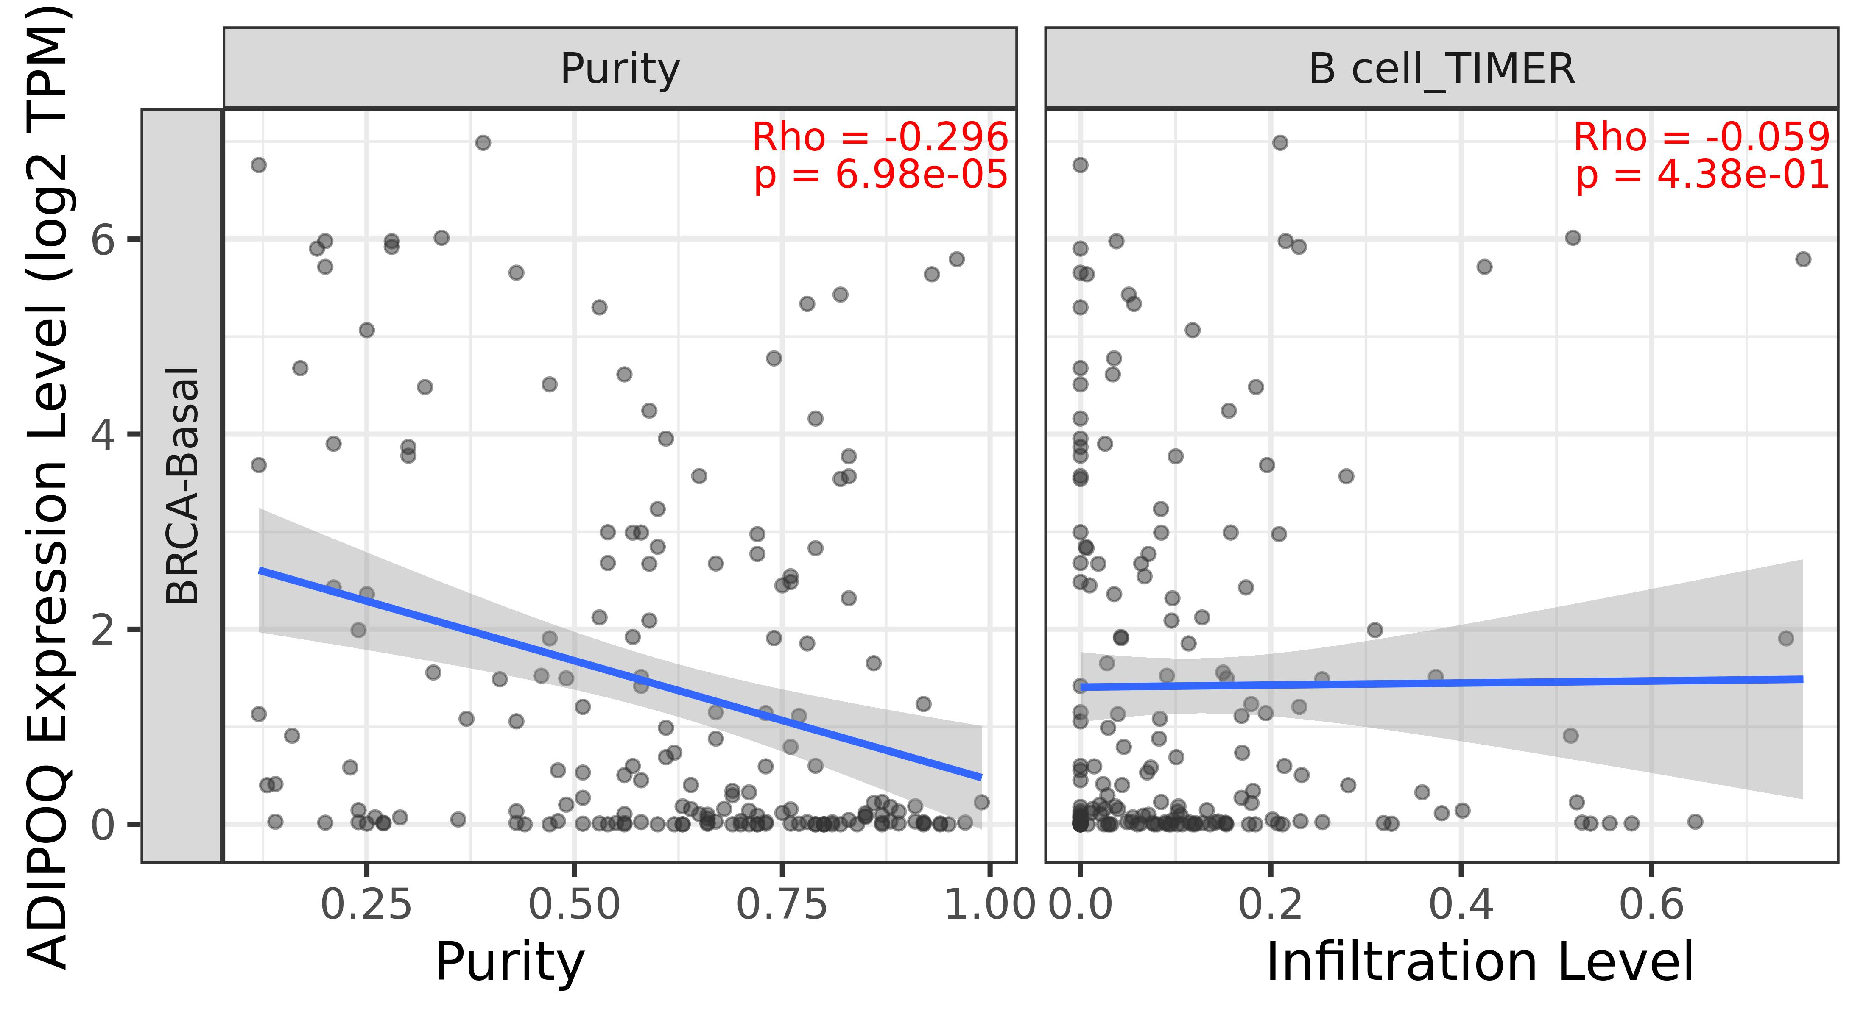
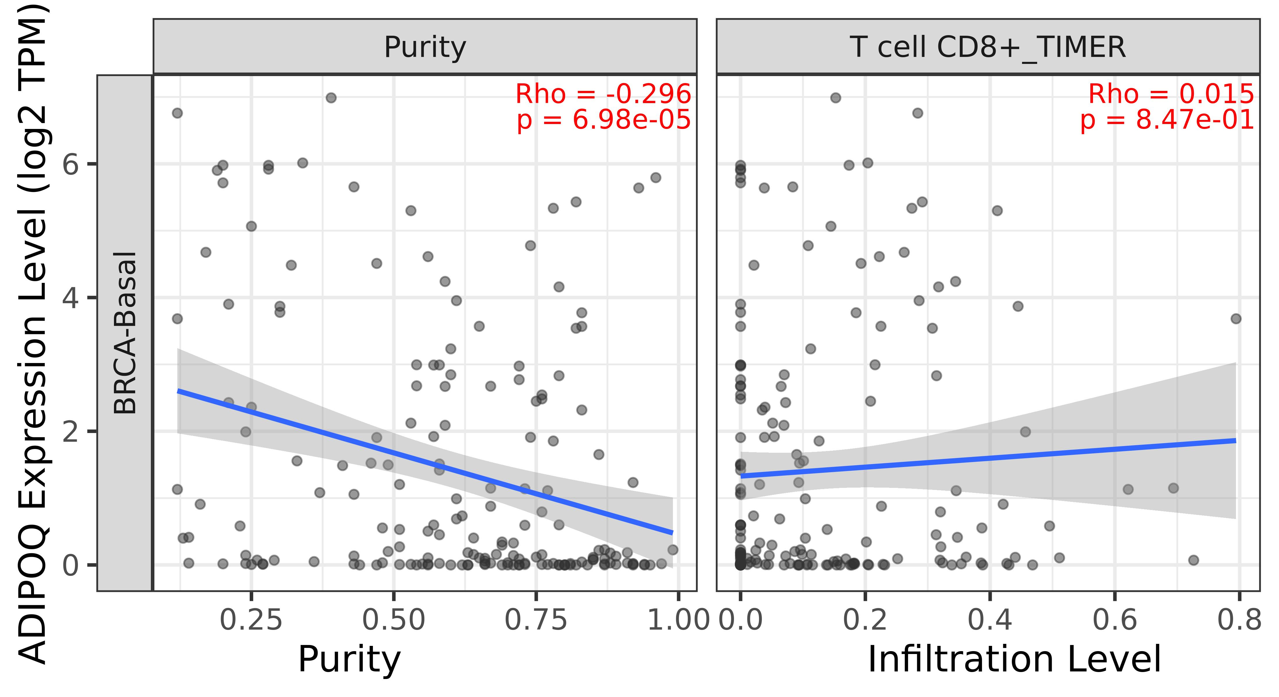
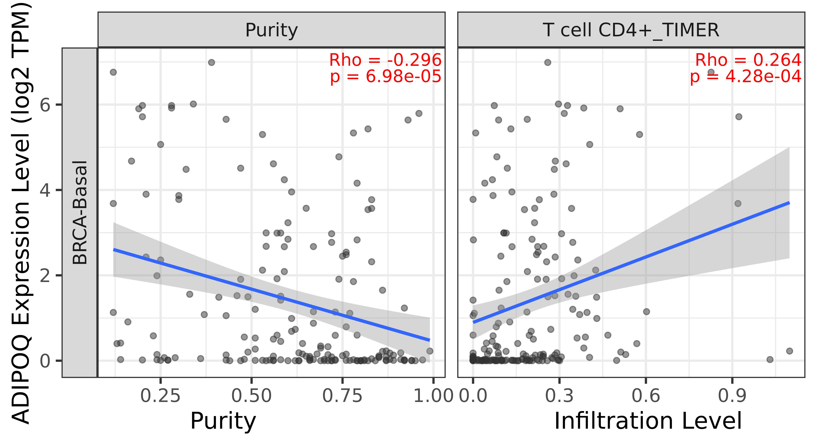
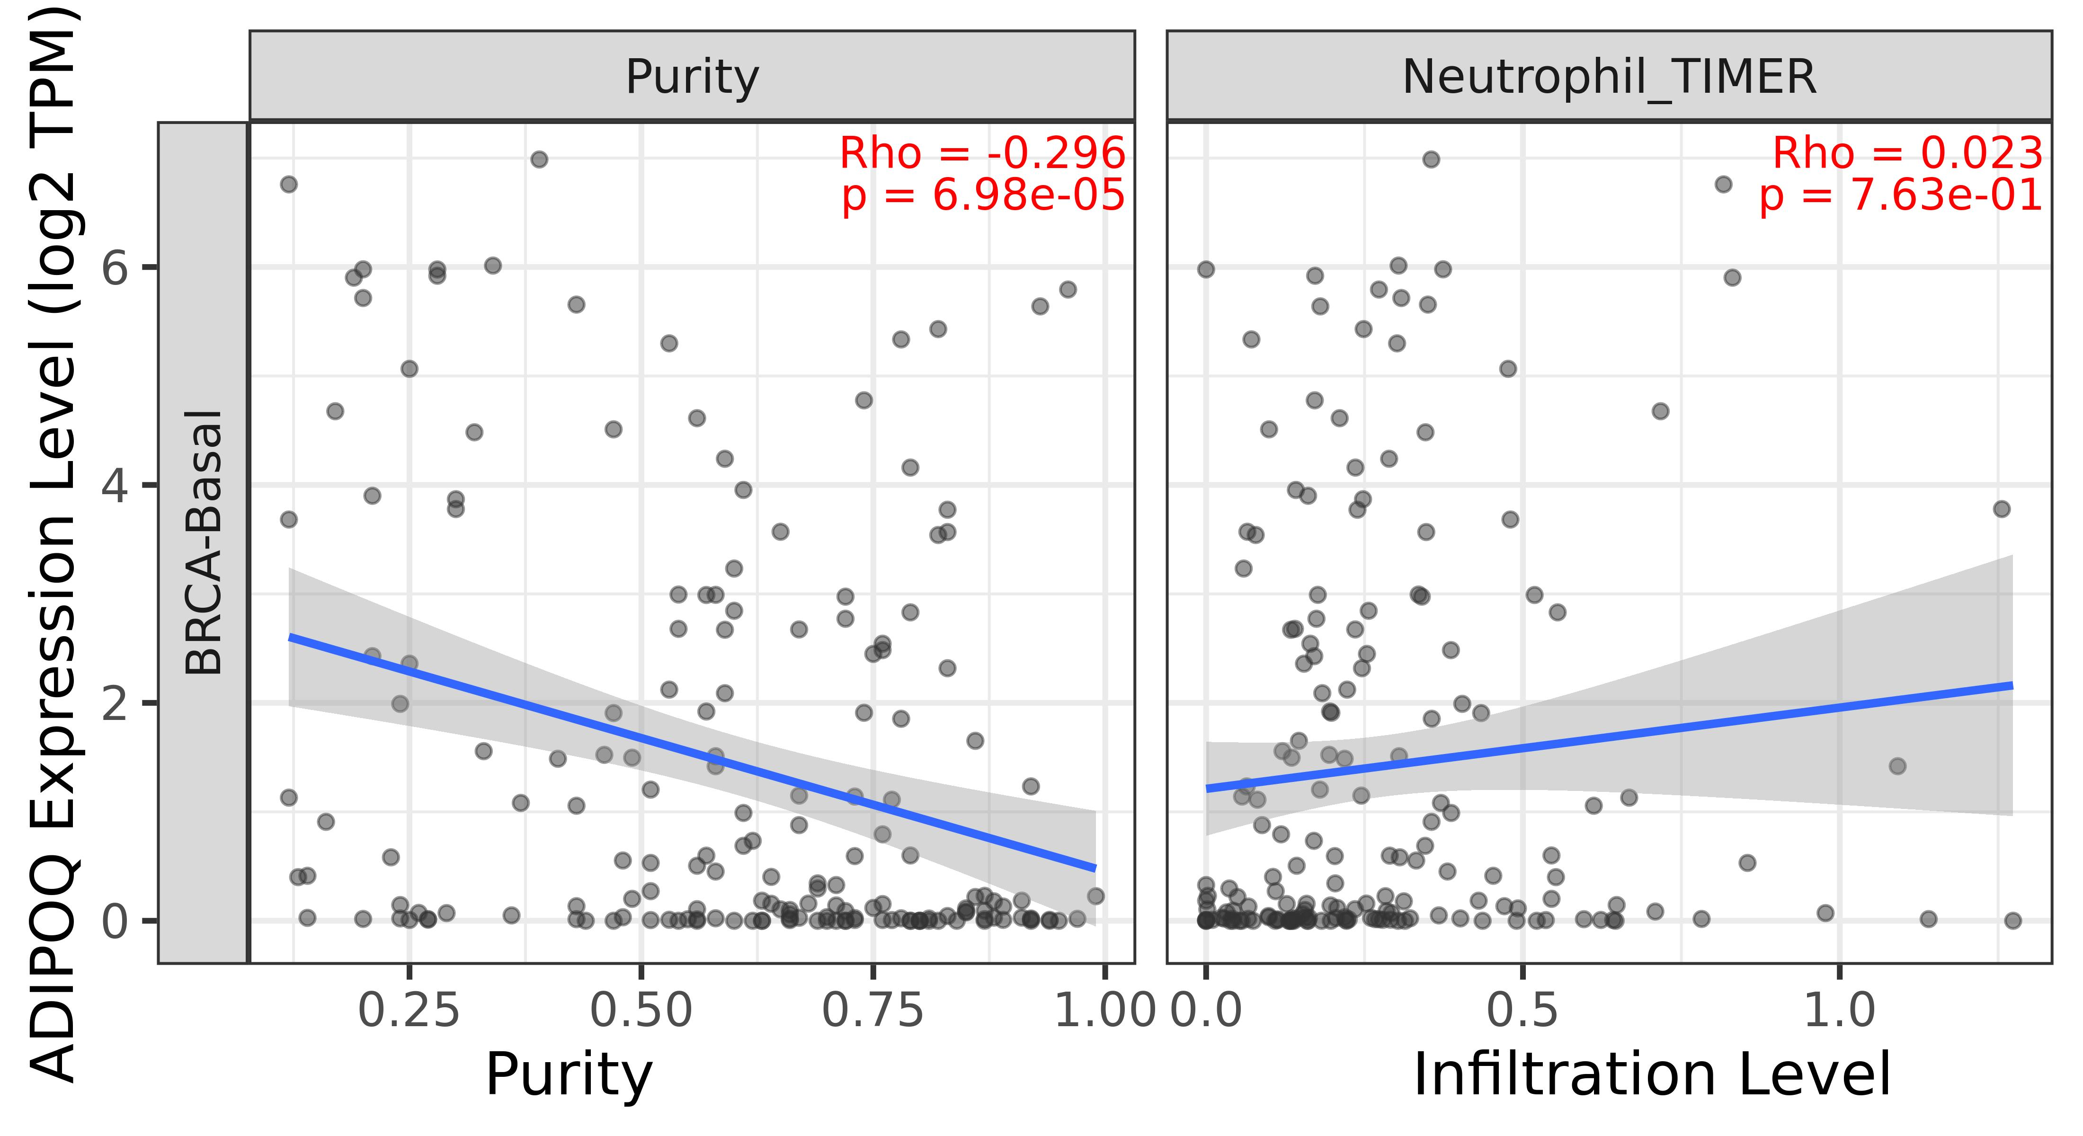
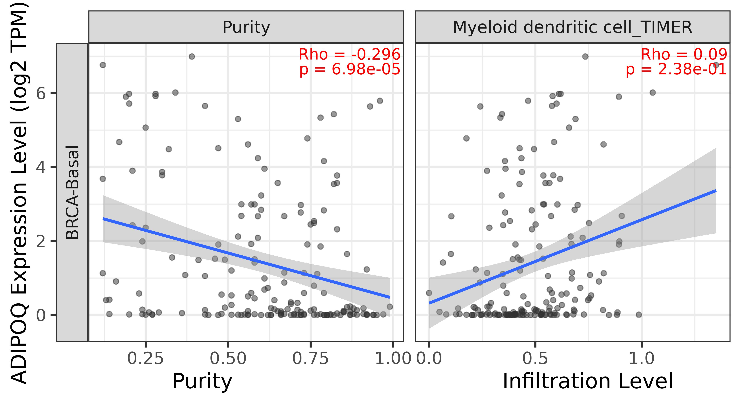
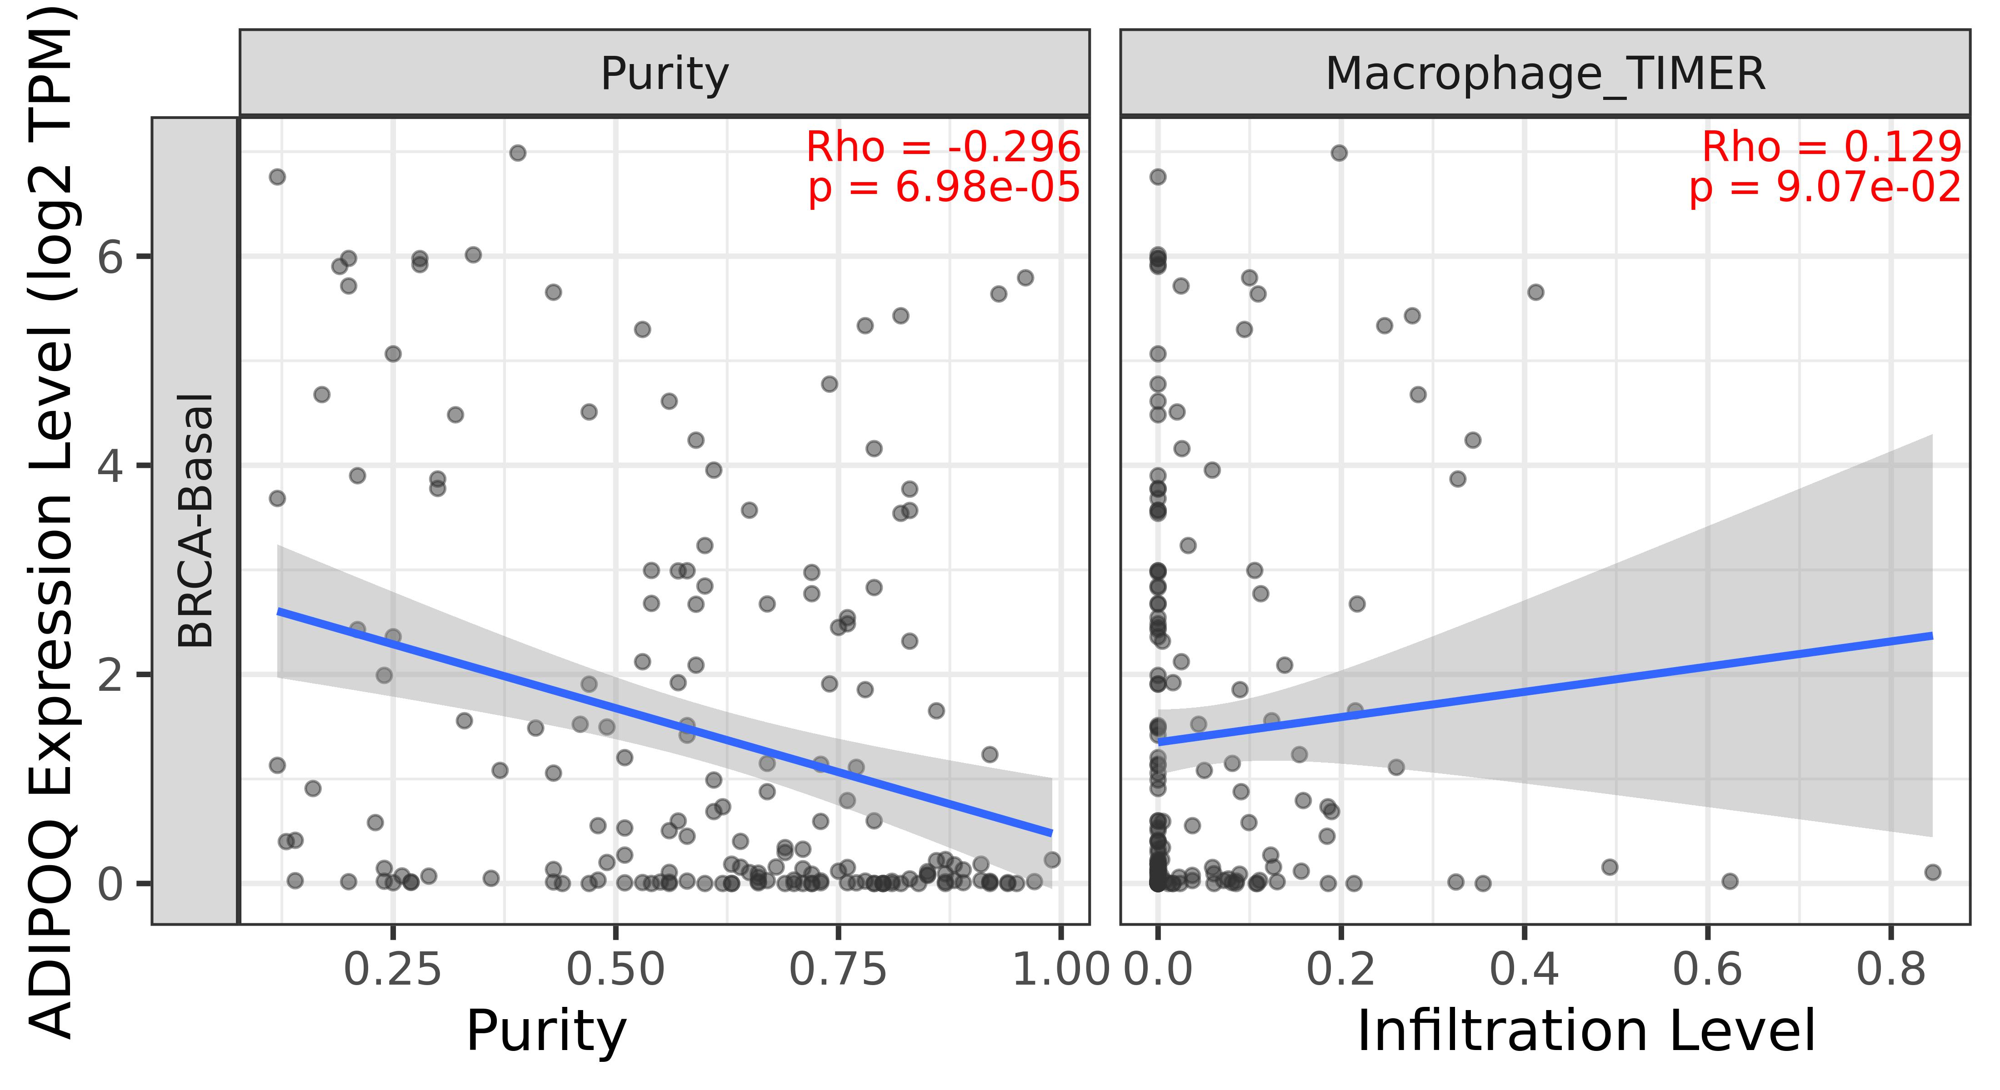
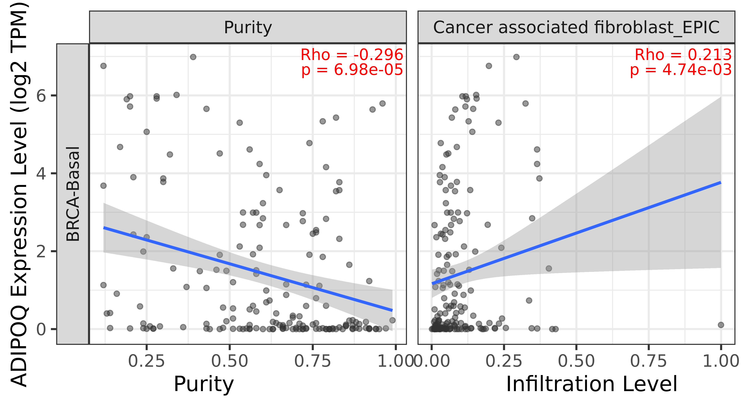
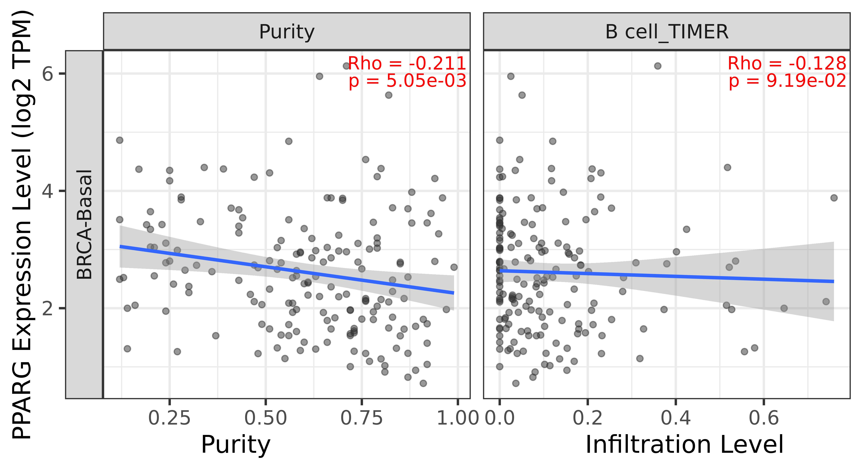
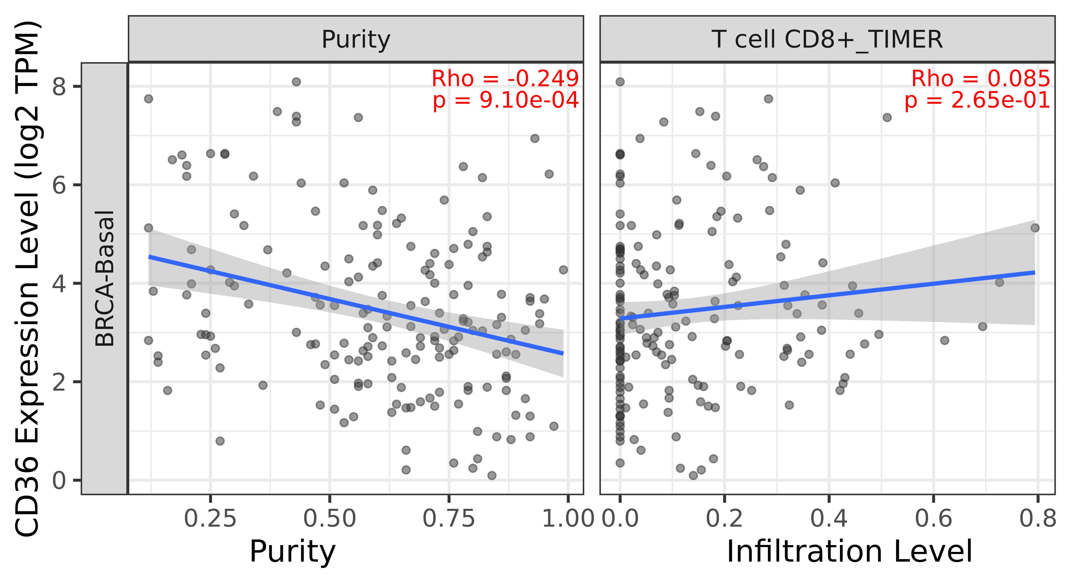
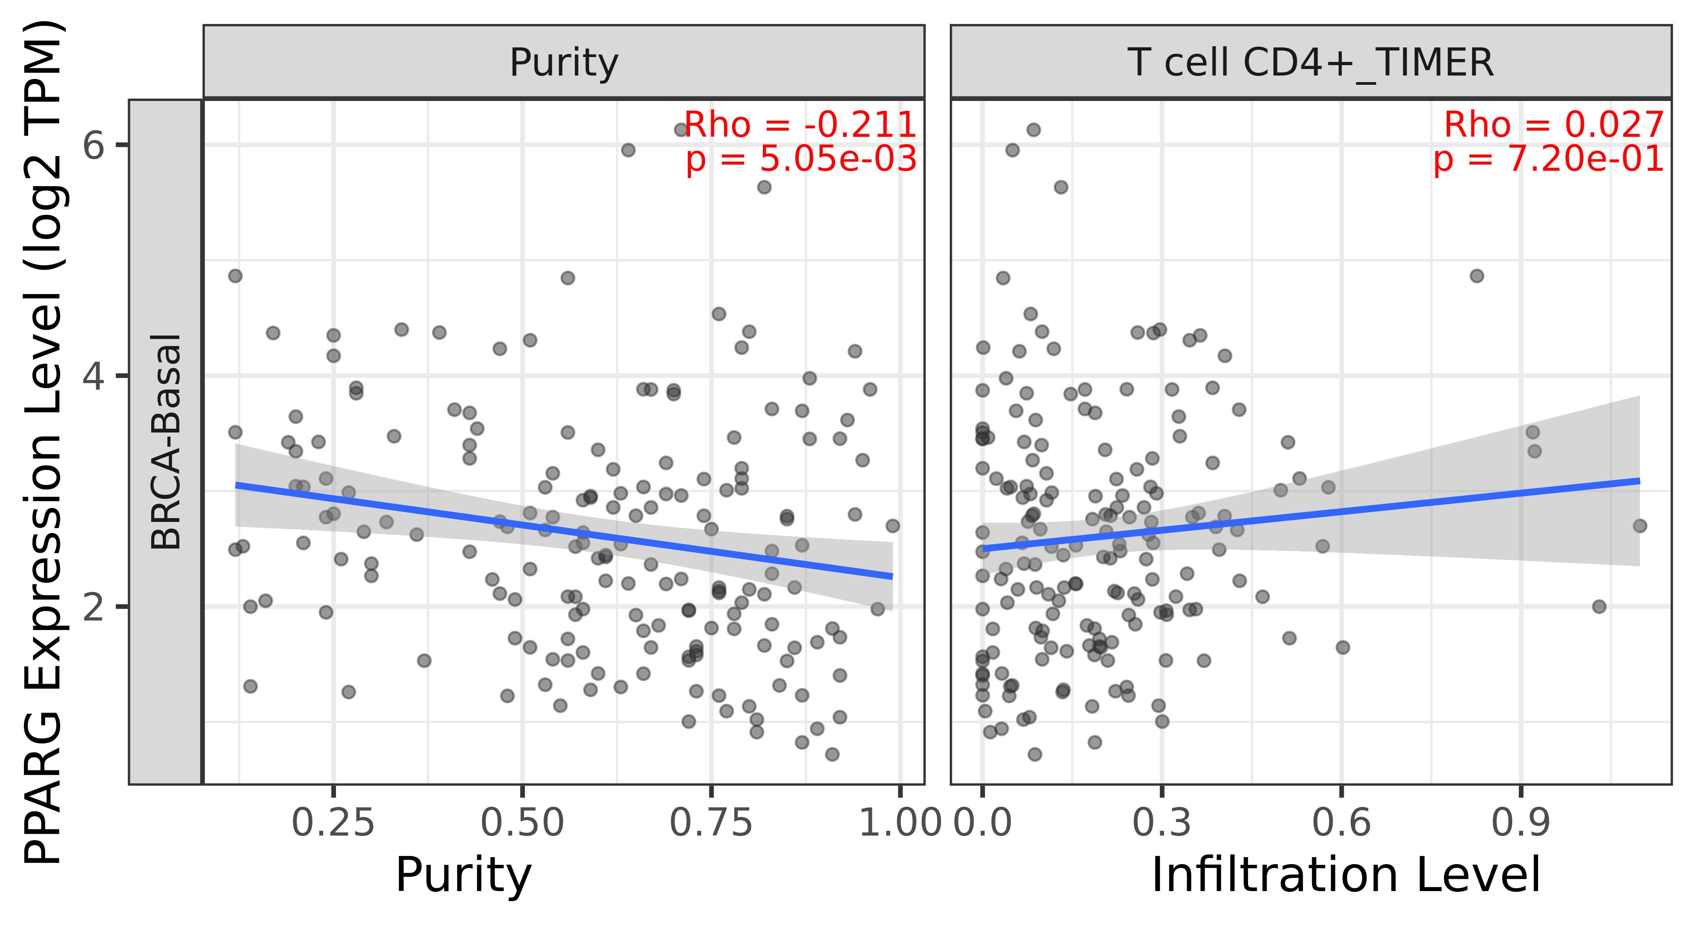
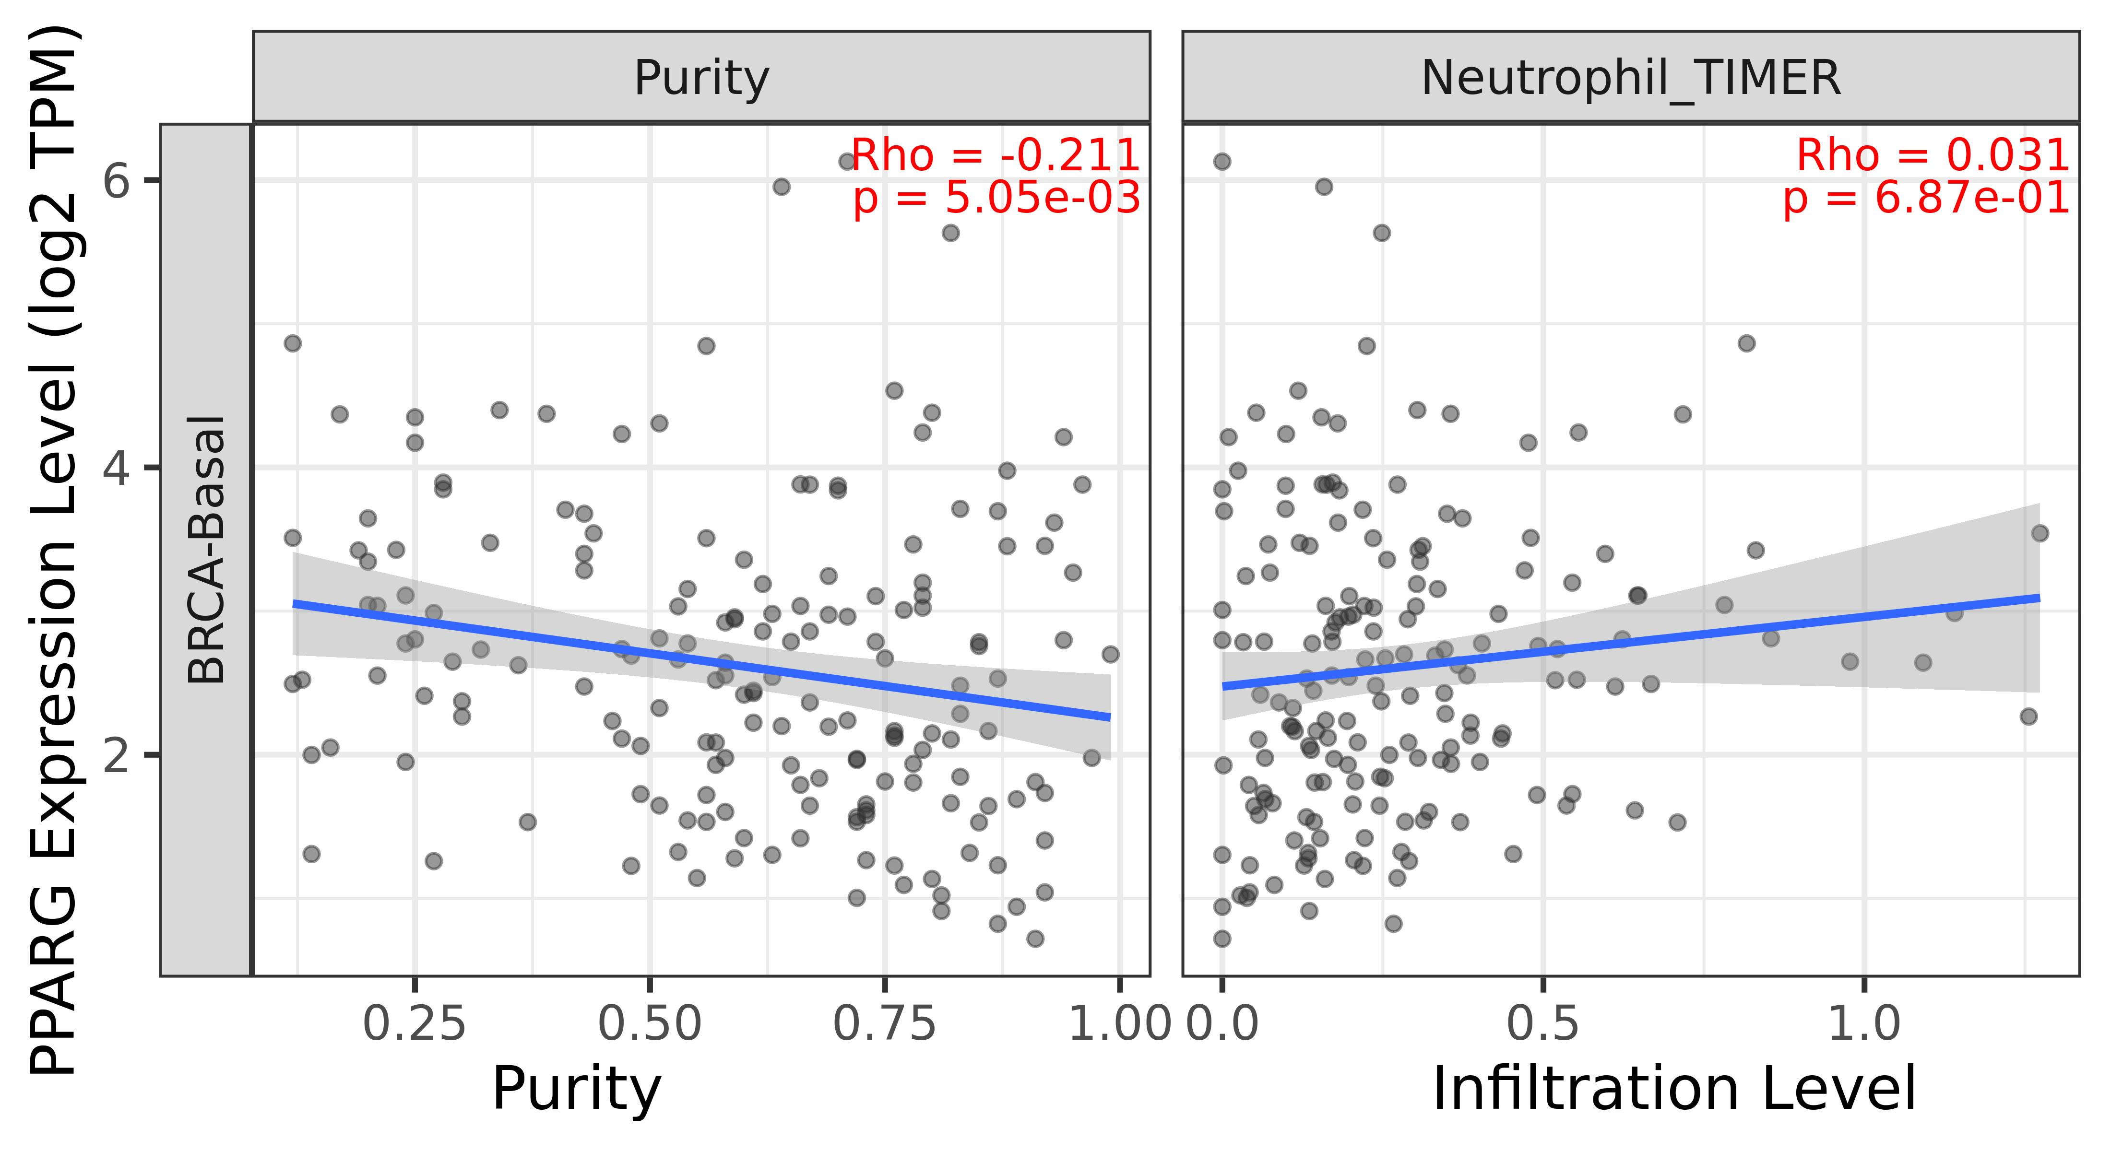
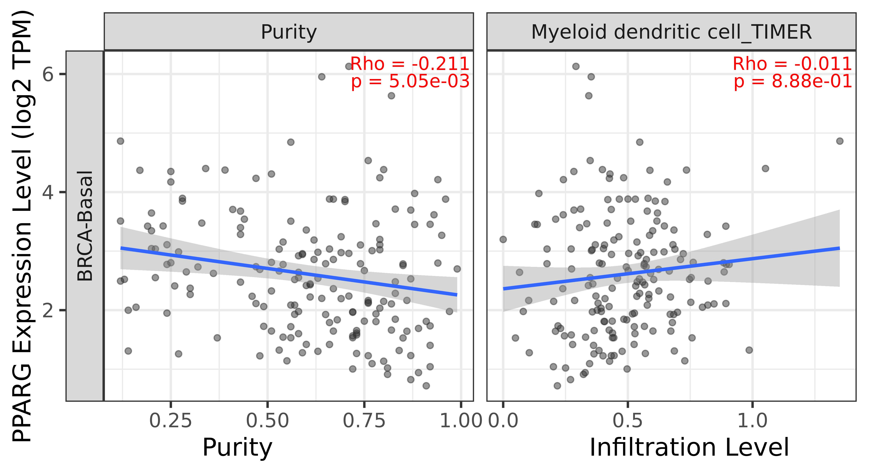
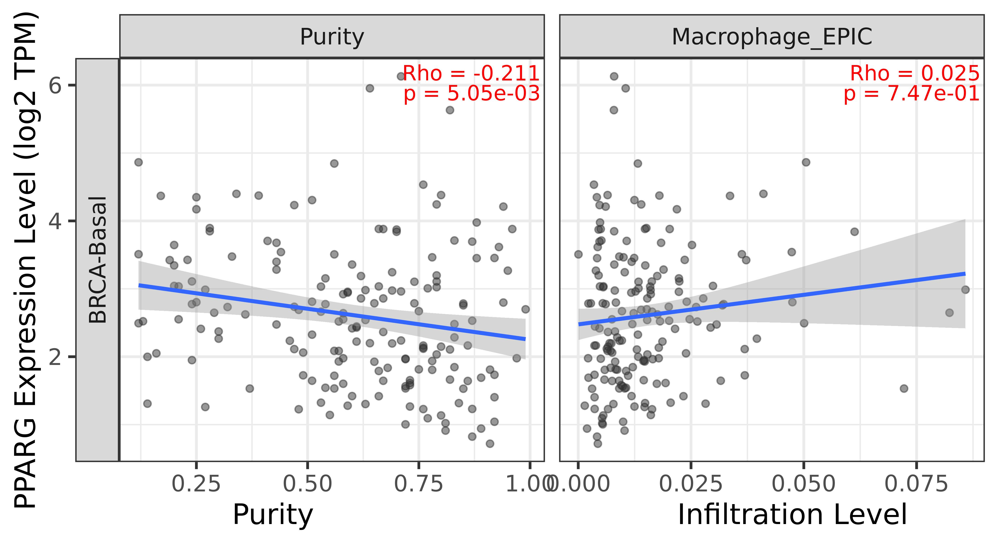
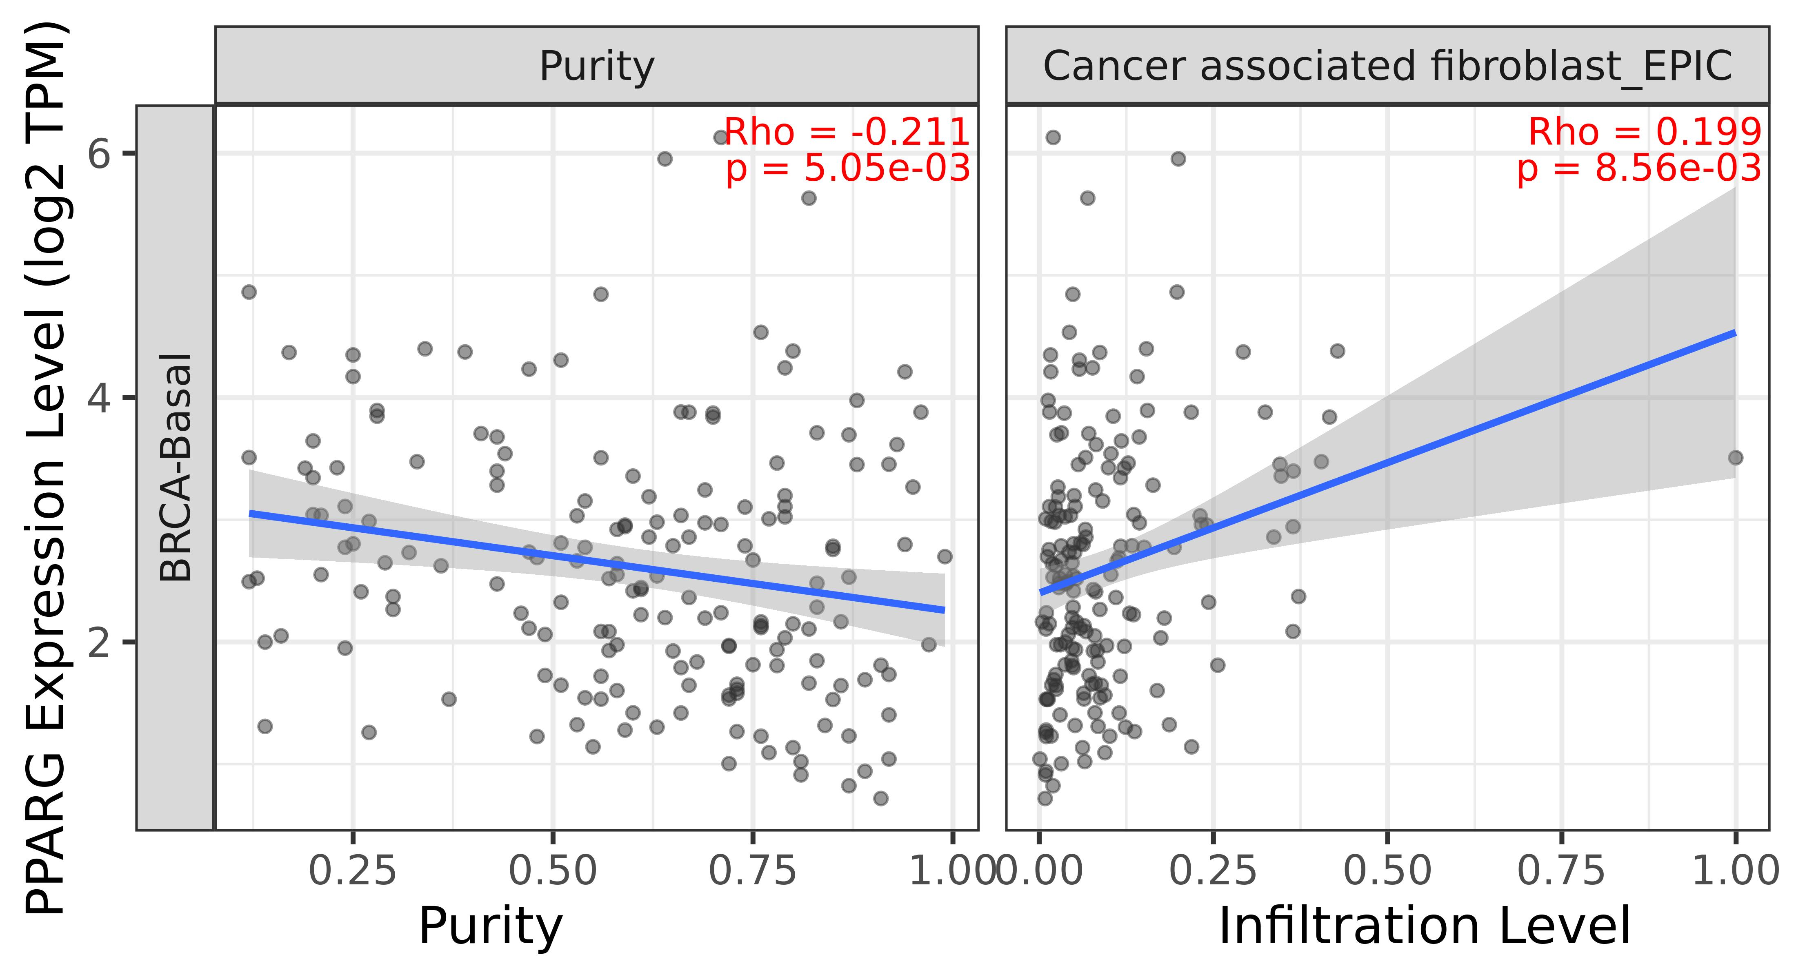
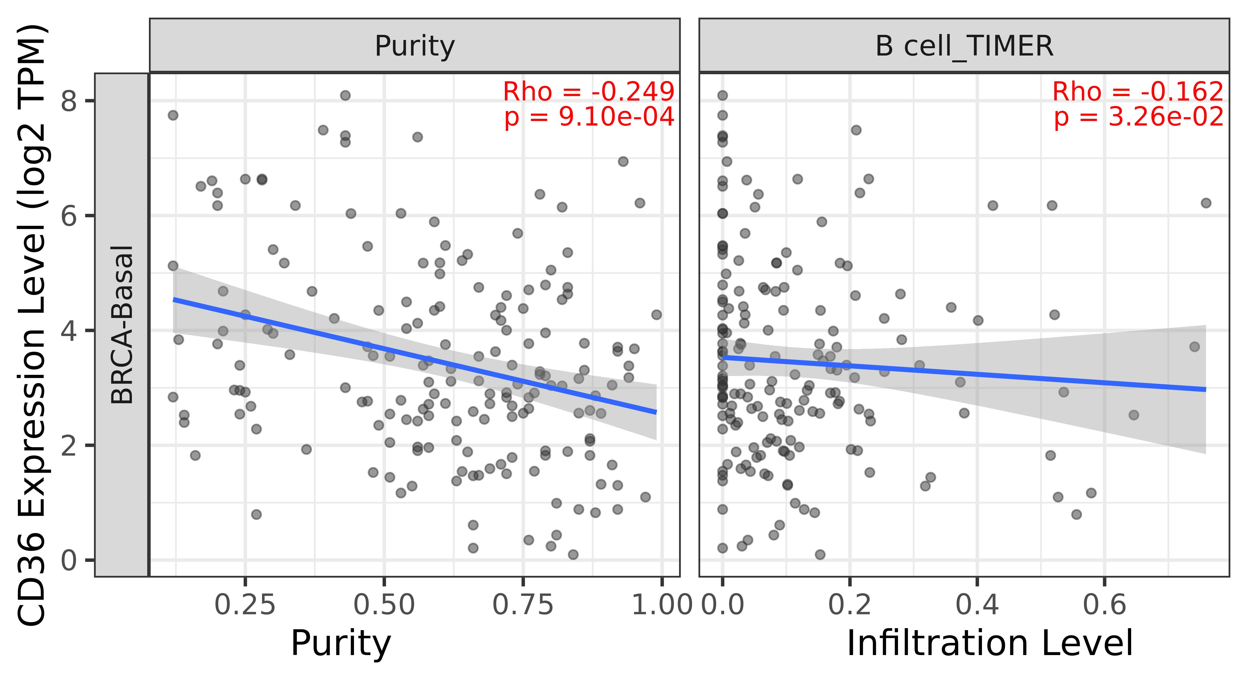
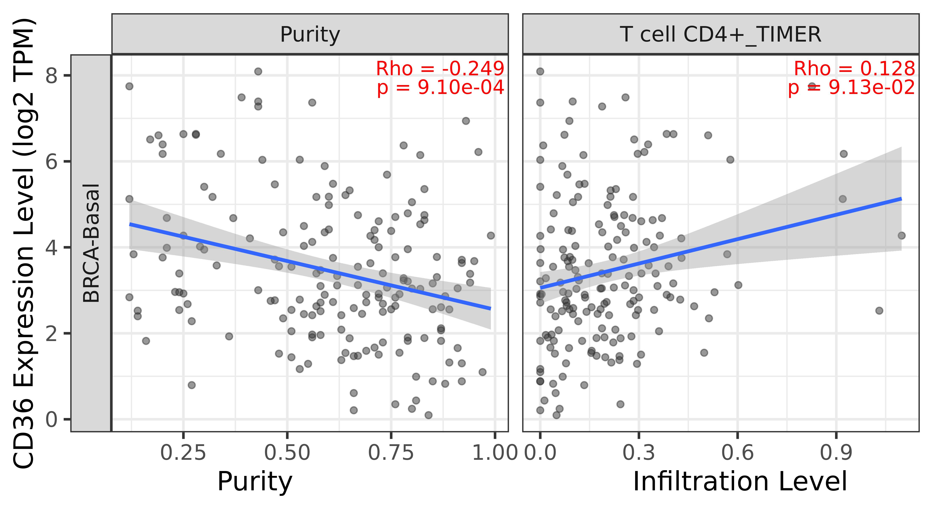
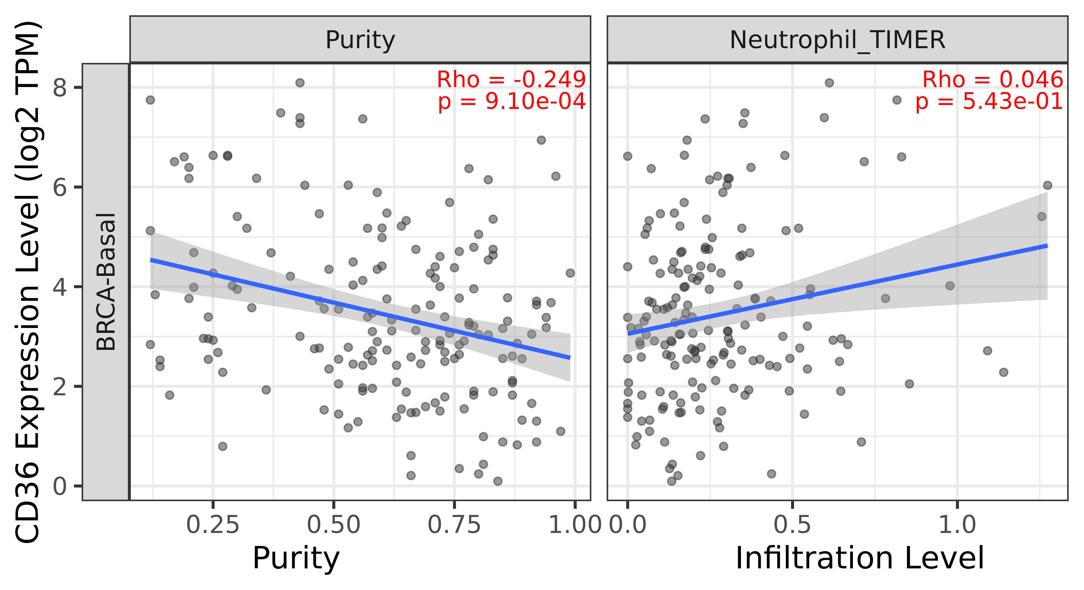
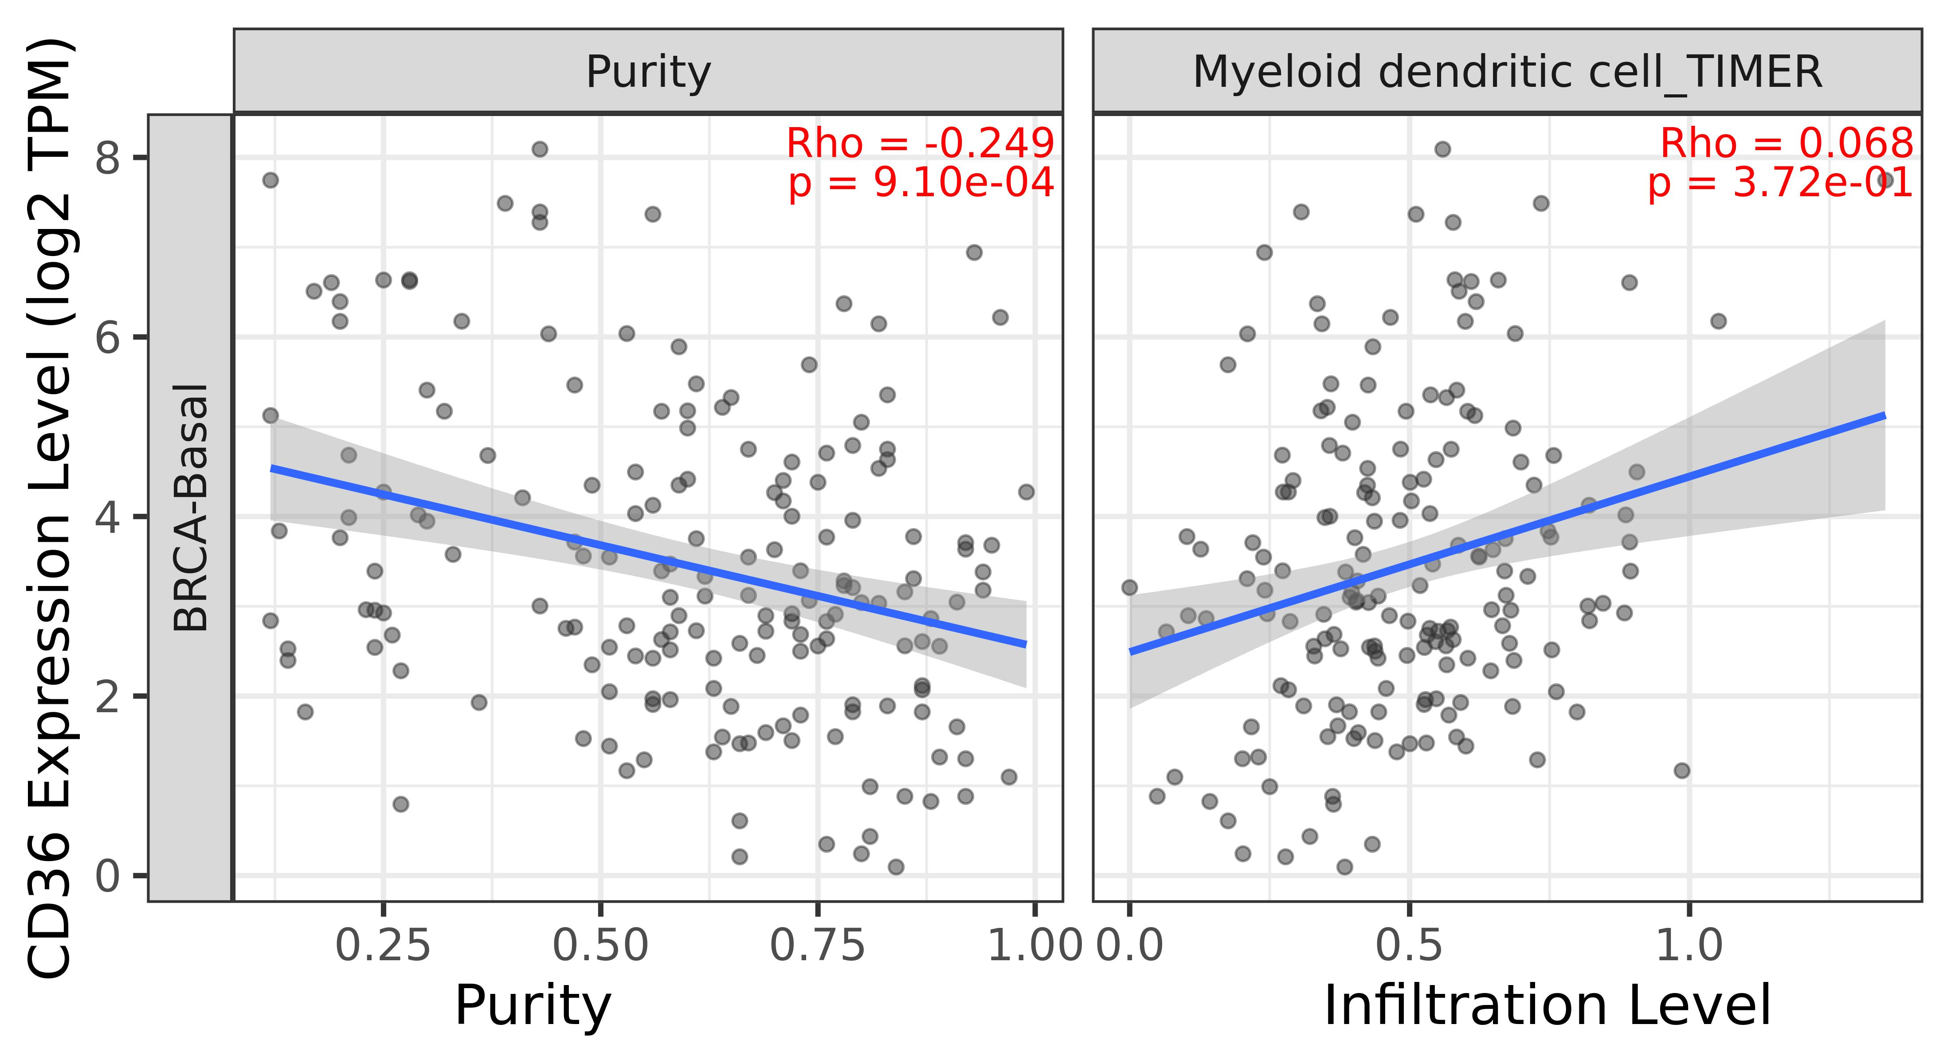
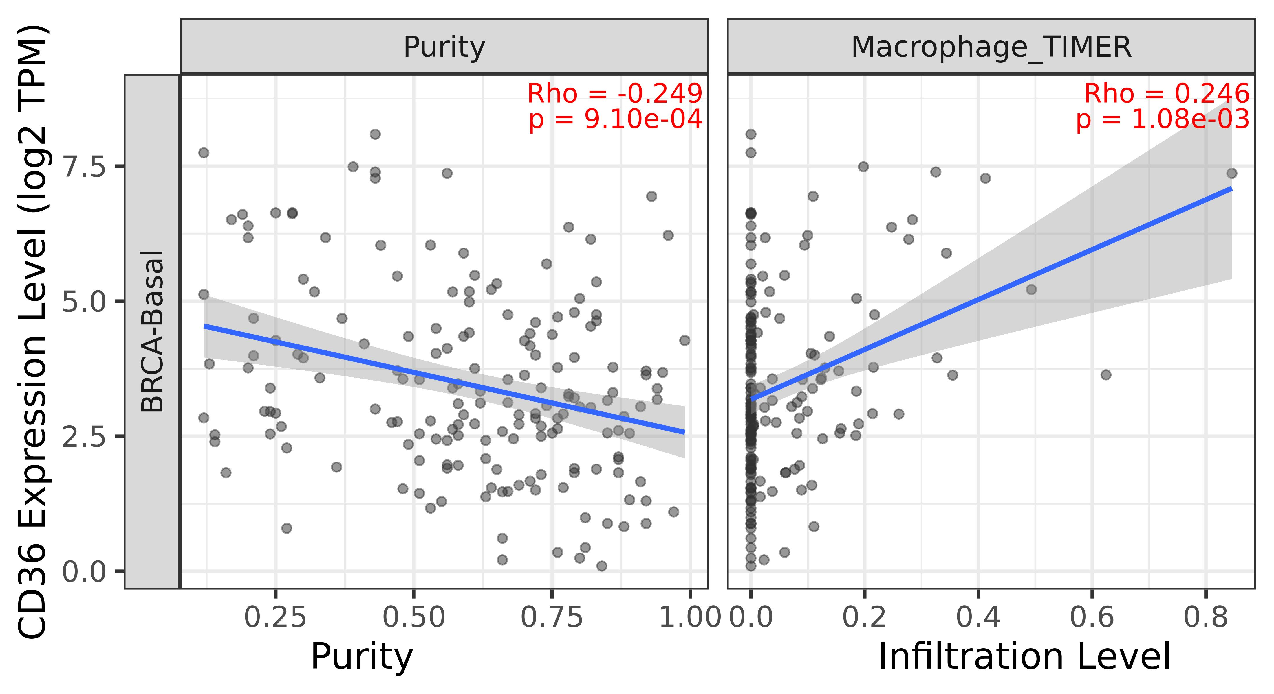
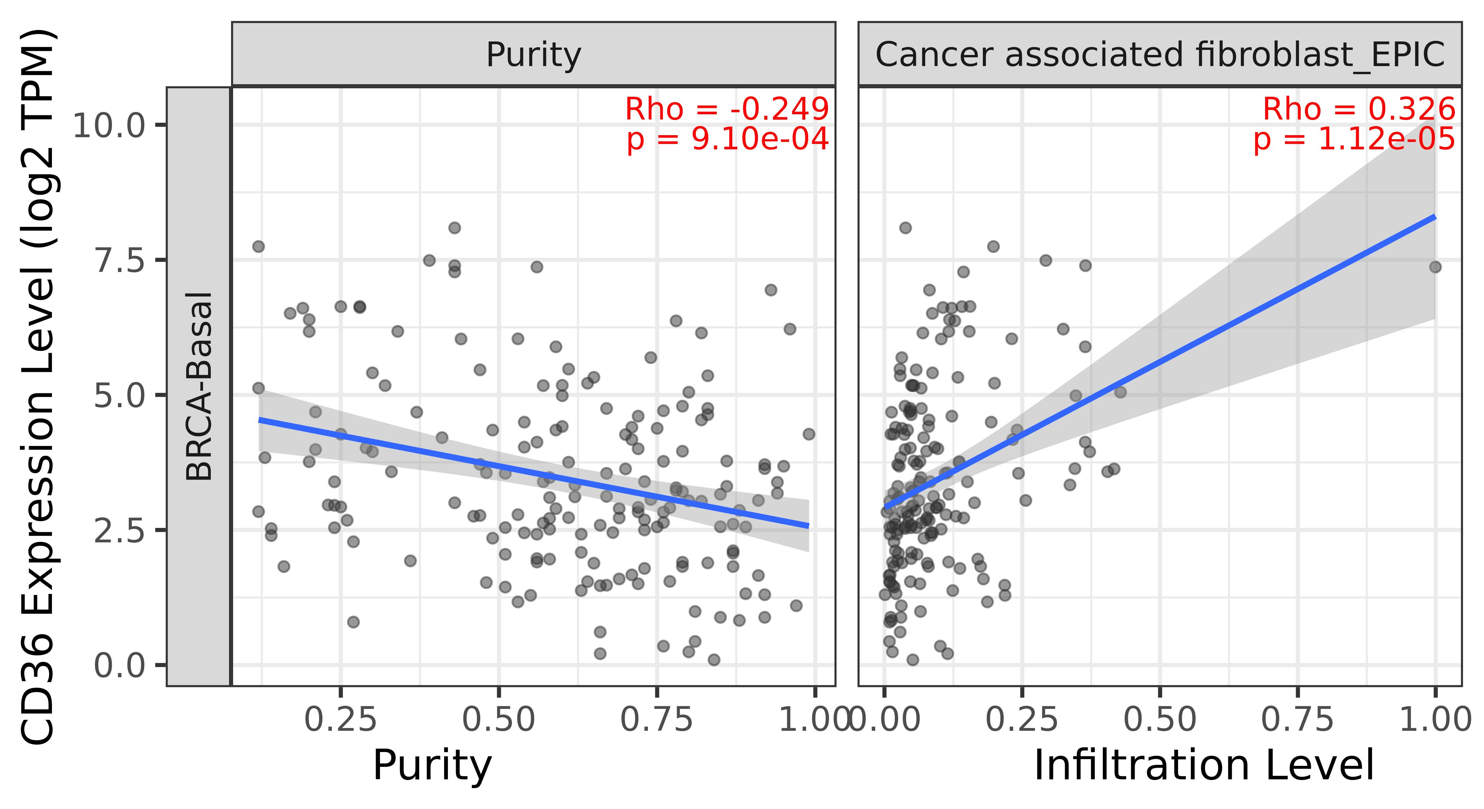
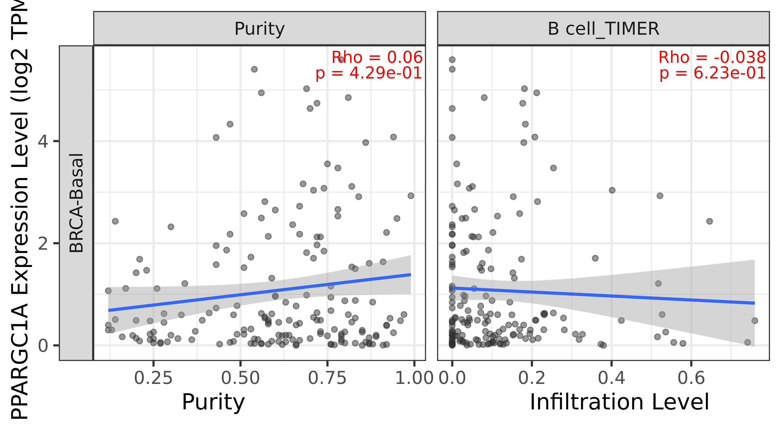
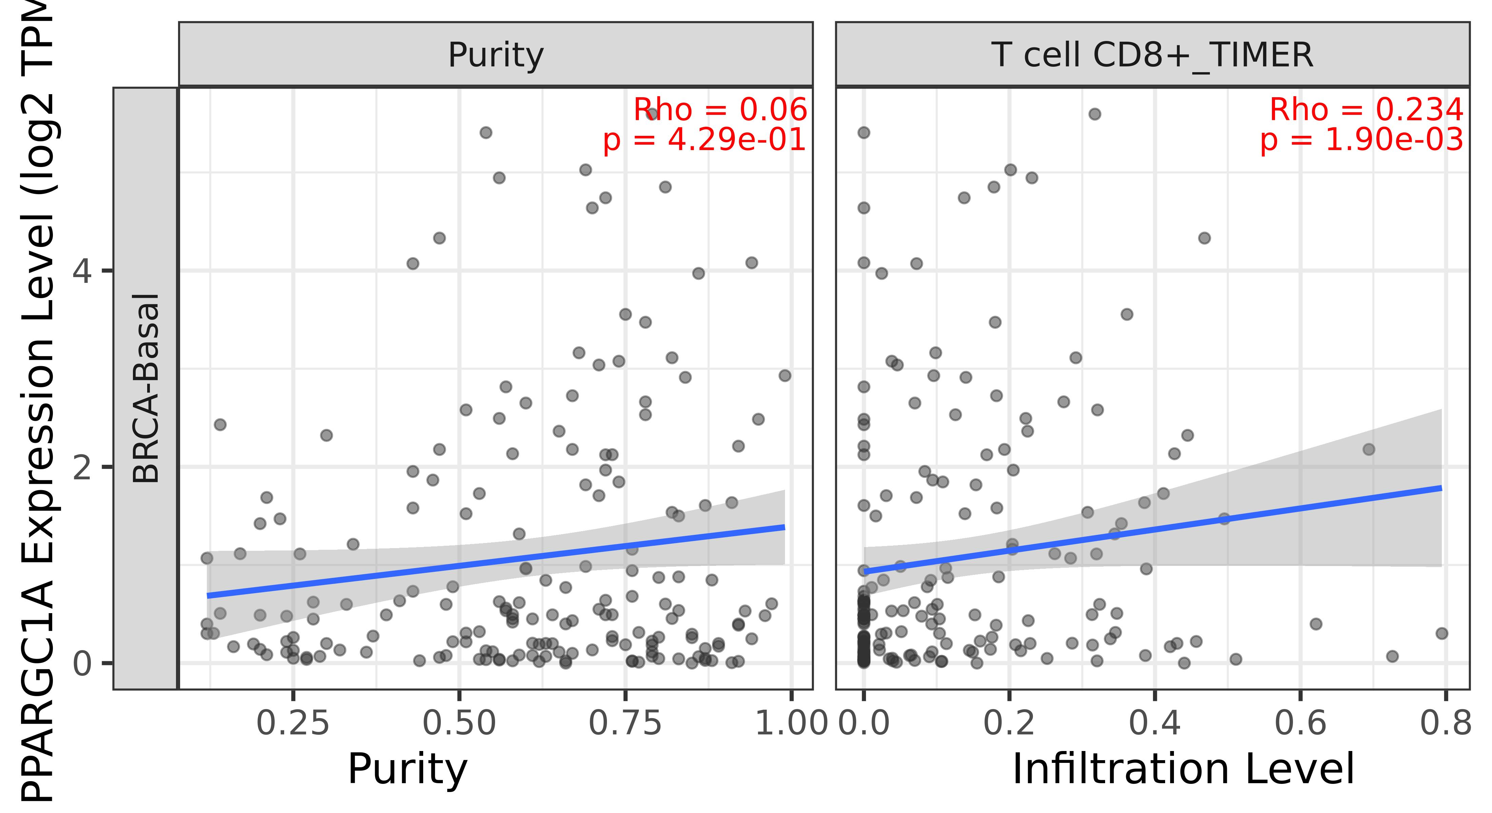
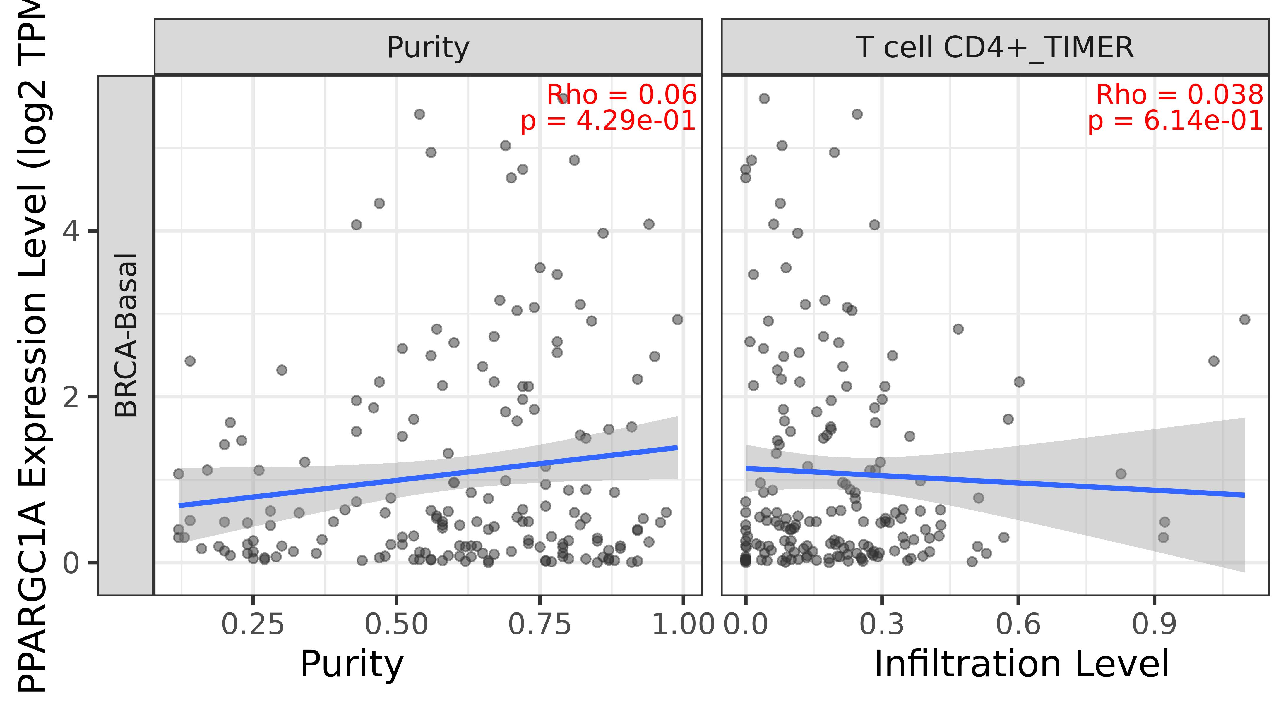
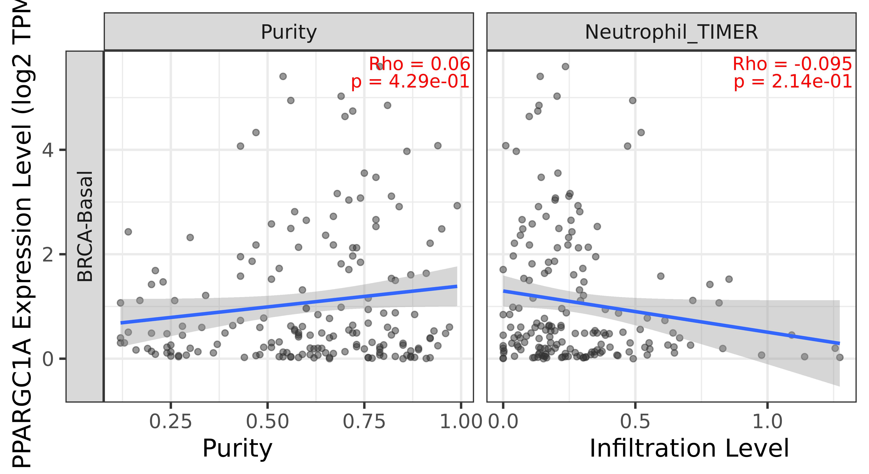
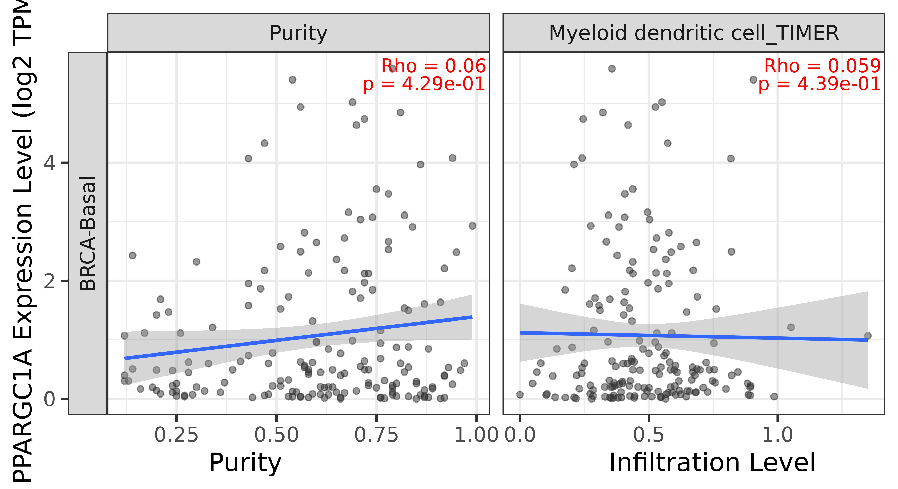
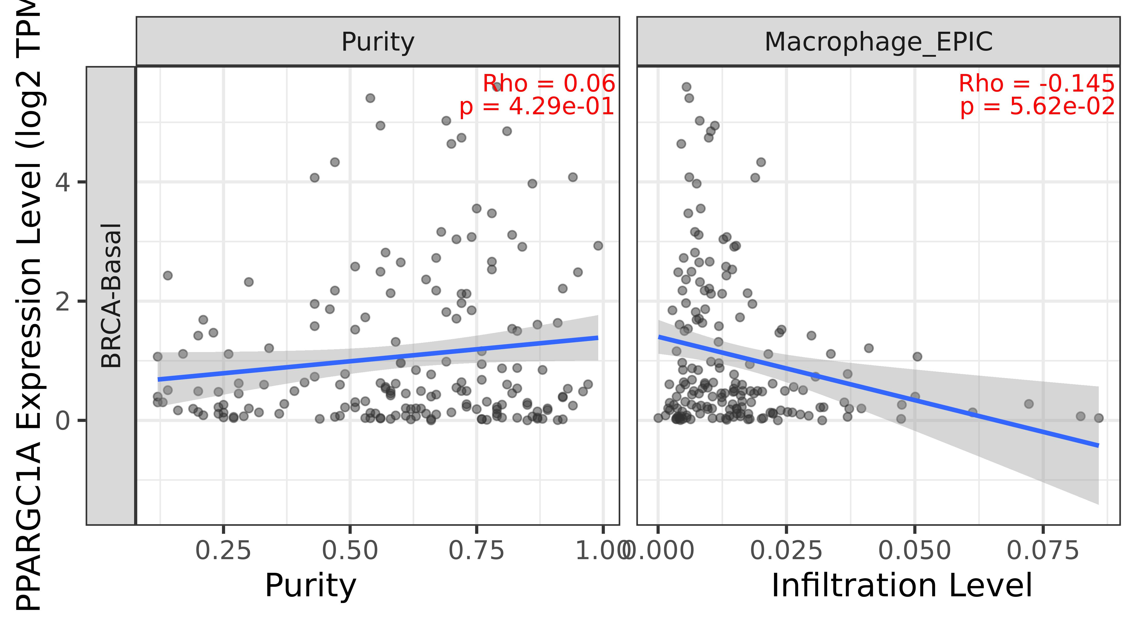
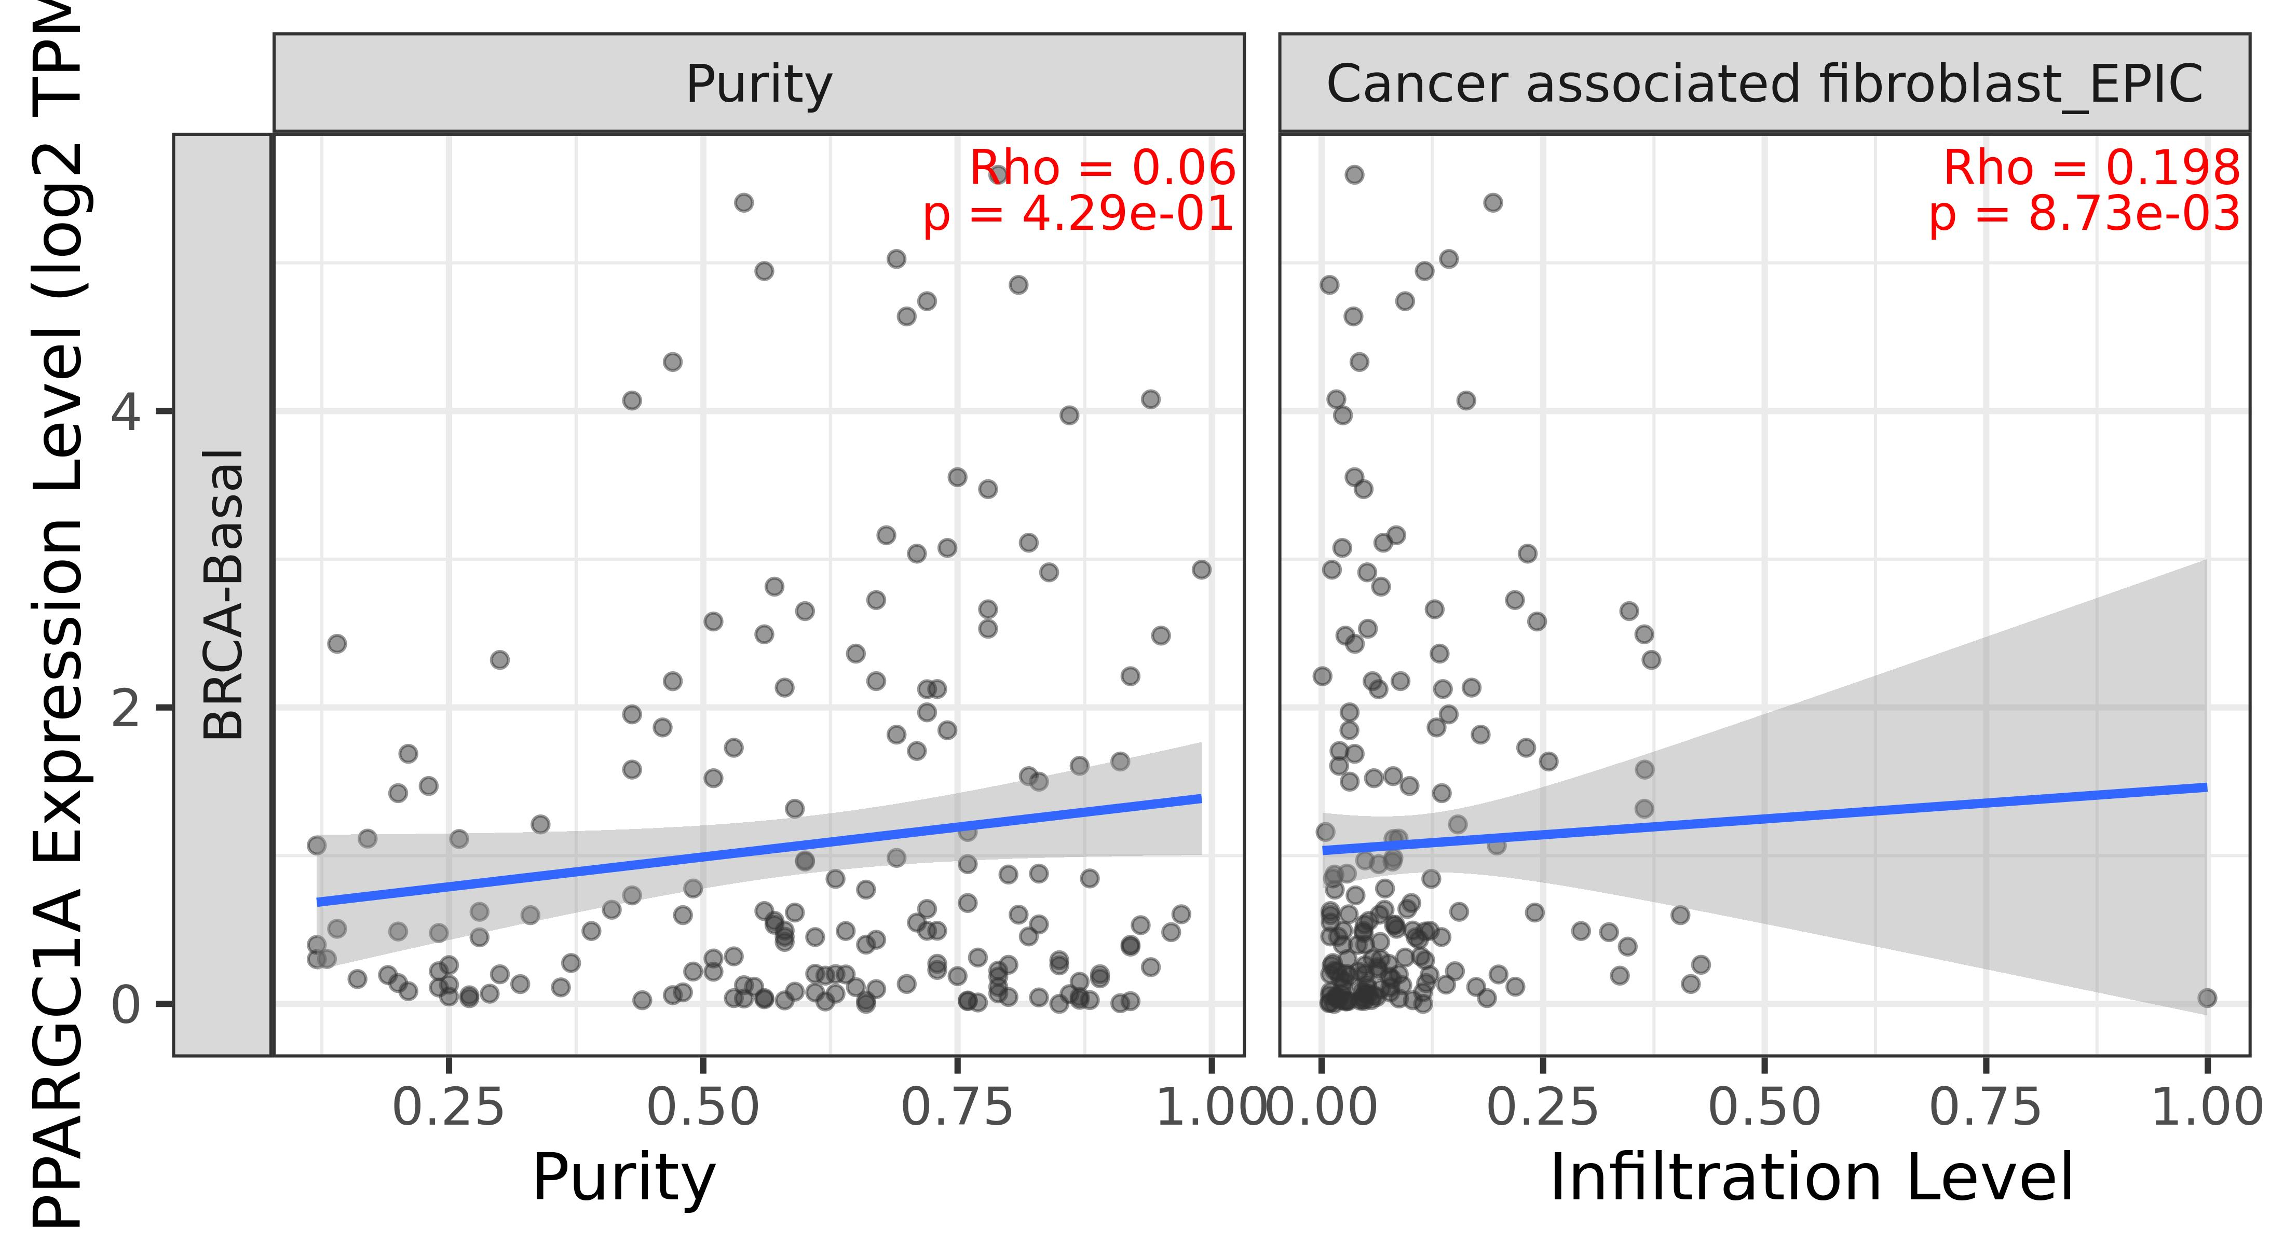
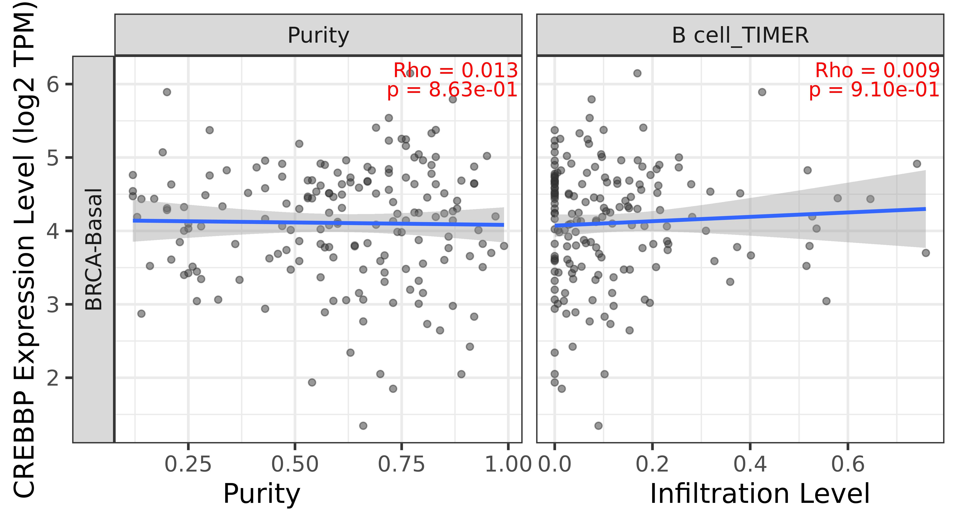
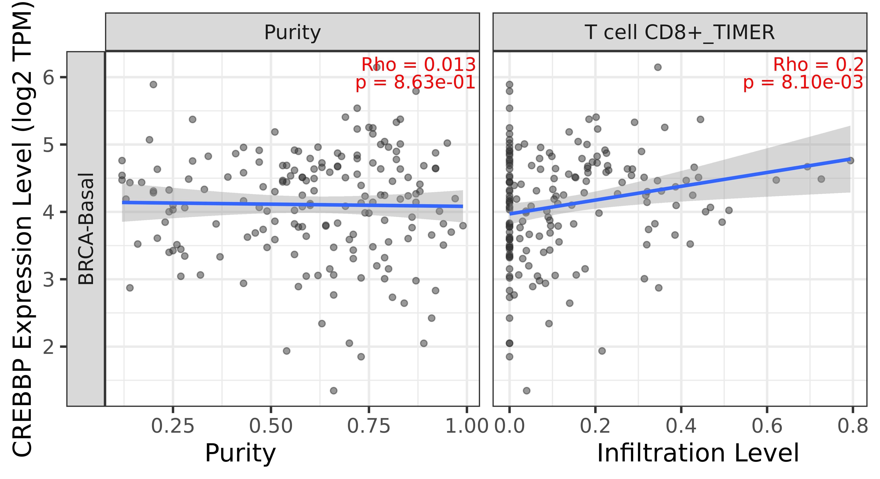
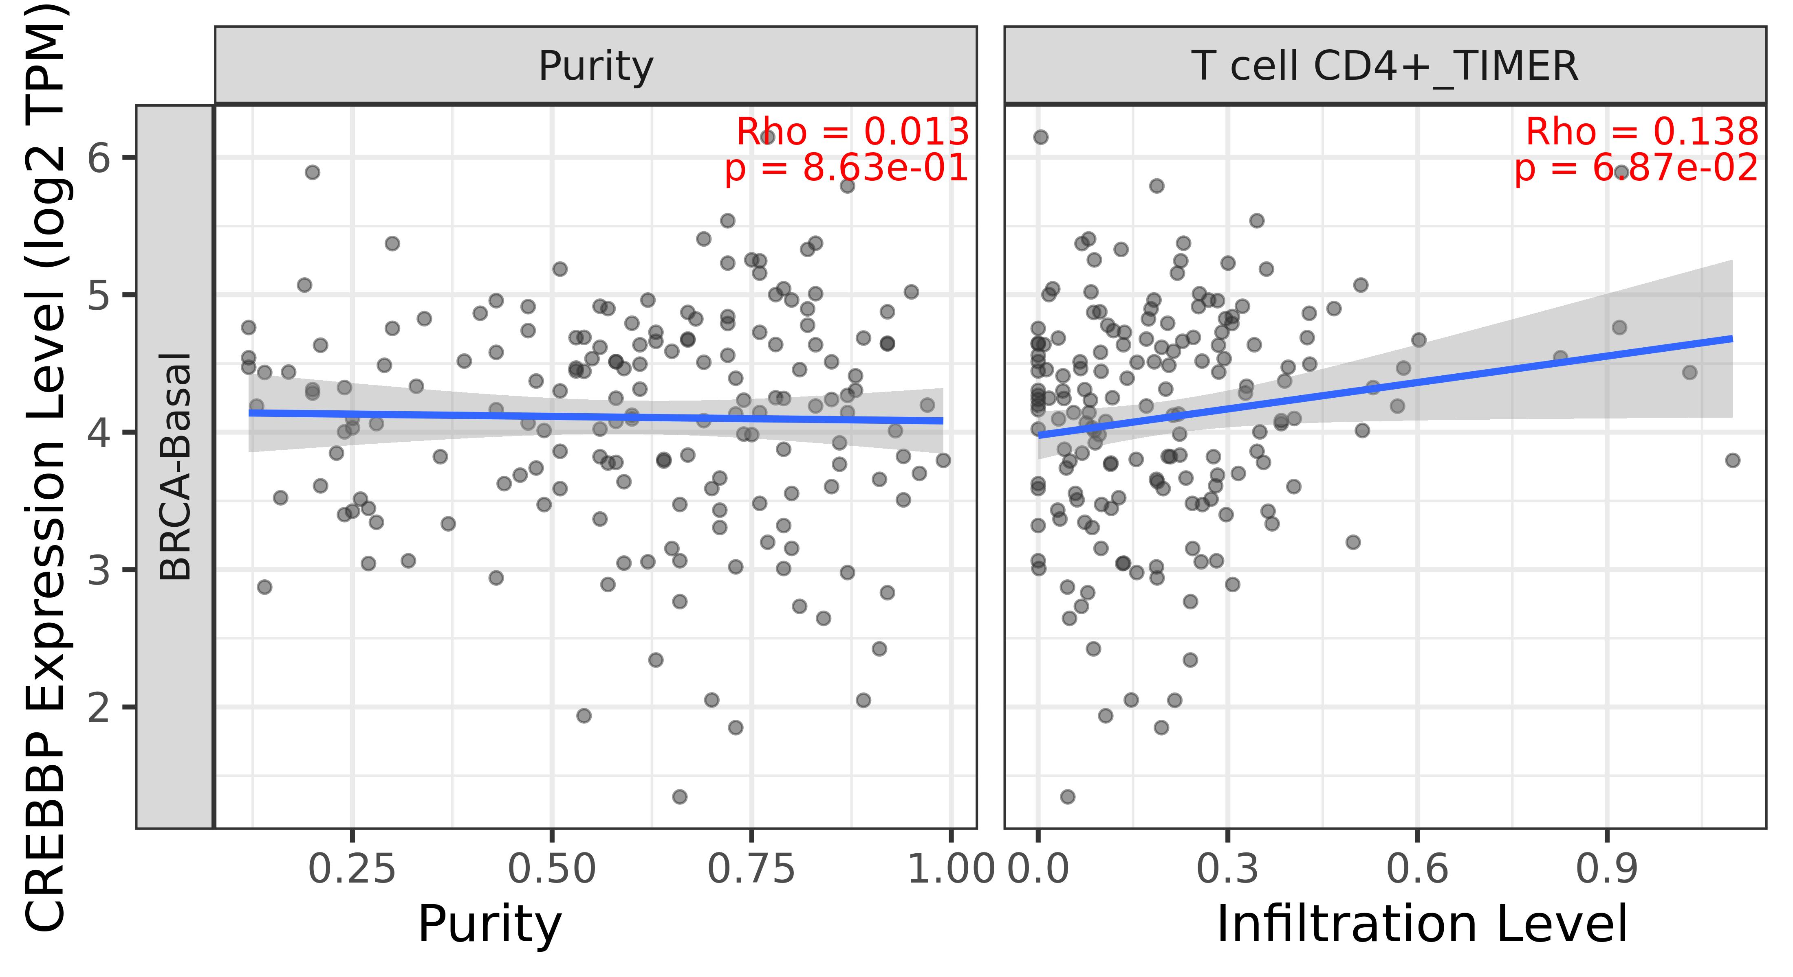
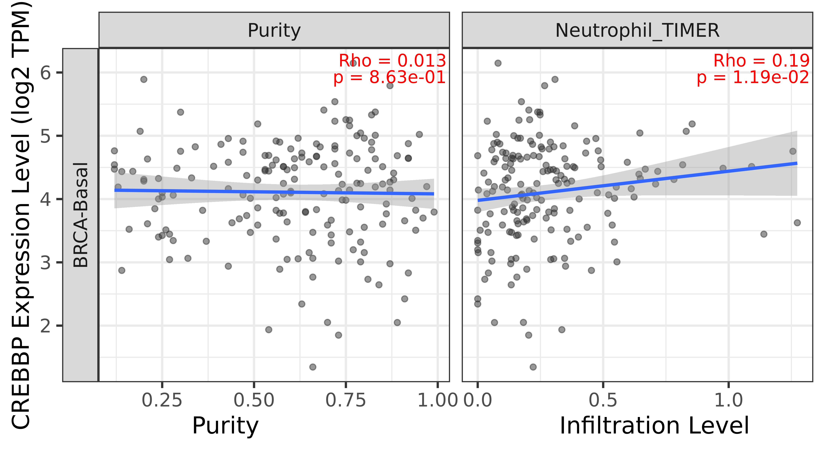
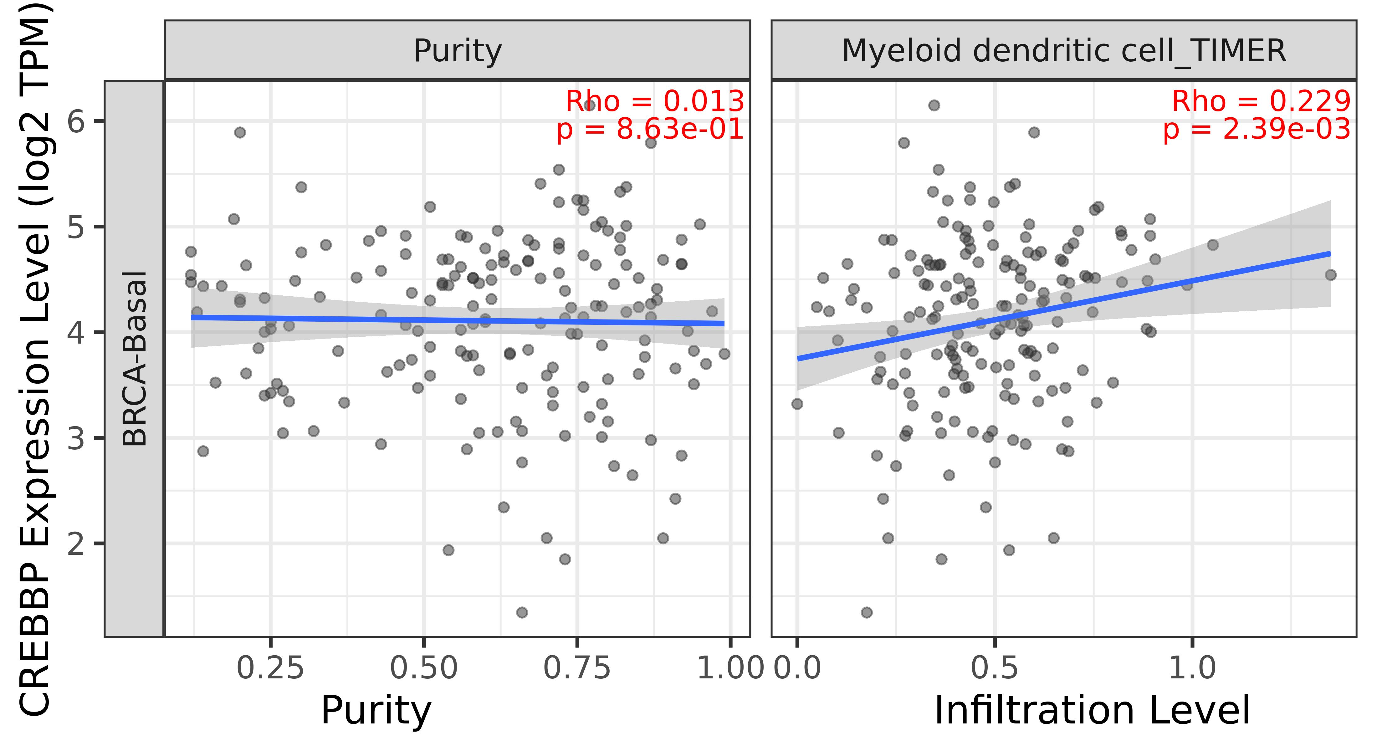
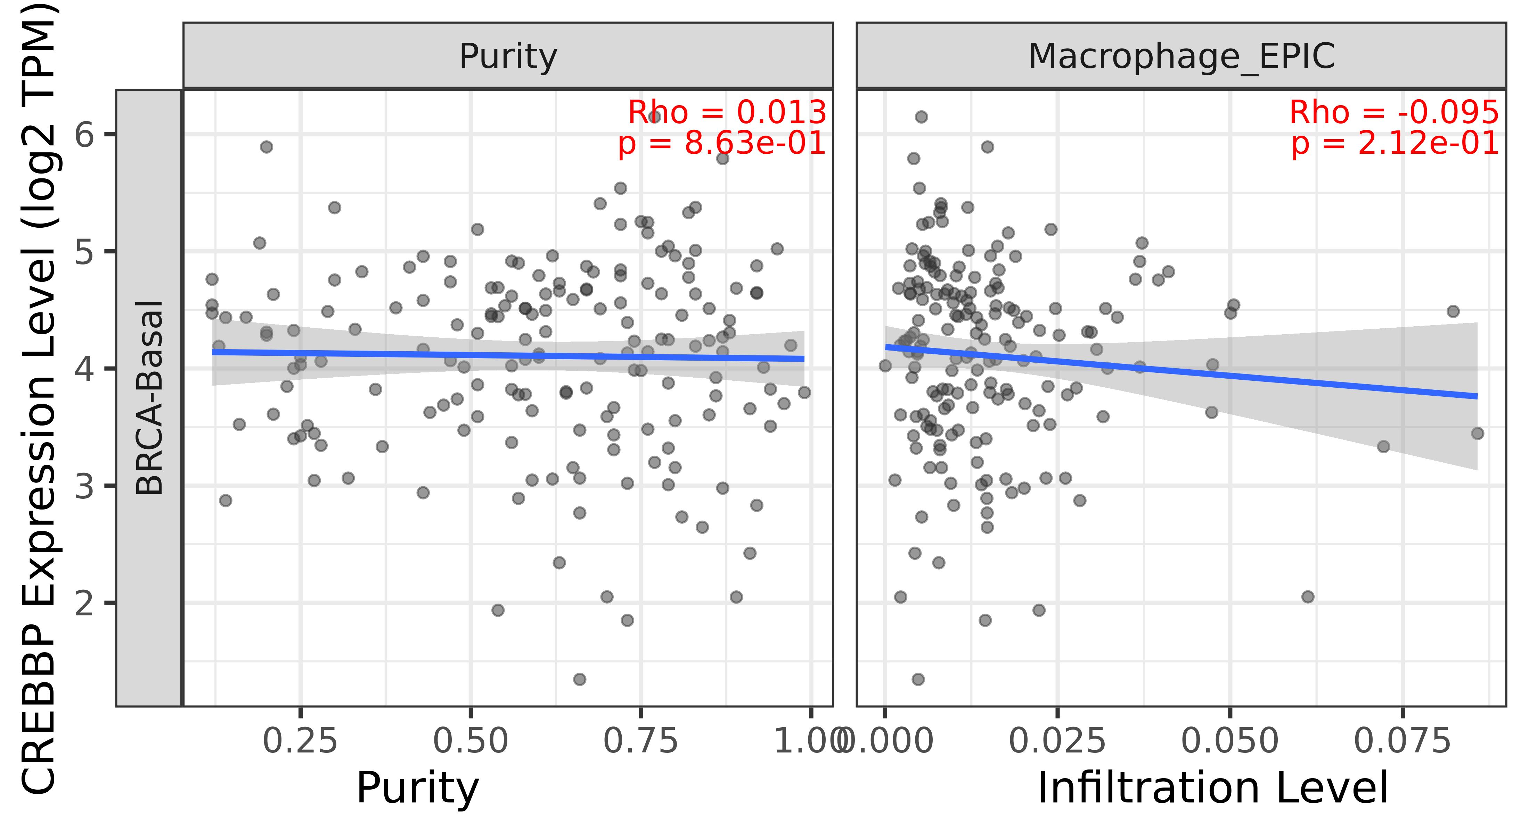
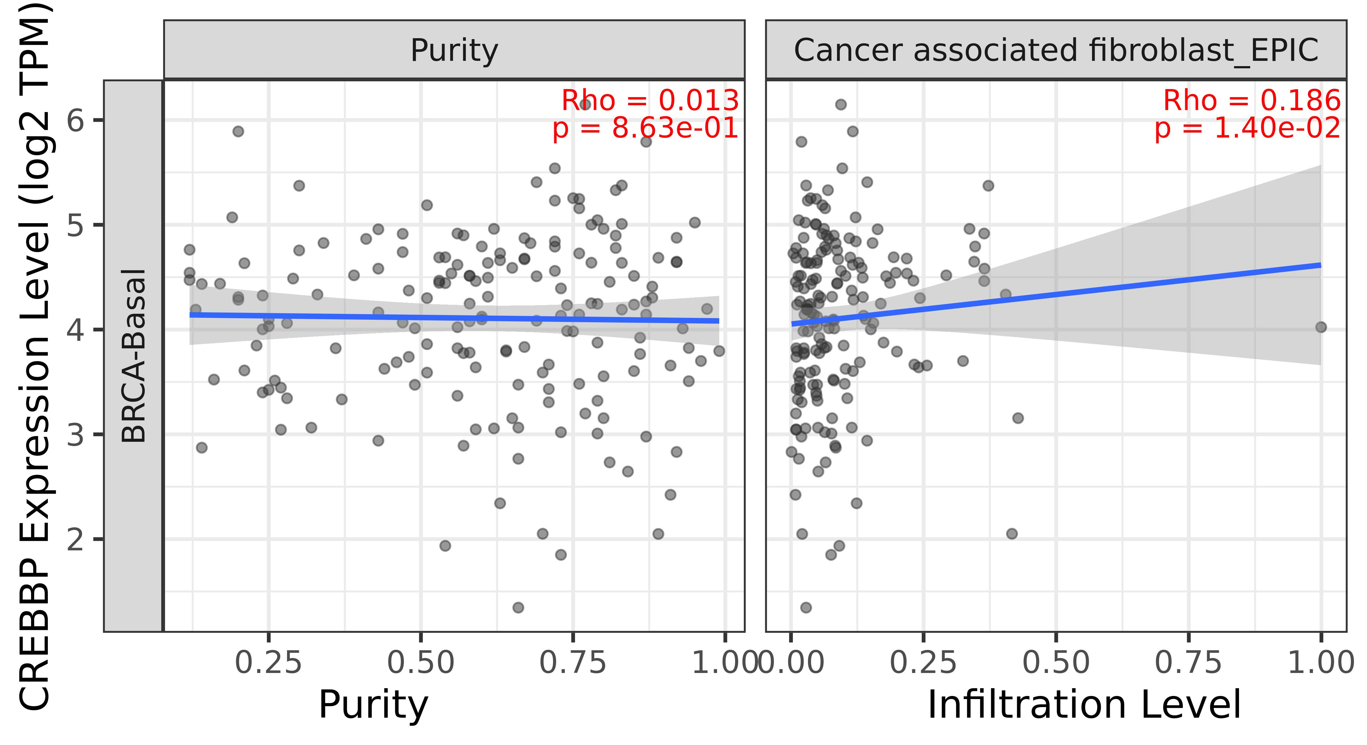
Supplementary Figure 2. The correlation between TR and the level of immune cell infiltration was analyzed using TIMER 2.0. Correlation analysis was performed using the Spearman coefficient correlation. Positive values indicate direct correlation, whereas negative values indicate inverse correlation. Statistical significance was set at p-value <0.05.

