Slide 1
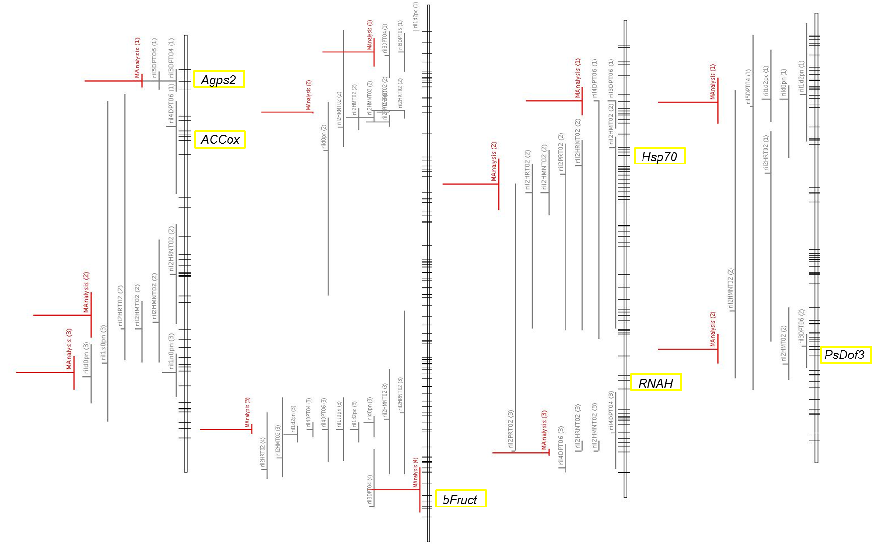
LGIII
LGV
LGI
LGVI

