Slide 1
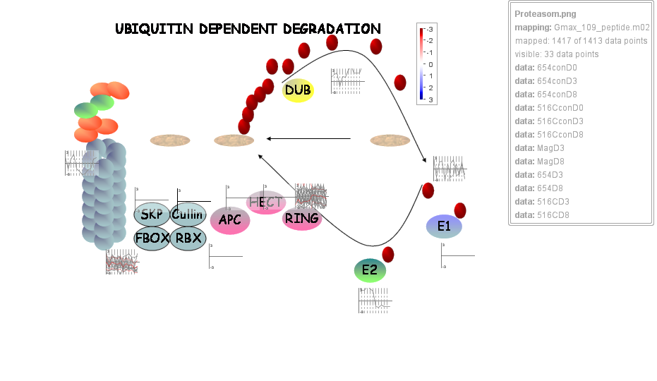
Supplemental Figure S2 Ubiquitin-dependent protein degradation pathway

