Slide 1
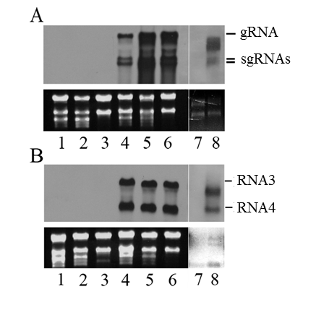
Suplemental Figure 1

