Slide 1
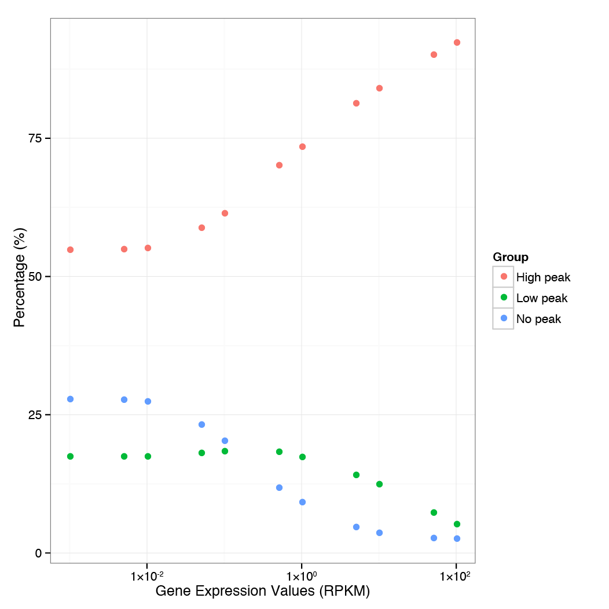
a
Supplementary Figure 1

Slide 2
b
ChIP-seq Sequencing Statistics
Sample Name | Sequencing Depth | Uniquely Mapped Reads | Number of peaks
H3K4me3 | 29,607,438 | 22,520,220 | 13829
PolII | 186,897,451 | 139,395,594 | 11395
Input | 71,328,884 | 54,200,494
c
RNA-seq Sequencing Statistics
Sample Name | Sequencing Depth | Uniquely Mapped Reads
Basal | 38260387 | 16146827
siCTRL_1 | 34070704 | 15353237
siCTRL_2 | 35590030 | 15965080
siUPF1_1 | 30991212 | 15029160
siUPF1_2 | 41238364 | 17146466
siCTRL_1 | 46202054 | 23153491
siCTRL_2 | 52056079 | 24794738
siEXOSC5_1 | 35065084 | 17853409
siEXOSC5_2 | 40062193 | 20404942
siCTRL | 36876205 | 29287082
siSTAU1_1 | 30256722 | 23896759
siSTAU1_2 | 36353208 | 29049849
Supplementary Figure 1

Slide 3
BRIC-seq Sequencing statistics
d
Sample Name | Sequencing Depth | Uniquely Mapped Reads
siCTRL_1 0h | 32113983 | 11795163
siCTRL_1 4h | 27332602 | 8410082
siCTRL_1 8h | 29910113 | 8223544
siCTRL_1 12h siUPF1 0h | 29209782 35319906 | 4683418 11151822
siUPF1 4h | 40875119 | 7125974
siUPF1 8h | 32442201 | 6047454
siUPF1 12h | 30350033 | 4353768
siCTRL_1 0h | 16889847 | 10067525
siCTRL_1 4h | 14850192 | 8384827
siCTRL_1 8h | 16570098 | 8854992
siCTRL_1 12h | 11755236 | 6132423
siCTRL_1 24h siEXOSC5 0h | 14667835 18576472 | 5230211 9683224
siEXOSC5 4h | 17433615 | 8799438
siEXOSC5 8h | 15412791 | 7458473
siEXOSC5 12h | 17570157 | 9208784
siEXOSC5 24h | 31969879 | 13096031
Supplementary Figure 1

Slide 4
BRIC-seq Sequencing statistics (continued)
Sample Name | Sequencing Depth | Uniquely Mapped Reads
siCTRL_0min_1 | 13352159 | 10594823
siCTRL_0min_2 | 31670976
siCTRL_15min_1 | 18132028 | 13936994
siCTRL_15min_2 | 41093930
siCTRL_45min_1 | 16438439 | 12952619
siCTRL_45min_2 | 34245283
siCTRL_75min_1 | 9327364 | 6211525
siCTRL_75min_2 | 18999831
siCTRL_105min_1 | 14939127 | 11909083
siCTRL_105min_2 | 33708692
siCTRL_165min_1 | 12177919 | 8021772
siCTRL_165min_2 | 27973798
siCTRL_225min_1 | 11488756 | 7437648
siCTRL_225min_2 | 22130531
siCTRL_345min_1 | 12489096 | 6494652
siCTRL_345min_2 | 26268851
siCTRL_465min_1 | 18994160 | 8497967
siCTRL_465min_2 | 41189955
siCTRL_585min_1 | 19046004 | 7014734
siCTRL_585min_2 | 40260306
siCTRL_705min_1 | 18497524 | 6036560
siCTRL_705min_2 | 36250937
siSTAU1_0min_1 | 13599505 | 6053372
siSTAU1_0min_2 | 26876128
siSTAU1_15min_1 | 13918840 | 5826463
siSTAU1_15min_2 | 25039572
siSTAU1_45min_1 | 13340751 | 9828708
siSTAU1_45min_2 | 50151533
siSTAU1_75min_1 | 10229758 | 8666838
siSTAU1_75min_2 | 43411999
siSTAU1_105min_1 | 12541178 | 6163057
siSTAU1_105min_2 | 25791604
siSTAU1_165min_1 | 10176708 | 6399917
siSTAU1_165min_2 | 37987332
siSTAU1_225min_1 | 8809751 | 3633723
siSTAU1_225min_2 | 17219377
siSTAU1_345min_1 | 9236900 | 4375736
siSTAU1_345min_2 | 32321157
siSTAU1_465min_1 | 18482010 | 4631584
siSTAU1_465min_2 | 36820119
siSTAU1_585min_1 | 12695833 | 1731351
siSTAU1_585min_2 | 19272525
siSTAU1_705min_1 | 15785239 | 3747637
siSTAU1_705min_2 | 51642750
Supplementary Figure 1

Slide 5
a)
b)
Half-lives:
BRIC: 1.72h
ActD: 1.72h
Half-lives:
BRIC: 2.09h
ActD: 1.70h
c)
d)
Half-lives:
BRIC: >24h
ActD: >24h
Half-lives:
BRIC: >24h
ActD: >24h
Supplementary Figure 2

Slide 6
e)
f)
Half-lives:
BRIC: >24h
ActD: >24h
Half-lives:
BRIC: >24h
ActD: >24h
g)
h)
Half-lives:
BRIC: 1.90h
ActD: 4.62h
Half-lives:
BRIC: 1.61h
ActD: 3.19h
Supplementary Figure 2

Slide 7
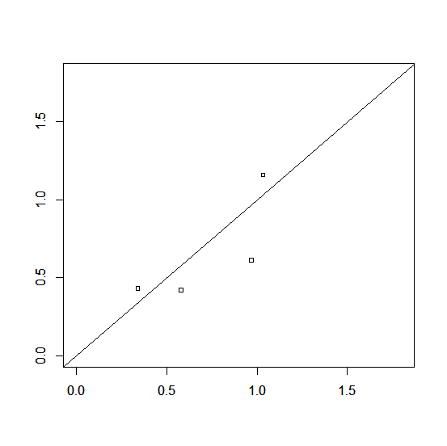
1.5
a
b
1.5
1.0
Predicted expression(log10)
1.0
Predicted expression(log10)
0.5
0.5
0.0
0.0
0.0
0.5
1.0
1.5
0.0
0.5
1.0
1.5
Observed expression (log10)
Observed expression (log10)
c
Predicted expression(log10)
Observed expression (log10)
Supplementary Figure 3

Slide 8
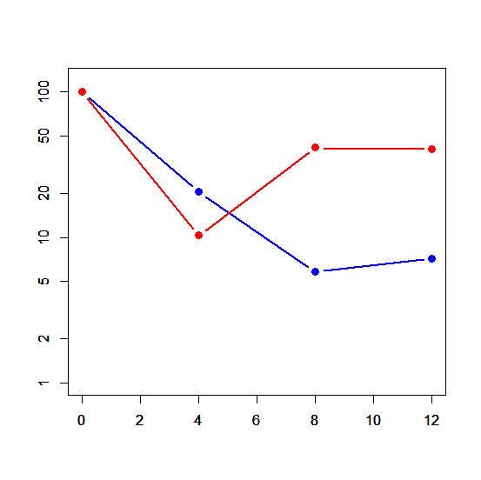
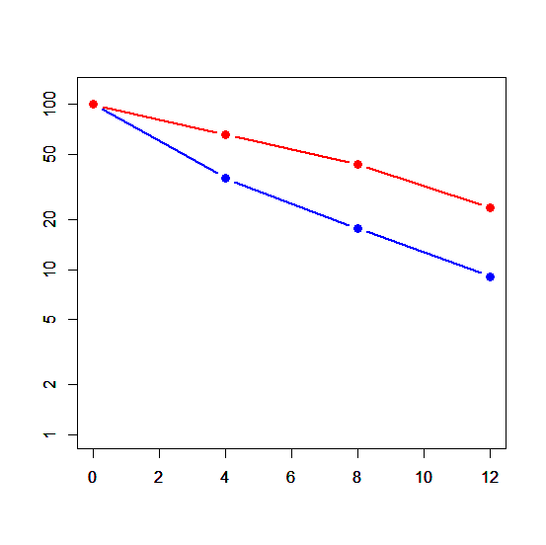
a
b
HIC1
Remaining transcripts (%)
Time (hours)
c
ZNF783
Remaining transcripts (%)
Time (hours)
Supplementary Figure 4

Slide 9
a
Cell type | Experimental factors | URL | Laboratory
GM12878 | H3k4me3 | ftp://hgdownload.cse.ucsc.edu/goldenPath/hg19/encodeDCC/wgEncodeBroadHistone/wgEncodeBroadHistoneGm12878H3k04me3StdPkV2.broadPeak.gz | Broad
 | Pol2 | ftp://hgdownload.cse.ucsc.edu/goldenPath/hg19/encodeDCC/wgEncodeOpenChromChip/wgEncodeOpenChromChipGm12878Pol2Pk.narrowPeak.gz | UT-A
 | H3k36me3 | ftp://hgdownload.cse.ucsc.edu/goldenPath/hg19/encodeDCC/wgEncodeBroadHistone/wgEncodeBroadHistoneGm12878H3k36me3StdPk.broadPeak.gz | Broad
H1-hESC | H3k4me3 | ftp://hgdownload.cse.ucsc.edu/goldenPath/hg19/encodeDCC/wgEncodeBroadHistone/wgEncodeBroadHistoneH1hescH3k4me3StdPk.broadPeak.gz | Broad
 | Pol2 | ftp://hgdownload.cse.ucsc.edu/goldenPath/hg19/encodeDCC/wgEncodeOpenChromChip/wgEncodeOpenChromChipH1hescPol2Pk.narrowPeak.gz | UT-A
 | H3k36me3 | ftp://hgdownload.cse.ucsc.edu/goldenPath/hg19/encodeDCC/wgEncodeBroadHistone/wgEncodeBroadHistoneH1hescH3k36me3StdPk.broadPeak.gz | Broad
K562 | H3k4me3 | ftp://hgdownload.cse.ucsc.edu/goldenPath/hg19/encodeDCC/wgEncodeBroadHistone/wgEncodeBroadHistoneK562H3k4me3StdPk.broadPeak.gz | Broad
 | Pol2 | ftp://hgdownload.cse.ucsc.edu/goldenPath/hg19/encodeDCC/wgEncodeBroadHistone/wgEncodeBroadHistoneK562Pol2bStdPk.broadPeak.gz | Broad
 | H3k36me3 | ftp://hgdownload.cse.ucsc.edu/goldenPath/hg19/encodeDCC/wgEncodeBroadHistone/wgEncodeBroadHistoneK562H3k36me3StdPk.broadPeak.gz | Broad
HepG2 | H3k4me3 | ftp://hgdownload.cse.ucsc.edu/goldenPath/hg19/encodeDCC/wgEncodeBroadHistone/wgEncodeBroadHistoneHepg2H3k04me1StdPk.broadPeak.gz | Broad
 | Pol2 | ftp://hgdownload.cse.ucsc.edu/goldenPath/hg19/encodeDCC/wgEncodeOpenChromChip/wgEncodeOpenChromChipHepg2Pol2Pk.narrowPeak.gz | UT-A
 | H3k36me3 | ftp://hgdownload.cse.ucsc.edu/goldenPath/hg19/encodeDCC/wgEncodeBroadHistone/wgEncodeBroadHistoneHepg2H3k36me3StdPk.broadPeak.gz | Broad
HUVEC | H3k4me3 | ftp://hgdownload.cse.ucsc.edu/goldenPath/hg19/encodeDCC/wgEncodeBroadHistone/wgEncodeBroadHistoneHuvecH3k4me3StdPk.broadPeak.gz | Broad
 | Pol2 | ftp://hgdownload.cse.ucsc.edu/goldenPath/hg19/encodeDCC/wgEncodeBroadHistone/wgEncodeBroadHistoneHuvecPol2bStdPk.broadPeak.gz | Broad
 | H3k36me3 | ftp://hgdownload.cse.ucsc.edu/goldenPath/hg19/encodeDCC/wgEncodeBroadHistone/wgEncodeBroadHistoneHuvecH3k36me3StdPk.broadPeak.gz | Broad
MCF-7 | H3k4me3 | ftp://hgdownload.cse.ucsc.edu/goldenPath/hg19/encodeDCC/wgEncodeUwHistone/wgEncodeUwHistoneMcf7H3k4me3StdPkRep1.narrowPeak.gz | USC
 | Pol2 | ftp://hgdownload.cse.ucsc.edu/goldenPath/hg19/encodeDCC/wgEncodeOpenChromChip/wgEncodeOpenChromChipMcf7Pol2PkRep1.narrowPeak.gz | UT-A
 | H3k36me3 | ftp://hgdownload.cse.ucsc.edu/goldenPath/hg19/encodeDCC/wgEncodeSydhHistone/wgEncodeSydhHistoneMcf7H3k36me3bUcdPk.narrowPeak.gz | USC
NHEK | H3k4me3 | ftp://hgdownload.cse.ucsc.edu/goldenPath/hg19/encodeDCC/wgEncodeBroadHistone/wgEncodeBroadHistoneNhekH3k4me3StdPk.broadPeak.gz | Broad
 | Pol2 | ftp://hgdownload.cse.ucsc.edu/goldenPath/hg19/encodeDCC/wgEncodeBroadHistone/wgEncodeBroadHistoneNhekPol2bStdPk.broadPeak.gz | Broad
 | H3k36me3 | ftp://hgdownload.cse.ucsc.edu/goldenPath/hg19/encodeDCC/wgEncodeBroadHistone/wgEncodeBroadHistoneNhekH3k36me3StdPk.broadPeak.gz | Broad
DLD-1 | H3k4me3 | http://dbtss.hgc.jp/cgi-bin/downloader2.cgi/DLD1_H3k4me3_peaks.xls.gz | DBTSS
 | Pol2 | http://dbtss.hgc.jp/cgi-bin/downloader2.cgi/DLD1_Pol2_peaks.xls.gz | DBTSS
 | H3k36me3 | http://dbtss.hgc.jp/cgi-bin/downloader2.cgi/DLD1_H3k36me3_peaks.xls.gz | DBTSS
Supplementary Figure 5

Slide 10
b
Cell type | Experimental factors | URL | Laboratory
GM12878 | Cell | ftp://hgdownload.cse.ucsc.edu/goldenPath/hg19/encodeDCC/wgEncodeCshlLongRnaSeq/wgEncodeCshlLongRnaSeqGm12878CellPapGeneGencV7.gtf.gz | CSHL
 | Nucleus | ftp://hgdownload.cse.ucsc.edu/goldenPath/hg19/encodeDCC/wgEncodeCshlLongRnaSeq/wgEncodeCshlLongRnaSeqGm12878NucleusPapGeneGencV7.gtf.gz | CSHL
 | Cytosol | ftp://hgdownload.cse.ucsc.edu/goldenPath/hg19/encodeDCC/wgEncodeCshlLongRnaSeq/wgEncodeCshlLongRnaSeqGm12878CytosolPapGeneGencV7.gtf.gz | CSHL
H1-hESC | Cell | ftp://hgdownload.cse.ucsc.edu/goldenPath/hg19/encodeDCC/wgEncodeCshlLongRnaSeq/wgEncodeCshlLongRnaSeqH1hescCellPapGeneGencV7.gtf.gz | CSHL
 | Nucleus | ftp://hgdownload.cse.ucsc.edu/goldenPath/hg19/encodeDCC/wgEncodeCshlLongRnaSeq/wgEncodeCshlLongRnaSeqH1hescNucleusPapGeneGencV7.gtf.gz | CSHL
 | Cytosol | ftp://hgdownload.cse.ucsc.edu/goldenPath/hg19/encodeDCC/wgEncodeCshlLongRnaSeq/wgEncodeCshlLongRnaSeqH1hescCytosolPapGeneGencV7.gtf.gz | CSHL
K562 | Cell | ftp://hgdownload.cse.ucsc.edu/goldenPath/hg19/encodeDCC/wgEncodeCshlLongRnaSeq/wgEncodeCshlLongRnaSeqK562CellPapGeneGencV7.gtf.gz | CSHL
 | Nucleus | ftp://hgdownload.cse.ucsc.edu/goldenPath/hg19/encodeDCC/wgEncodeCshlLongRnaSeq/wgEncodeCshlLongRnaSeqK562NucleolusTotalGeneGencV7.gtf.gz | CSHL
 | Cytosol | ftp://hgdownload.cse.ucsc.edu/goldenPath/hg19/encodeDCC/wgEncodeCshlLongRnaSeq/wgEncodeCshlLongRnaSeqK562CytosolPapGeneGencV7.gtf.gz | CSHL
HepG2 | Cell | ftp://hgdownload.cse.ucsc.edu/goldenPath/hg19/encodeDCC/wgEncodeCshlLongRnaSeq/wgEncodeCshlLongRnaSeqHepg2CellPapGeneGencV7.gtf.gz | CSHL
 | Nucleus | ftp://hgdownload.cse.ucsc.edu/goldenPath/hg19/encodeDCC/wgEncodeCshlLongRnaSeq/wgEncodeCshlLongRnaSeqHepg2NucleusPapGeneGencV7.gtf.gz | CSHL
 | Cytosol | ftp://hgdownload.cse.ucsc.edu/goldenPath/hg19/encodeDCC/wgEncodeCshlLongRnaSeq/wgEncodeCshlLongRnaSeqHepg2CytosolPapGeneGencV7.gtf.gz | CSHL
HUVEC | Cell | ftp://hgdownload.cse.ucsc.edu/goldenPath/hg19/encodeDCC/wgEncodeCshlLongRnaSeq/wgEncodeCshlLongRnaSeqHuvecCellPapGeneGencV7.gtf.gz | CSHL
 | Nucleus | ftp://hgdownload.cse.ucsc.edu/goldenPath/hg19/encodeDCC/wgEncodeCshlLongRnaSeq/wgEncodeCshlLongRnaSeqHuvecNucleusPapGeneGencV7.gtf.gz | CSHL
 | Cytosol | ftp://hgdownload.cse.ucsc.edu/goldenPath/hg19/encodeDCC/wgEncodeCshlLongRnaSeq/wgEncodeCshlLongRnaSeqHuvecCytosolPapGeneGencV7.gtf.gz | CSHL
MCF-7 | Cell | ftp://hgdownload.cse.ucsc.edu/goldenPath/hg19/encodeDCC/wgEncodeCshlLongRnaSeq/wgEncodeCshlLongRnaSeqMcf7CellPapGeneGencV7.gtf.gz | CSHL
 | Nucleus | ftp://hgdownload.cse.ucsc.edu/goldenPath/hg19/encodeDCC/wgEncodeCshlLongRnaSeq/wgEncodeCshlLongRnaSeqMcf7NucleusPapGeneGencV10.gtf.gz | CSHL
 | Cytosol | ftp://hgdownload.cse.ucsc.edu/goldenPath/hg19/encodeDCC/wgEncodeCshlLongRnaSeq/wgEncodeCshlLongRnaSeqMcf7CytosolPapGeneGencV10.gtf.gz | CSHL
NHEK | Cell | ftp://hgdownload.cse.ucsc.edu/goldenPath/hg19/encodeDCC/wgEncodeCshlLongRnaSeq/wgEncodeCshlLongRnaSeqNhekCellPapGeneGencV7.gtf.gz | CSHL
 | Nucleus | ftp://hgdownload.cse.ucsc.edu/goldenPath/hg19/encodeDCC/wgEncodeCshlLongRnaSeq/wgEncodeCshlLongRnaSeqNhekNucleusPapGeneGencV7.gtf.gz | CSHL
 | Cytosol | ftp://hgdownload.cse.ucsc.edu/goldenPath/hg19/encodeDCC/wgEncodeCshlLongRnaSeq/wgEncodeCshlLongRnaSeqNhekCytosolPapGeneGencV7.gtf.gz | CSHL
DLD-1 |  | http://dbtss.hgc.jp/cgi-bin/downloader2.cgi/DLD1_RNAseq.wig.gz | DBTSS
Supplementary Figure 5

Slide 11
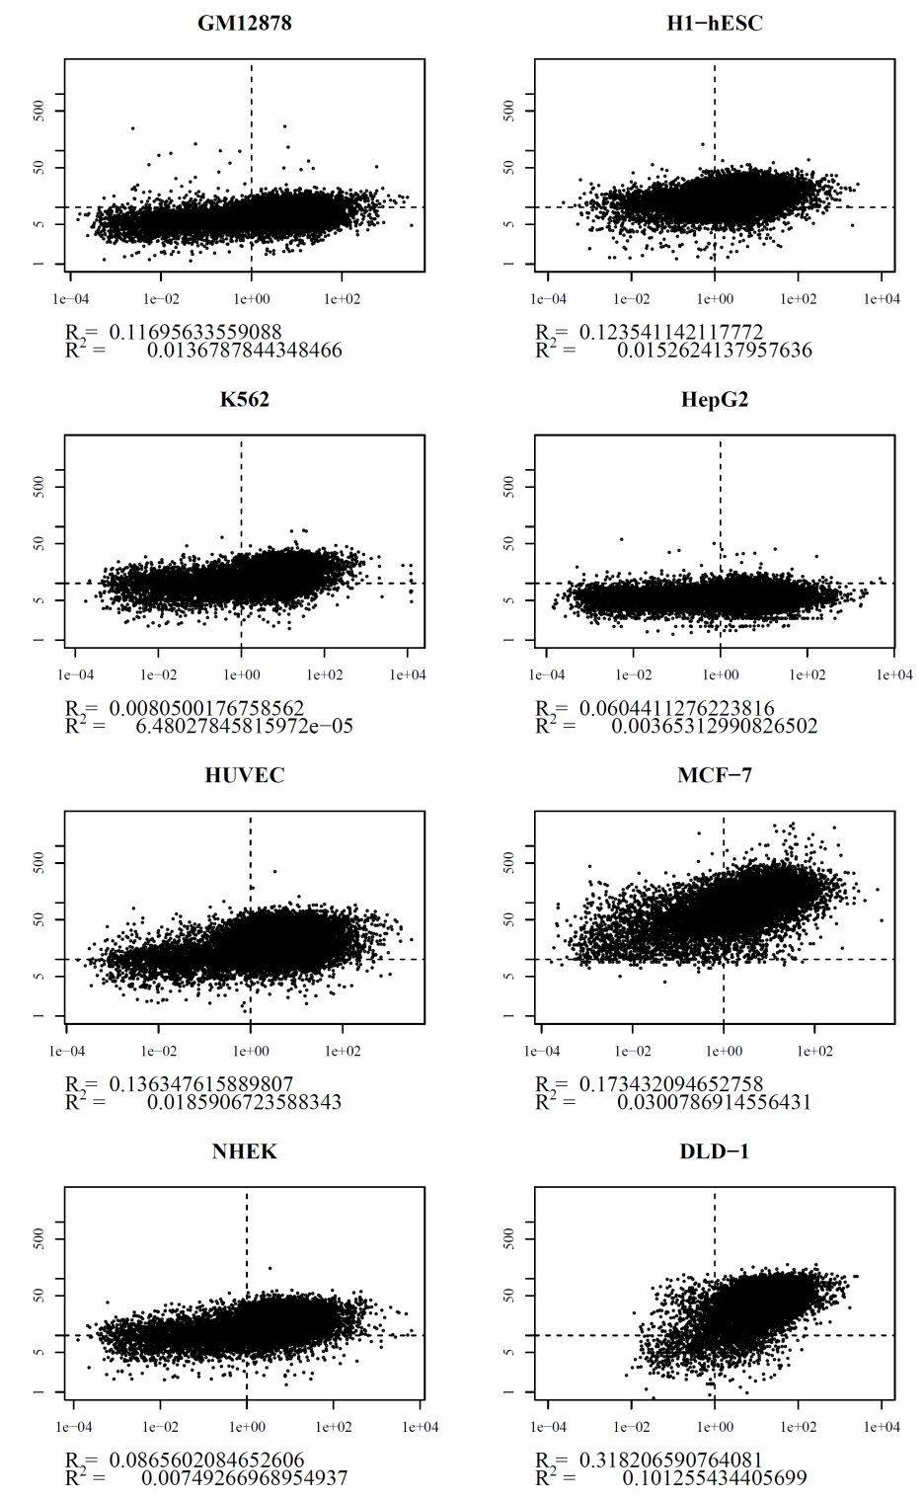
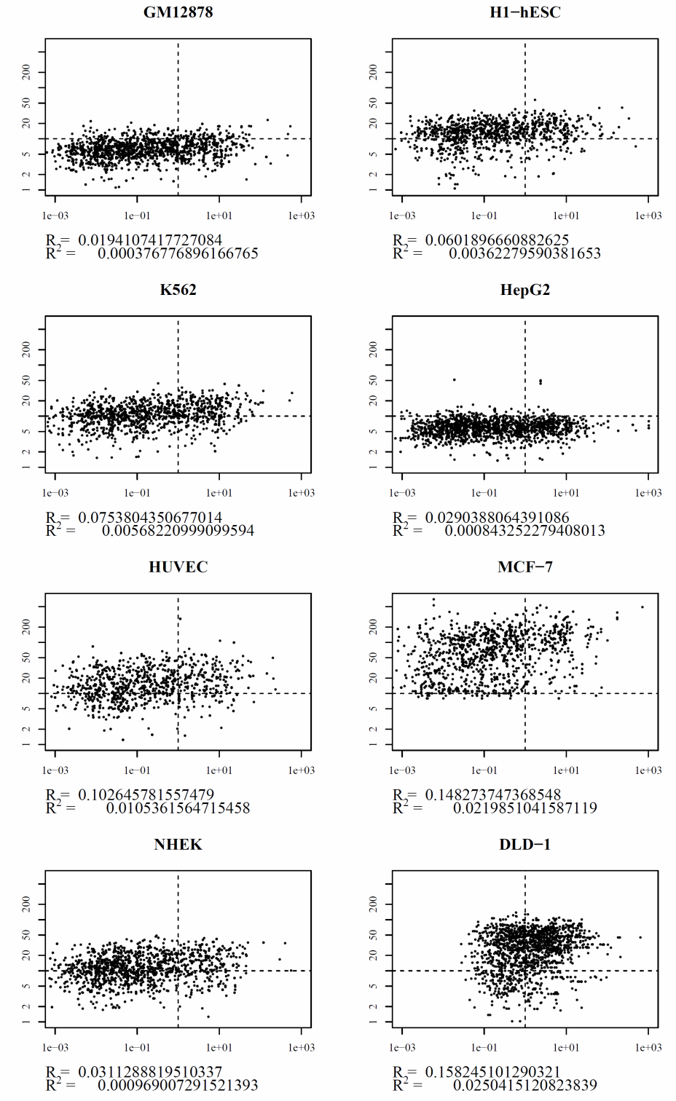
R = 0.38
R = 0.32
R = 0.28
R = 0.28
R = 0.64
R = 0.40
R = 0.36
R = 0.32
H3K4me3 Intensities
R = 0.57
R = 0.34
R = 0.29
R = 0.27
R = 0.60
R = 0.70
R = 0.31
R = 0.40
RNA Expression
RNA Expression
Supplementary Figure 6

Slide 12
Frequency of Occurrences
Frequency in different cell types
Refseq (mRNA) lincRNA
Supplementary Figure 7

Slide 13
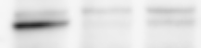
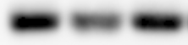
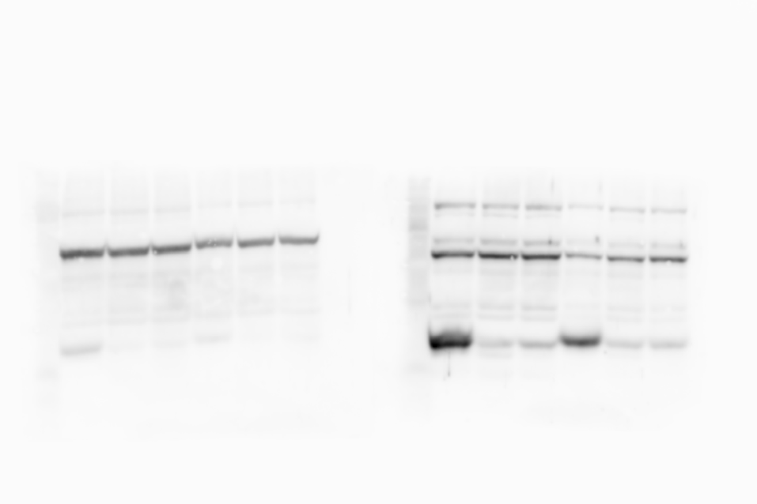
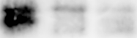
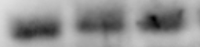
RT-qPCR and Western blot used to determine knockdown efficiencies
a
d
siCTRL
siUPF1_1
siUPF1_1
UPF1
α-tubulin
b
e
siCTRL
siEXOSC5_1
siEXOSC5_2
EXOSC5
α-tubulin
c
f
siSTAU1_1
siSTAU1_2
siCTRL
STAU1
α-tubulin
Supplementary Figure 8

Slide 14
siRNAs uesd for knock-down and oligonucleotides used for qPCR
Name | Sence sequece (5'-3') | Antisense sequece (5'-3')
siRNAs
Control siRNA-1 | GTACCTGACTAGTCGCAGAAG | TCTGCGACTAGTCAGGTACGG
Control siRNA-2 | UUCUCCGAACGUGUCACGUTT | ACGUGACACGUUCGGAGAATT
UPF1 siRNA-1 | GAUGCAGUUCCGCUCCAUUdTdT | AAUGGAGCGGAACUGCAUCdTdT
UPF1 siRNA-2 | AAUUUCUGUAACUUGUUUCCU | GAAACAAGUUACAGAAAUUAC
EXOSC5 siRNA-1 | CAACACGUCUUCCGUUUCUdTdT | AGAAACGGAAGACGuGuuGdTdT
EXOSC5 siRNA-2 | GCAAAGAGAUUUUCAACAAdTdT | UUGUUGAAAAUCUCUUUGCdTdT
siSTAU1-1 | CUCUGCGUGUGGUCCGUAUGG | AUACGGACCACACGCAGAGCC
siSTAU1-2 | CAGGGGAUCAAUCCGAUUAGC | UAAUCGGAUUGAUCCCCUGGC
Primer pairs for RT-qPCR
GAPDH | GCACCGTCAAGGCTGAGAAC | TGGTGAAGACGCCAGTGGA
UPF1 | AGATCACGGCACAGCAGAT | TGGCAGAAGGGTTTTCCTT
EXOSC5 | CCACACTCGAAGTGATCCTG | CCGGCTCTTCTCTGCAAC
STAU1 | TATCGGCAAGGATGTGGAGT | TGGTCCAACTCAGACAGCAA
HIC1 | GATGCTGGACACGATGGA | CTTGGTGCGCTGGTTGTT
PVT1 | CTCTTCCTGGTGAAGCATCTG | ATGGCTGTATGTGCCAAGGT
XLOC_003734 | TTTCAGAGGTTCTTTAGGGAAAAG | ACGTGCAAGAGGTCAAAGAAC
XLOC_007604 | GGACTGAGGCAACCCATCTA | TTCAAGATGAACCTTATGAGTGGT
XLOC_013194 | GGGGGCTCTGTGATATGCTA | TTCCTTTTCCTCTTGGGTTTAGT
XLOC_000048 | TGGAATATGGCTAATGTAAAGTTCA | GCCCGTTCTTGTGGTAGAAG
BAMBI | CGCCACTCCAGCTACATCTT | CACAGTAGCATCGAATTTCACC
ZNF574 | CGACGGCGAGAGCTAGAG | CCTCTGATTCCTCAGTCATGG
ZNF691 | CCTTCCCTCGCCTACAGAG | TCAGGCAGGTGTGGTTCTG
ZBED5 | TGAAGAGTGCATTTCAAGCTG | TGGTACACCTTTTCTTAAAGGTAGATT
MMP2 | CCCCAAAACGGACAAAGAG | CTTCAGCACAAACAGGTTGC
SLC25A23 | GAATTTTCCCGCTATCTGC | CTGTTGGATCTCAGAGACATCAAT
Supplementary Figure 9

Slide 15
Assumed differential equation:
RNA half-life:
Supplementary Figure 10

Slide 16
Experimental factors | Cell type | GM12878 | H1-hESC | K562 | HepG2 | HUVEC | MCF-7 | NHEK | DLD-1
H3K4me3 | No. of peaks | 73,952 | 33,270 | 52,422 | 138,709 | 40,948 | 69,525 | 51,310 | 16,917
 | No. of peaks (>= fold10) | 6,035 | 22,303 | 26,063 | 11,333 | 23,282 | 67,458 | 28,428 | 11,498
Pol2 | No. of peaks | 33,710 | 35,877 | 54,277 | 41,666 | 38,862 | 50,973 | 43,496 | 32,865
 | No. of peaks (>= fold10) | 0 | 0 | 25,315 | 0 | 47,713 | 0 | 28,354 | 9,167
H3K36me3 | No. of peaks | 141,174 | 173,091 | 62,502 | 252,660 | 90,694 | 157,267 | 56,505 | 101,691
 | No. of peaks (>= fold10) | 14,123 | 10,727 | 26,468 | 21,615 | 16,095 | 6,291 | 21,429 | 27,693
Experimental factors | Cell type | GM12878 | H1-hESC | K562 | HepG2 | HUVEC | MCF-7 | NHEK | DLD-1
H3K4me3 | No. of genes | 14,817 | 14,834 | 13,718 | 16,062 | 14,258 | 14,186 | 14,874 | 11,954
Pol2 | No. of genes | 14,642 | 14,545 | 13,692 | 13,480 | 13,692 | 13,093 | 13,153 | 12,306
H3K36me3 | No. of genes | 11,508 | 11,571 | 11,524 | 11,420 | 11,782 | 7,542 | 12,214 | 10,996
all positive | No. of genes | 10,611 | 10,194 | 10,569 | 10,902 | 10,640 | 7,286 | 10,971 | 9,706
 | No. of genes (>= fold10) | 2,246 | 8,906 | 7,914 | 299 | 9,485 | 7,277 | 9,366 | 9,464
 | No. of genes (< 1RPKM) | 1,582 | 1,321 | 1,522 | 1,470 | 1,450 | 247 | 1,488 | 121
 | No. of genes (>= 1RPKM) | 9,029 | 8,873 | 9,047 | 9,432 | 9,190 | 7,039 | 9,483 | 9,585
 | No. of genes (>= fold10 & < 1RPKM) | 148 | 1,068 | 787 | 53 | 1,121 | 245 | 1,014 | 86
 | No. of genes (>= fold10 & >= 1RPKM) | 2,098 | 7,838 | 7,127 | 246 | 8,364 | 7,032 | 8,352 | 9,378
 | No. of genes (>= fold25 & < 1RPKM) | 4 | 130 | 34 | 3 | 402 | 227 | 117 | 42
 | No. of genes (>= fold25 & >= 1RPKM) | 8 | 1,476 | 770 | 7 | 3,611 | 7,002 | 2,200 | 7,830
Experimental factors | Cell type | GM12878 | H1-hESC | K562 | HepG2 | HUVEC | MCF-7 | NHEK | DLD-1
H3K4me3 | No. of genes | 5,023 | 3,668 | 4,015 | 6,802 | 3,784 | 3,559 | 4,581 | 2,022
Pol2 | No. of genes | 4,824 | 4,141 | 4,529 | 3,175 | 4,554 | 2,625 | 4,148 | 2,894
H3K36me3 | No. of genes | 2,293 | 2,143 | 2,593 | 1,915 | 2,026 | 201 | 2,491 | 1,077
all positive | No. of genes | 1,258 | 880 | 1,742 | 1,233 | 1,197 | 95 | 1,605 | 379
 | No. of genes (>= fold10) | 352 | 697 | 1,199 | 63 | 972 | 95 | 1,192 | 341
 | No. of genes (< 1RPKM) | 822 | 571 | 1,210 | 824 | 923 | 43 | 1,214 | 55
 | No. of genes (>= 1RPKM) | 436 | 309 | 532 | 409 | 274 | 52 | 391 | 324
 | No. of genes (>= fold10 & < 1RPKM) | 213 | 423 | 769 | 48 | 734 | 43 | 884 | 50
 | No. of genes (>= fold10 & >= 1RPKM) | 139 | 274 | 430 | 15 | 238 | 52 | 308 | 291
 | No. of genes (>= fold25 & < 1RPKM) | 7 | 66 | 46 | 0 | 319 | 40 | 194 | 35
 | No. of genes (>= fold25 & >= 1RPKM) | 0 | 53 | 49 | 3 | 121 | 41 | 96 | 248
Supplementary Figure 11

Slide 17
Nuclear to Cytoplasm ratio (N/C)
Nuclear to Cytoplasm ratio (N/C)
Nuclear to Cytoplasm ratio (N/C)
Nuclear to Cytoplasm ratio (N/C)
ChIP+/RNA-
Other
ChIP+/RNA-
Other
ChIP+/RNA-
Other
ChIP+/RNA-
Other
Cell Type | P Value
Gm12878 | 0.42
H1hesc | 3.73E-14
K562 | 0.40
Hepg2 | 0.17
Huvec | 0.31
Mcf7 | 0.37
Nhek | 0.008
Nuclear to Cytoplasm ratio (N/C)
Nuclear to Cytoplasm ratio (N/C)
Nuclear to Cytoplasm ratio (N/C)
ChIP+/RNA-
Other
ChIP+/RNA-
Other
ChIP+/RNA-
Other
Supplementary Figure 12

