Slide 1
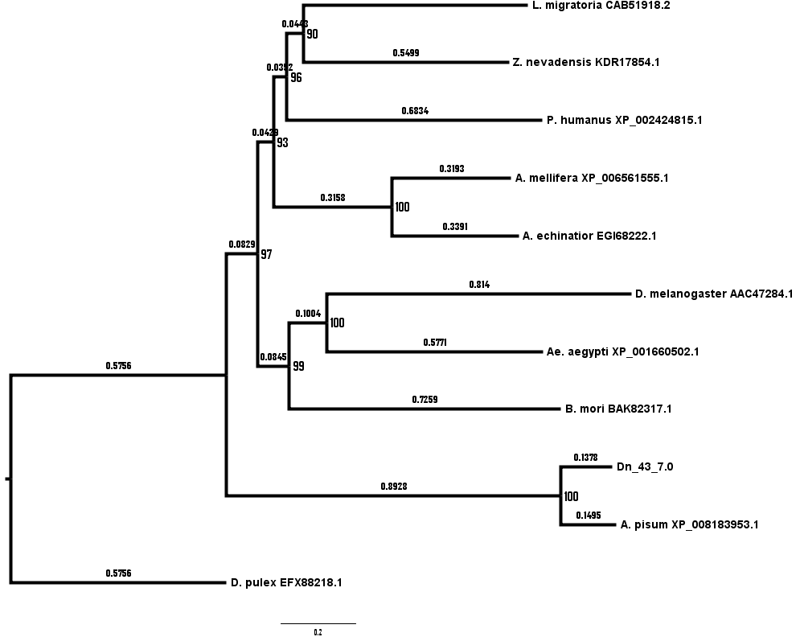
Figure S4. Maximum-likelihood phylogeny of apolipophorin sequences from 11 arthropod species. A MUSCLE alignment of the indicated protein sequences was used to generate a maximum-likelihood phylogenetic tree based upon 1000 replicates. Bootstrap support is indicated at each node, and substitutions per site are indicated on each branch. D. noxia occupies the same branch as A. pisum, which emerged from the insect lineage prior to the development of the holometabola.

