Slide 1
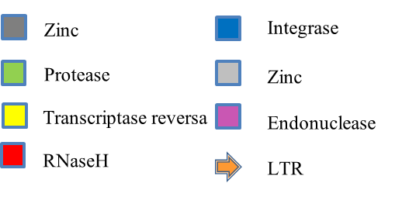
PBS
LTR-GYPSY-RtPc1
PPT
1
Gag-1188bp
Pol-3915bp
5740
1144
1145
1146
1147
1148
1149
1150
1151
1152
1153
1154
1155
1156
1157
1158
1160
3336
1161
PPT/PBS
ESTs groups

Slide 2
PBS
LTR-GYPSY-RtPc2
PPT
1
Pol-4785bp
5412
12801
PPT/PBS
ESTs groups

Slide 3
PBS
LTR-COPIA-RtPc3
PPT
1
Pol-4587bp
5181
8104
11330
12427
PPT/PBS
ESTs groups

Slide 4
PBS
LTR-COPIA-RtPc4
PPT
1
Pol-5061bp
5685
8707
9844
PPT/PBS
ESTs groups

Slide 5
LINE-Tad-RtPc5
1
ORF 1716bp
Pol-3939bp
5905
Poli A
1945
6641
9783
PPT/PBS
ESTs groups

