Slide 1
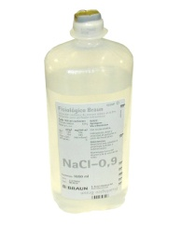
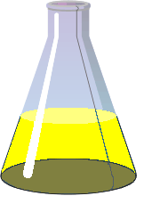
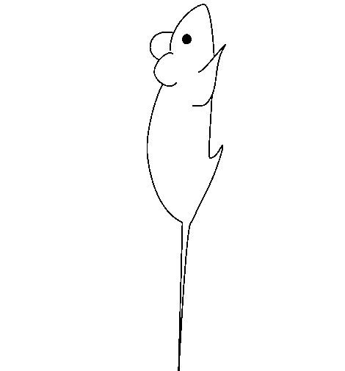
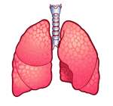
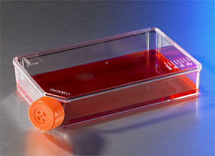
Acinetobacter baumannii
AbH12O-A2
Cell culture
50 overexpressed proteins
Acinetobacter baumannii
AbH12O-A2
Cell culture
114
NaCl 0.9 %
LB
21 h
protein
extraction
NaCl 0.9 %
labelling
BALF model
digestion
61
underexpressed
proteins
21 h
115
BALF
BALF + LB
21 h
combine
2D LC-MALDI-TOF/TOF
116
Acinetobacter baumannii
AbH12O-A2
Cell culture
DMEM
21 h
protein
extraction
digestion
labelling
76
overexpressed proteins
macrophage model
117
21
underexpressed
proteins
Macrophage + DMEM
21 h

