Slide 1
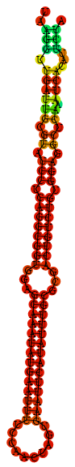
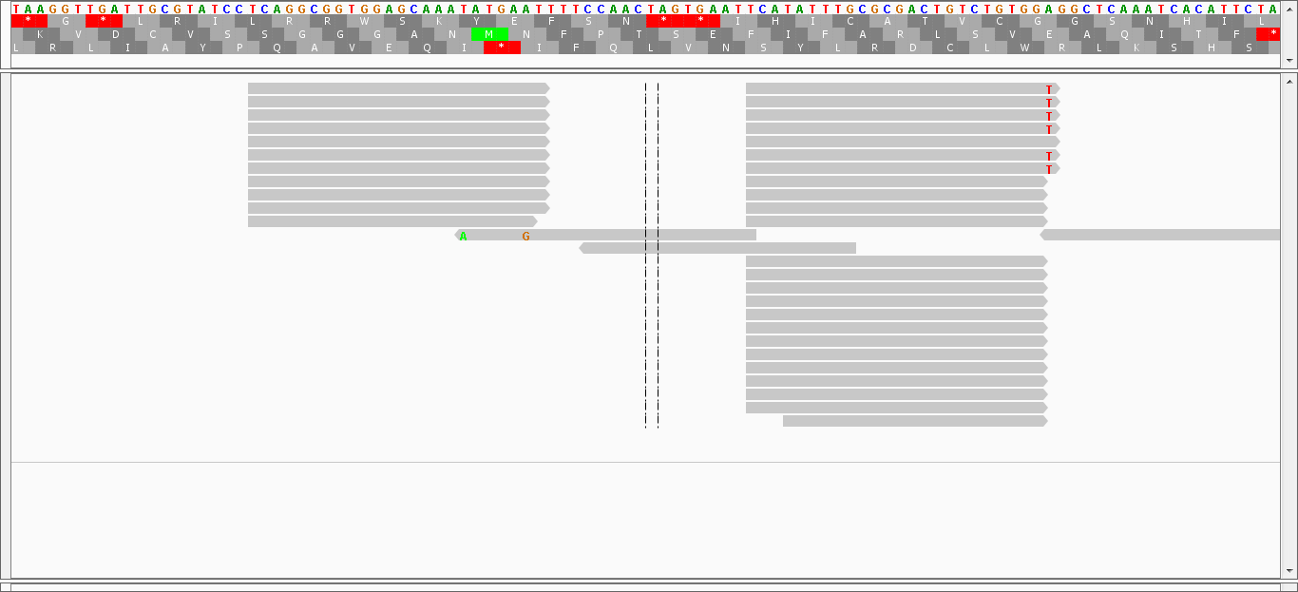
Additional file 5 Figure S1 Distribution of sequencing reads from soybean nodule libraries mapped on the soybean precursor of miRNov153.
A
miRNov153
miRNov153*
B
miRNov153
miRNov153*

