Slide 1
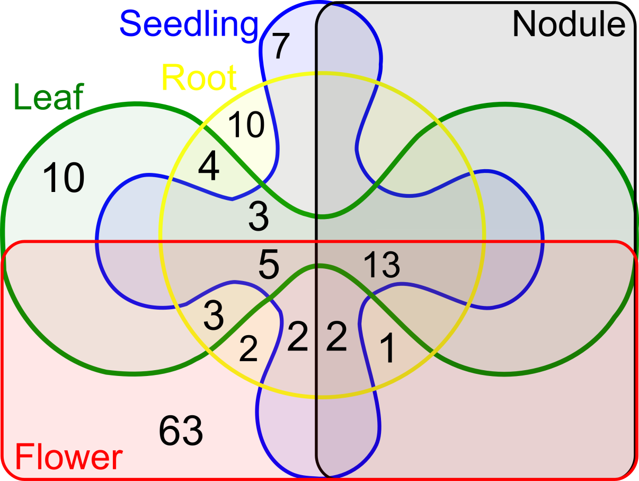
Additional file 7 Figure S3 Distribution of the identified PHAS genes in 5 plant organs

