Slide 1
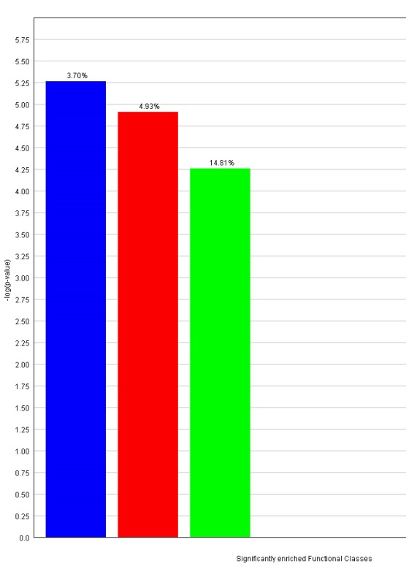
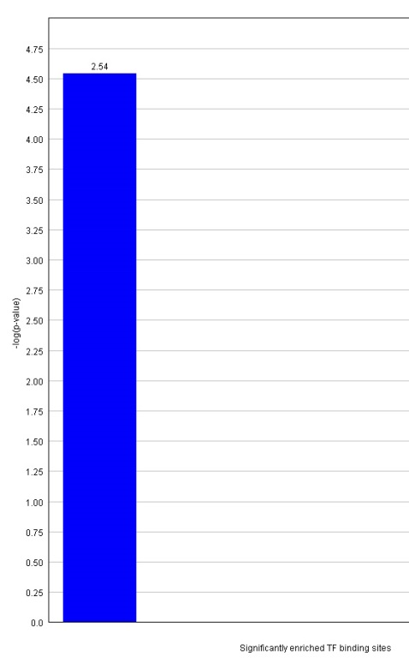
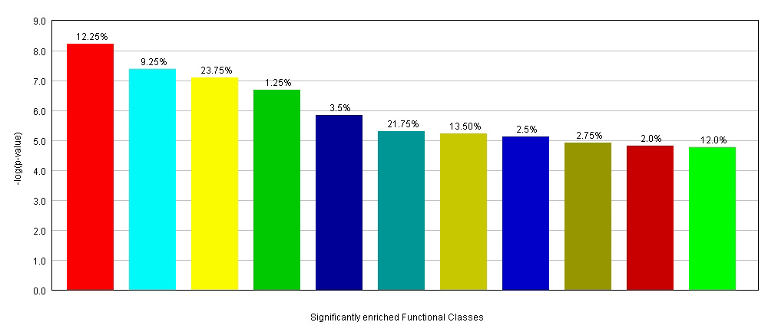
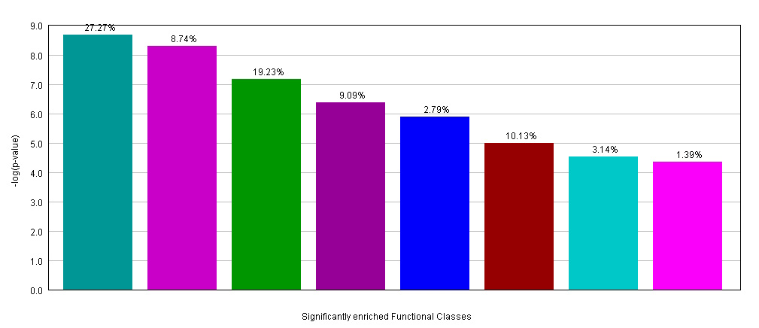
Supplementary Figure 9
A.
B.
Response to other organism
Immune response
Hydrolase activity
IRF7
C.
Signal transducer activity
Response to stimulus
Biological regulation
Peptide cross-linking
Response to external stimulus
Protein binding
Cell communication
Defence response
Locomotion
Response to other organism
Hydrolase activity
D.
Protein binding
Calcium ion binding
Cation binding
Cellular component organization
Extracellular structure organization
Developmental process
Metallopeptidase activity
Gas transport

Slide 2
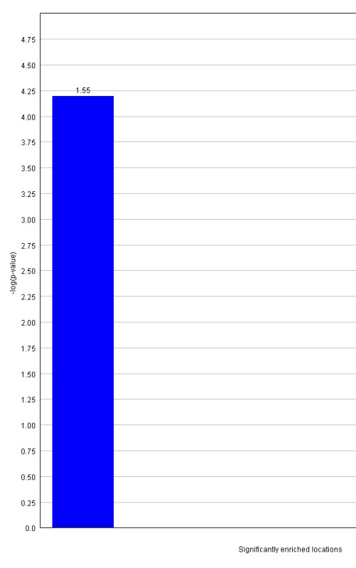
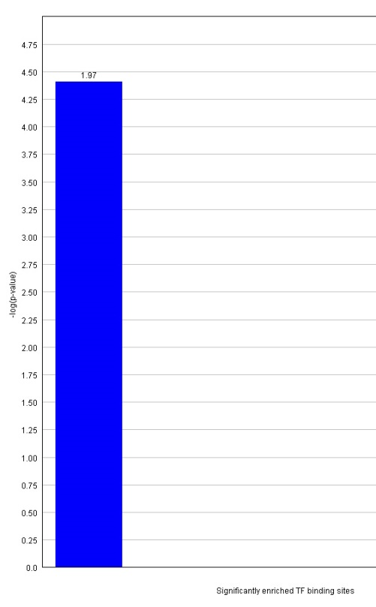
E.
F.
NF-kB
Chr.1

