Slide 1
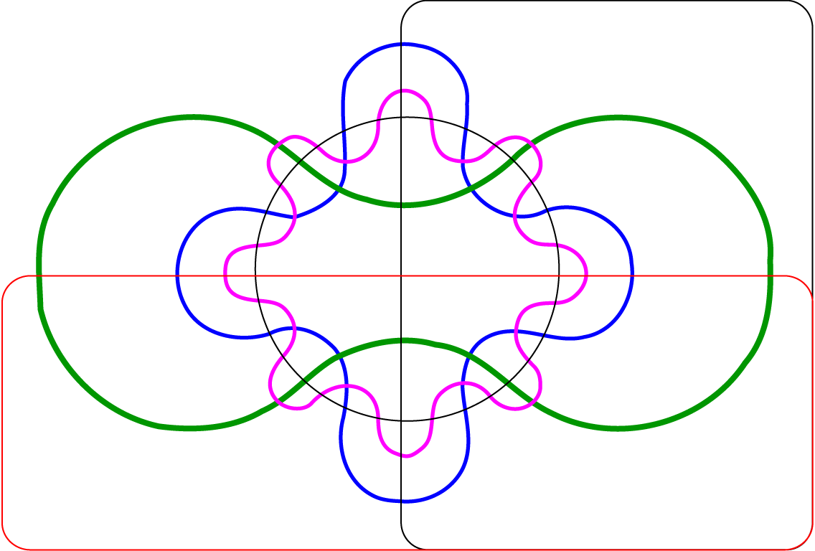
Brachypodium distachyon
Zea mays
Sorghum bicolor
463
3,340
48
Oryza sativa
58
ALOMYbase
179
1705
289
1122
131
70
187
92
308
130
55
833
24
454
577
77
63
22
217
145
31
45
38
7
384
13
21
35
9,328
217
40
53
166
442
30
511
41
47
81
210
257
3024
412
62
75
222
184
163
74
110
235
61
176
53
109
2,408
149
51
370
Hordeum vulgare
Figure S3: OrthoMCL analysis results showing groups of peptides shared among ALOMYbase and grass genomes. The six-way Venn diagram shows the number of OrthoMCL groups of peptides shared among ALOMYbase and B. distachyon, H. vulgare, Z. mays, O. sativa and/or S. bicolor. An 80% match cutoff threshold was implemented for ortholog clustering.

