Slide 1
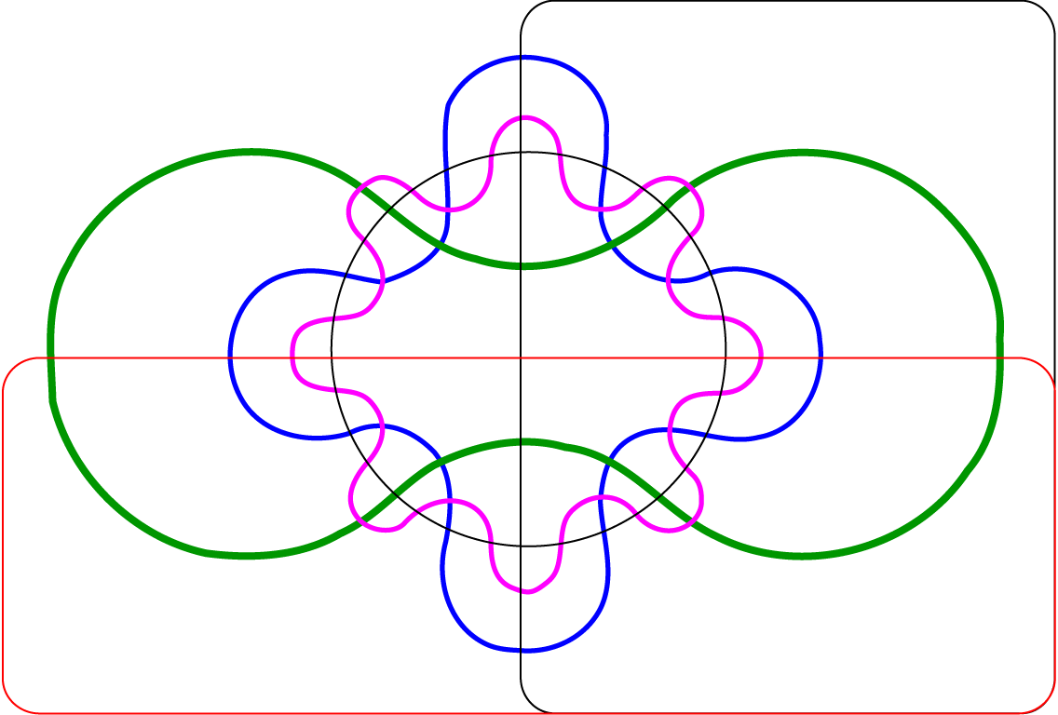
A
Total= 7,214
UT
73 HAT
6 HAT
12 HAT
917
61
581
35
24 HAT
9
311
628
93
17
56
16
877
613
17
4
0
5
6
12
39
15
10
48
72
17
11
20
11
23
40
18
12
35
339
33
12
29
14
38
59
46
14
70
38
30
26
5
7
18
8
26
52
55
44
18
134
35
5
13
1,121
136
38
122
36 HAT
UT
B
Total= 6,707
73 HAT
6 HAT
12 HAT
647
62
729
45
24 HAT
13
1316
68
24
81
58
554
42
690
166
58
20
10
23
97
45
40
35
97
44
26
19
47
34
22
8
10
3
7
14
258
17
6
14
33
28
20
16
12
19
57
20
13
10
16
15
19
65
61
15
16
14
23
7
2
656
35
12
74
36 HAT
Figure S6: Number of contigs differentially regulated between phenotypes. Six-way Venn diagrams show the number of contigs up-regulated at each time-point in the sensitive pool compared to the resistant pool (A) or in the resistant pool compared to the sensitive pool (B). UT, untreated; xHAT, x hours after herbicide treatment.

