Slide 1
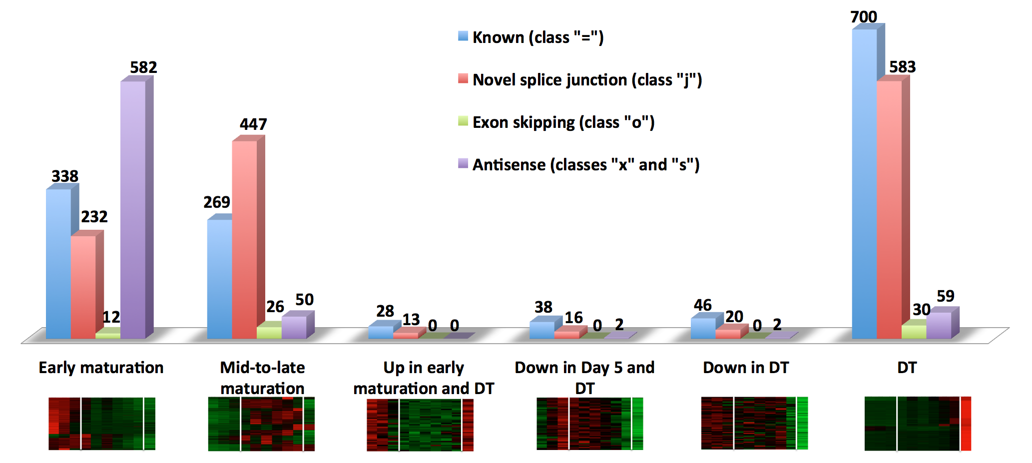
Supplemental Figure 4. Distribution of 2,938 transcripts among the super-clusters. The graph shows the distribution of known and novel transcripts belonging to different Cuffcompare classes among six super-clusters.
S4

