Slide 1
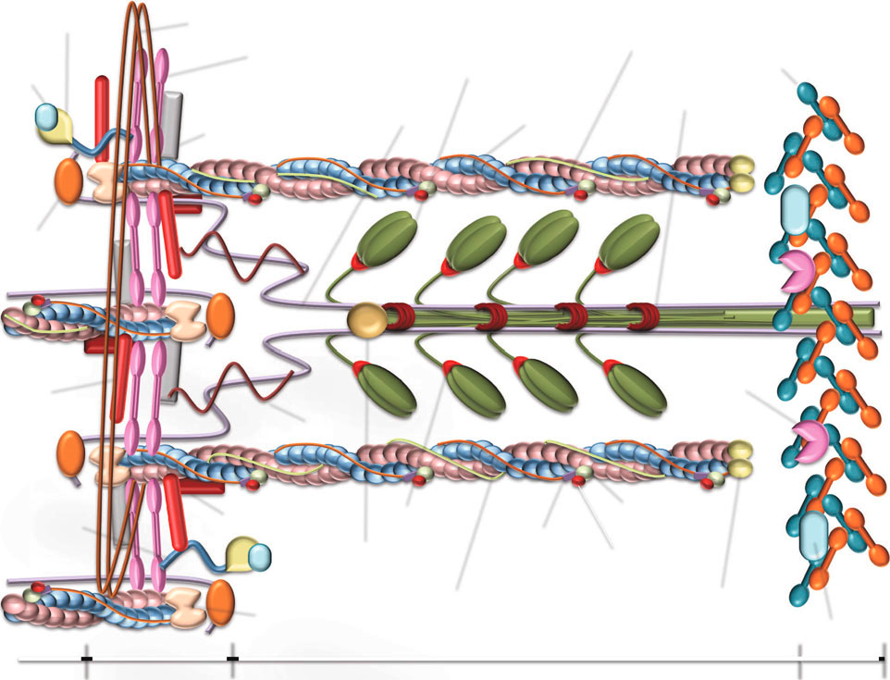
Mid1IP = tubulin scaffolding
CD9 = myocyte fusion
calcineurin
desmin
Actinin-associated LIM protein
nebulin
NFATC3
Actinin
Myomesin 1,2
MHC
β-actin
xin-actin
Mybp
myopalladin
titin
α-actin
telethonin
filamin-α,β,γ
Murf-1
Obscurin
Myozenin 1,2
Myotilin
MLC
Troponin T2
calpain
Troponin C
Troponin I
Tropomyosin
Tropomodulin
Actin capping
up-regulation of genes
calmodulin
small rainbow trout = blue
large rainbow trout = red
Both = purple
Z-disc
M-line
Adapted from:
Garcia de la Serrana et al. 2012. BMC Genomics 13: 181

Slide 2
Mid1IP = tubulin scaffolding
CD9 = myocyte fusion
calcineurin
desmin
Actinin-associated LIM protein
nebulin
Myomesin 1,2
NFATC3
Actinin
MHC
nebulin-anchoring protein
xin-actin
myopalladin
titin
α-actin
Mybp
telethonin
filamin-α,β,γ
Murf-1
Obscurin
Myozenin 1,2
Myotilin
MLC
Troponin T2
calpain
Troponin C
Troponin I
Tropomyosin
Tropomodulin
Actin capping
up-regulation of genes
calmodulin
Sept. rainbow trout = blue
Dec. rainbow trout = red
Both = purple
Z-disc
M-line
Adapted from:
Garcia de la Serrana et al. 2012. BMC Genomics 13: 181

