Slide 1
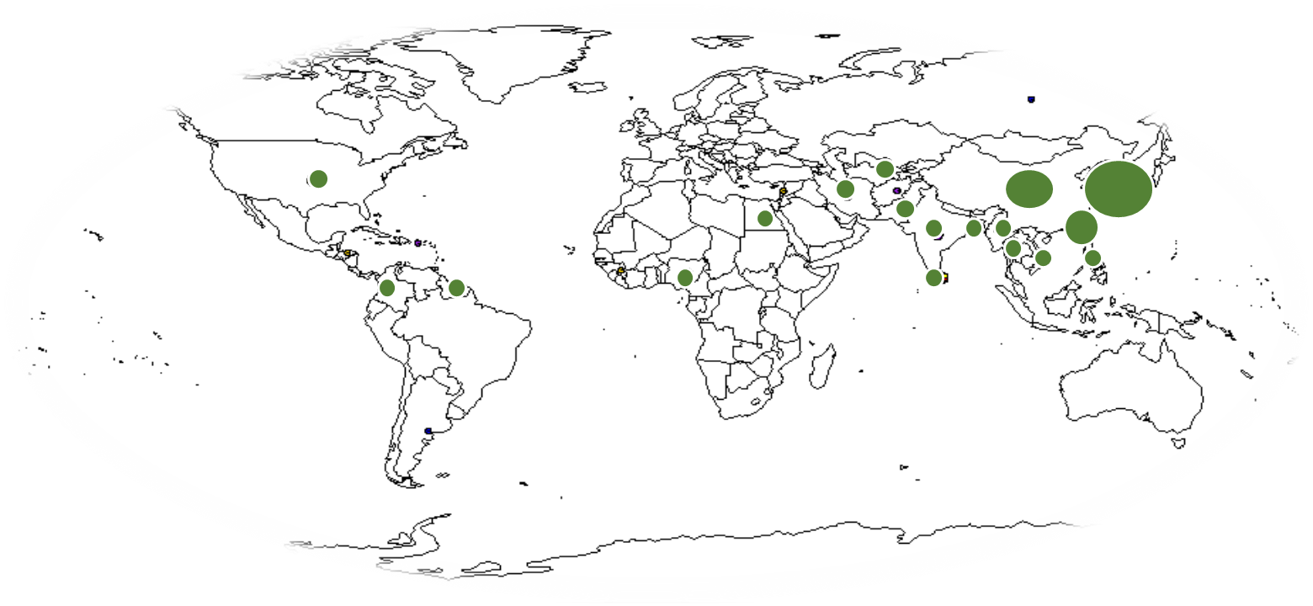
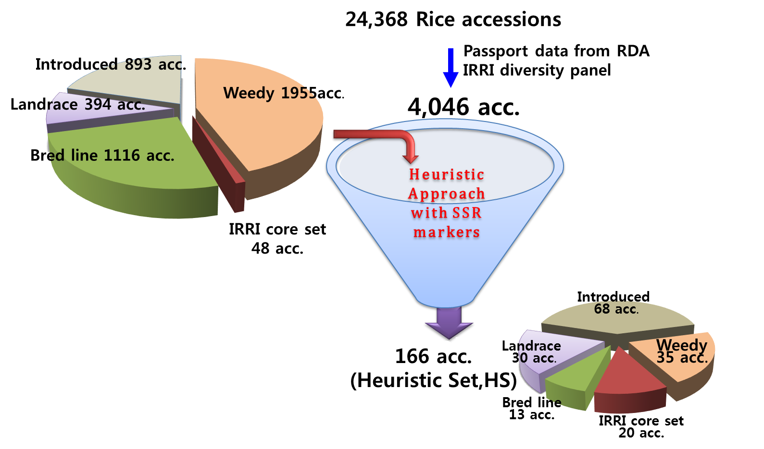
a.
c.
b.
Asia other(14,10%)
Africa (5,4%)
Europe (1,1%)
America (10,7%)
Southeast (10,7%)
Figure S1. Geographical (a,b) and methodological (c) origins of KRICE_CORE.

Slide 2
Figure S2. Scatter plot between mapping rate and sequencing depth of KRICE_CORE.
Sequencing depth
Mapping rate

Slide 3
Figure S3. Neighbor-joining tree analysis of previously defined rice accessions.
Temperate japonica
GroupV
Tropical japonica
Aus
Indca

Slide 4
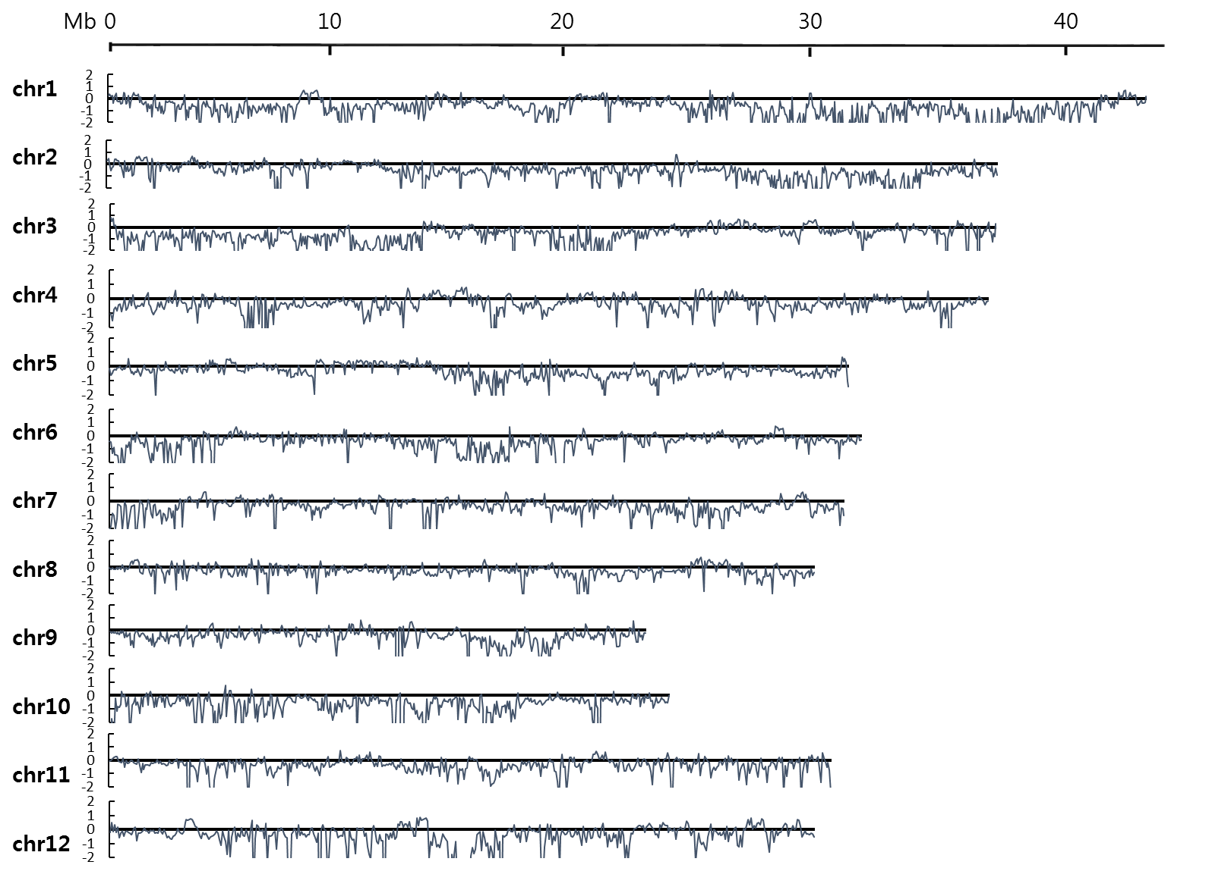
Figure S4. Sliding-window analysis of reduction of diversity (ROD) across KRICE_CORE genome.

Slide 5
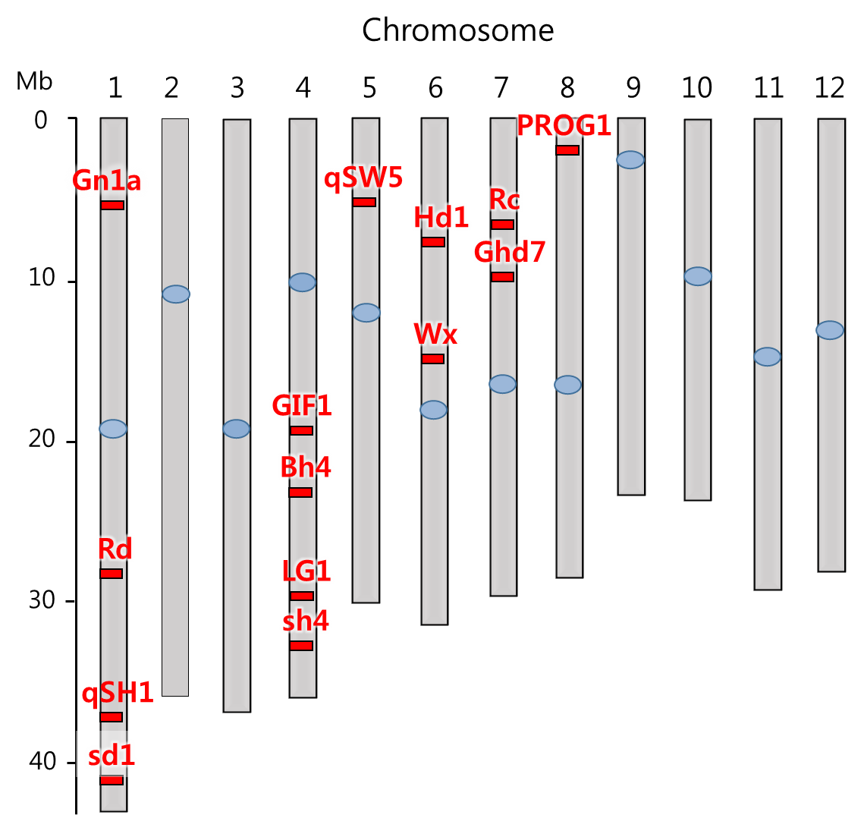
Figure S5. Genomic positions of previously identified domesticated genes.

Slide 6
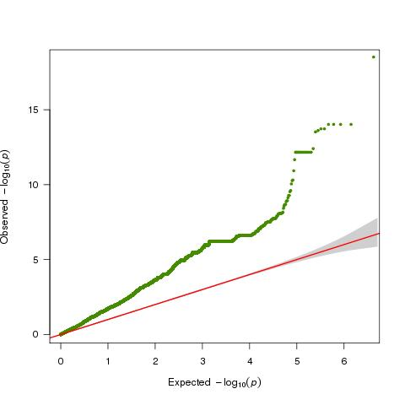
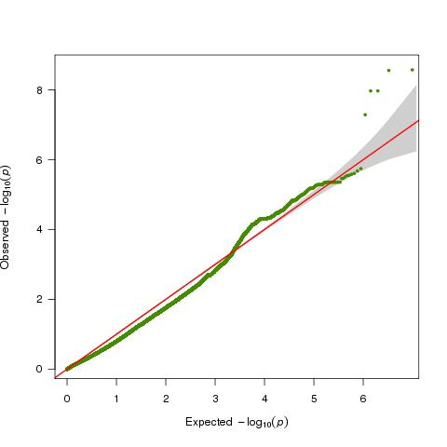
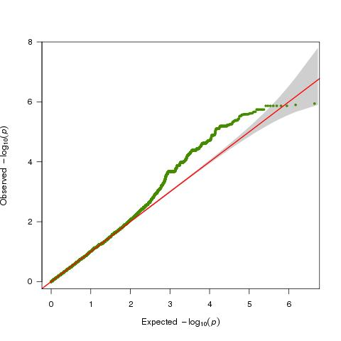
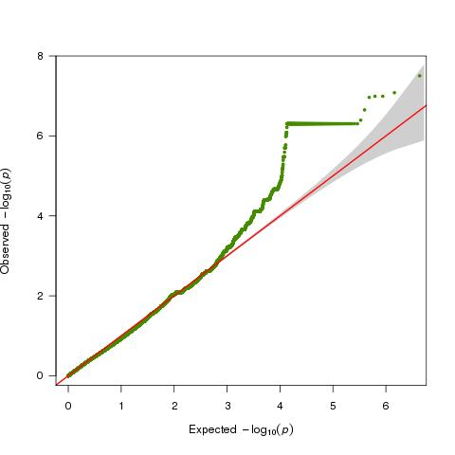
Figure S6. Quantile-quantile plot of the Genome-wide association studies of ‘pericarp color’(a), ‘amylose content’(b), ‘rice seed protein content’(c) and ‘number of panicle per plant’(d).
a.
b.
c.
d.

Slide 7
Figure S7. Phenotypic variation of the target traits for the GWAS study.
a.
b.
Number of accessions
Number of accessions
White
Pink
Red
c.
Pericarp color
Grain amylose percentage
d.
Number of accessions
Number of accessions
Protein content
Panicle number

