Slide 1

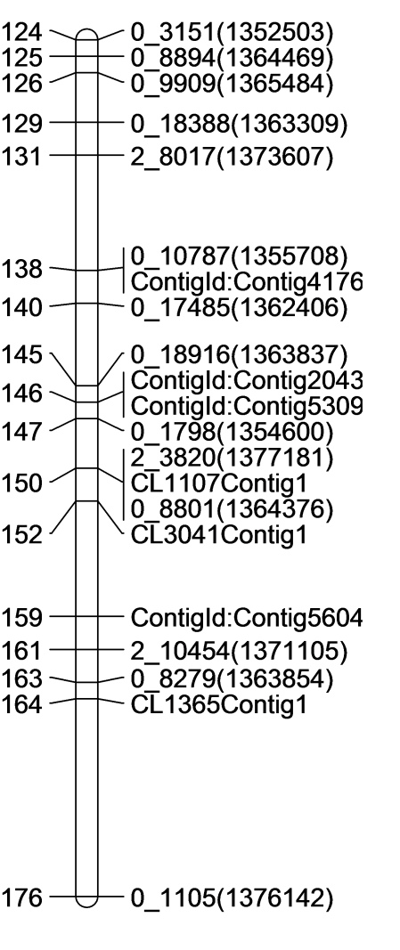
Cr4-LG Pinus consensus LG8

