Slide 1
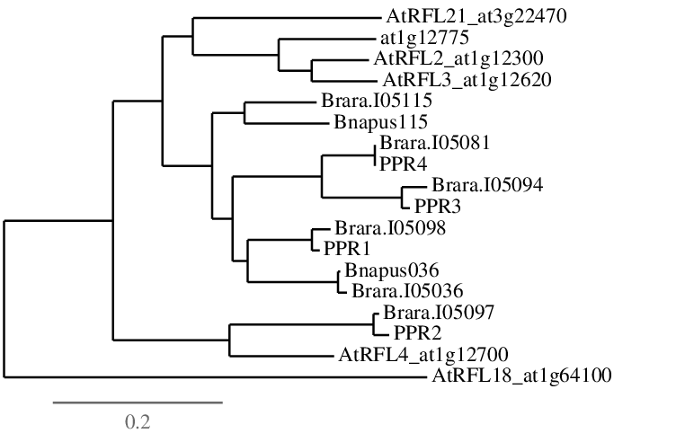
0.8025
AtRFL21_at3g22470
1.0
At1g12775
0.7975
AtRFL2_at1g12300
AtRFL3_at1g12620
0.9775
Brara.I05115
0.87
B. napus 115
1.0
Brara.I05081
0.545
0.995
B. napus PPR4
1.0
Brara.I05094
0.64
0.5725
B. napus PPR3
1.0
Brara.I05098
B. napus PPR1
1.0
B. napus 036
Brara.I05036
1.0
Brara.I05097
1.0
B. napus PPR2
AtRFL4_at1g12700
AtRFL18_at1g64100

