Slide 1
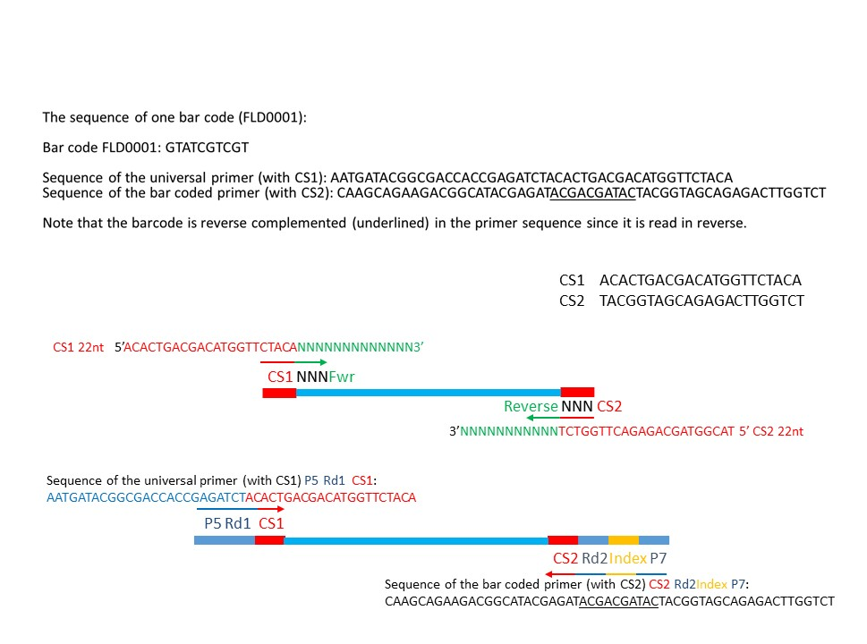
Notes:
Supplementary Figure 1: Further to the information provided in Figure 1, supplementary figure 1 provides additional details regarding the CS1, CS2, P5, and P7 primer sequences, as well as the location of the barcode.

