Slide 1
Additional file 9: Figure S2. Visualization of the 52 potentially translated annotated ncRNAs in alphabetical order. The data are visualized in Artemis 16.0.2 (35). The sequencing reads from the footprint (yellow) and transcriptome (blue) sequencing are shown as coverage plot plotted above and below the center line. The scaling had to be adjusted to the actual coverage and is shown in the right corner of each plot. The EHEC genome is visualized in a six frame translation. Annotated genes are shown in their respective reading frame (light blue). Vertical black bars indicate stop codons, i.e. a protein-coding ORF must be located between two black bars. ncRNAs are indicated in green.

Slide 2
ArcZ
C0299
CRISPR-DR4_1
CRISPR-DR4_2

Slide 3
CyaR_RyeE
DicF_1
DicF_2
frnS

Slide 4
GadY
GcvB
MicA
MicC

Slide 5
OmrA-B_1
OmrA-B_2
OrzO-P_1
OrzO-P_2

Slide 6
P26
QUAD_7
rdlD_3
RprA

Slide 7
RtT_2
RtT_3
RtT_4
RybB

Slide 8
rydB
RyhB
sok_10
sok_14

Slide 9
sok_15_sokX
Spot_42_spf
sraL
sroB

Slide 10
sroC
sroD
sroE
sroH

Slide 11
STAXI_4
STnc70
STnc100_1
STnc100_2

Slide 12
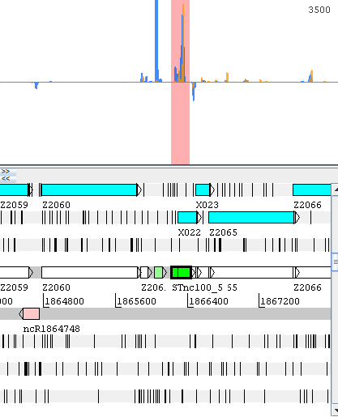
STnc100_3
STnc100_4
STnc100_5
STnc100_10

Slide 13
STnc130
STnc180
STnc450
STnc550

Slide 14
STnc560
STnc630
tpke11
Z6077/DicF_4

