Slide 1
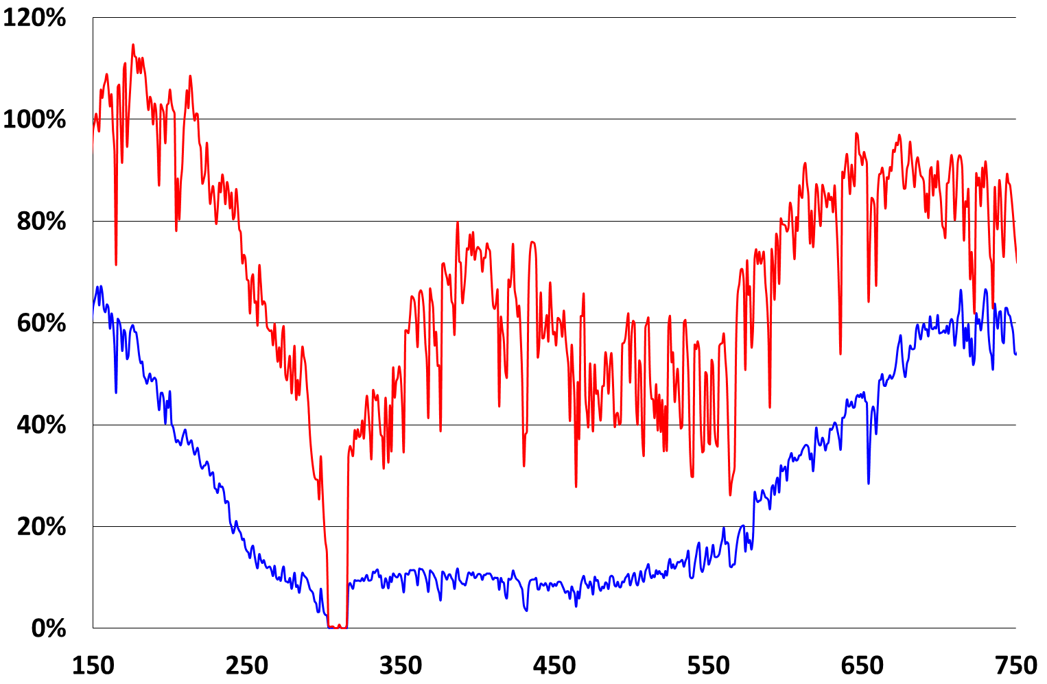
% average coverage
PCR free method
MitoRS
DNA position

