Slide 1
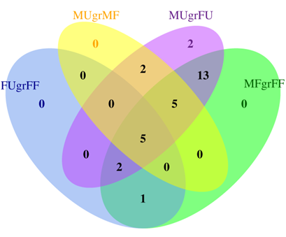


A. Intersection of Purple Genes
B. Intersection of Light Blue Genes
C. Intersection of Orange Genes

