Slide 1
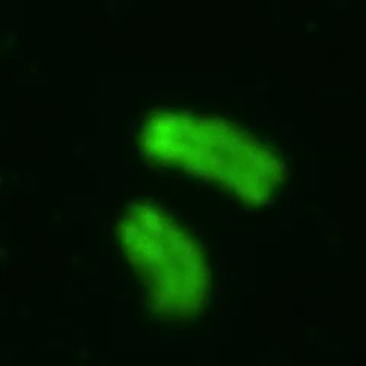
Additional file 8: Movie S1. 3D images of DAPI stained chromosomes of oocyte in Fig.2c.

Slide 2
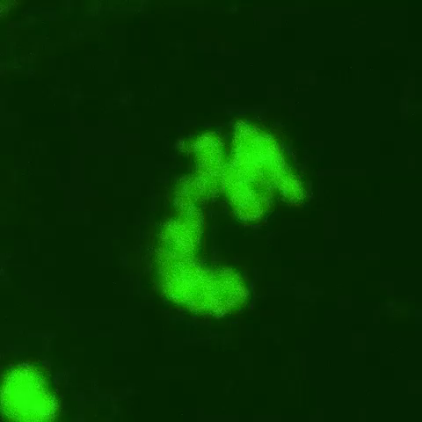
Additional file 8: Movie S2. 3D images of DAPI stained chromosomes of embryo in Fig.2f.

