Slide 1
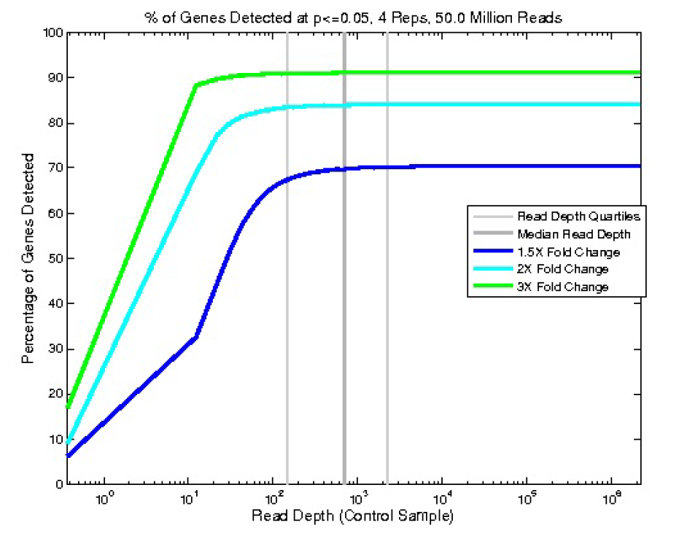
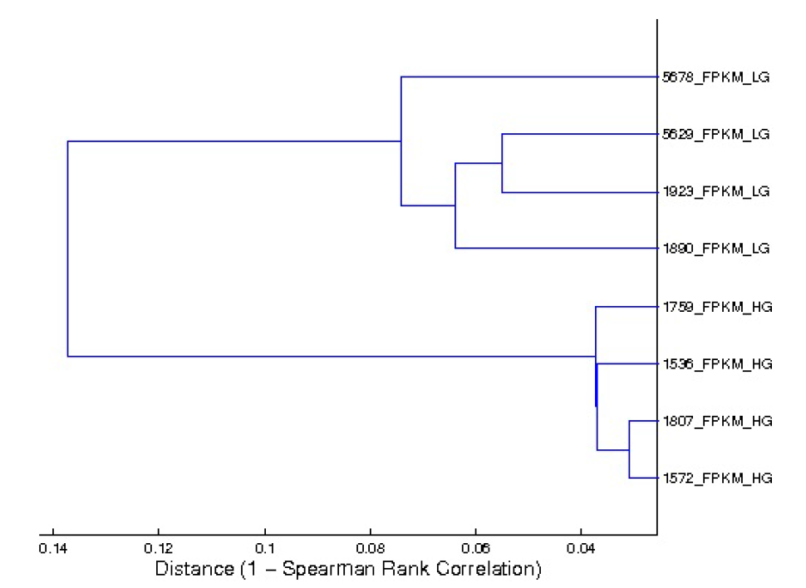
A.
% of Genes Detected at P≤0.05, 4 reps, 50M Reads
100
90
80
70
60
50
40
30
20
10
0
Percentage of Genes Detected
10⁰ 10¹ 10² 10³ 10⁴ 10⁵ 10⁶
B.
Read Depth (control sample)
Bird # 5678_LG
Bird # 5629_LG
Bird # 1923_LG
Bird # 1890_LG
Bird # 1750_HG
Bird # 1536_HG
Bird # 1807_HG
Bird # 1572_HG
0.14 0.12 0.1 0.08 0.06 0.04
Distance (1 – Spearman Rank Correlation)

