Slide 1
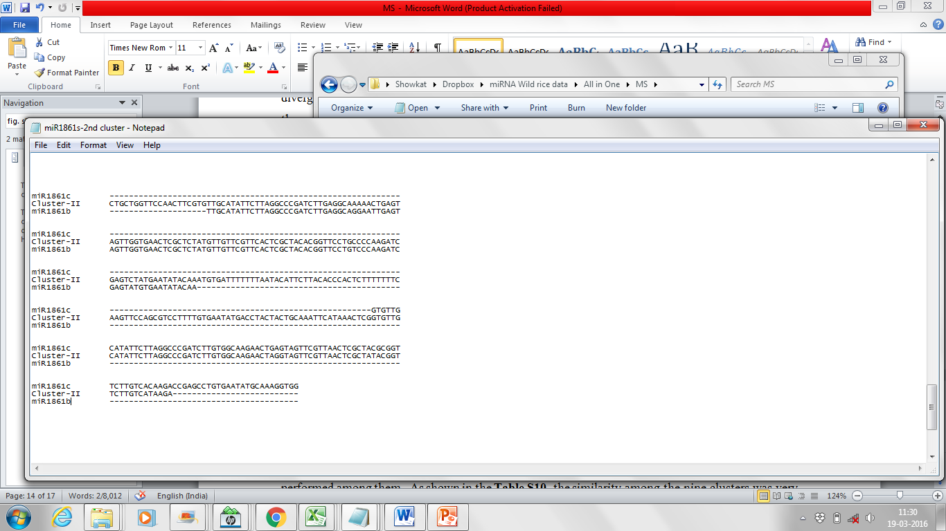
A

Slide 2
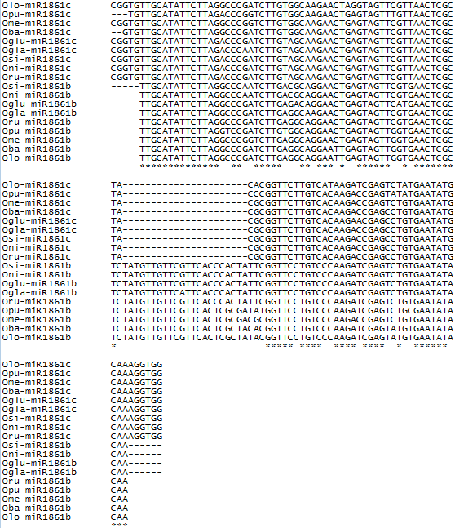
B
Figure S7. Structure of the 2-membered clusters of miR1861 family. Here cluster-II represents all the 2-membered miR1861-clusters. The two members of a 2-membered cluster are joined by a nt. sequence of ~100bp (A). Alignment of cluster-II from the Oryza species (B) showing the deletion of 22nt is consistently present in the 2nd member of a 2-membered cluster.

