Slide 1
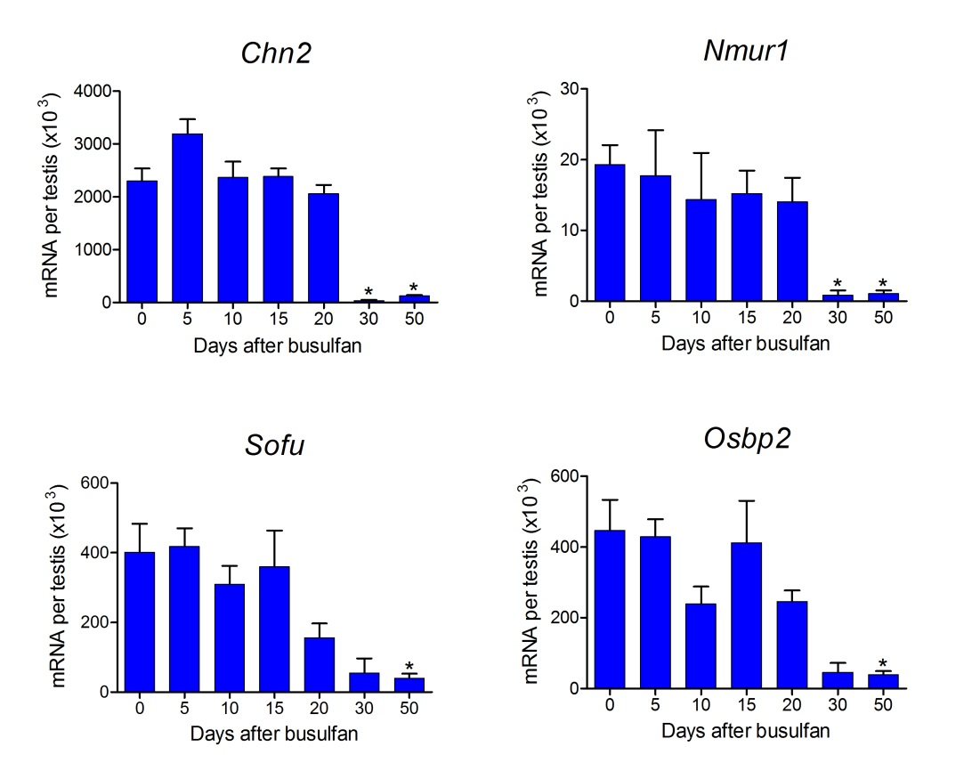
Additional File 11 Changes in selected germ cell transcript levels following a single injection of busulfan. Results show mean ± SEM of between 3 and 5 animals in the busulfan treated groups and 18 animals in the control group. Data were analysed by single factor anova and groups marked with an asterisk (*) are significantly different from control.

