Slide 1
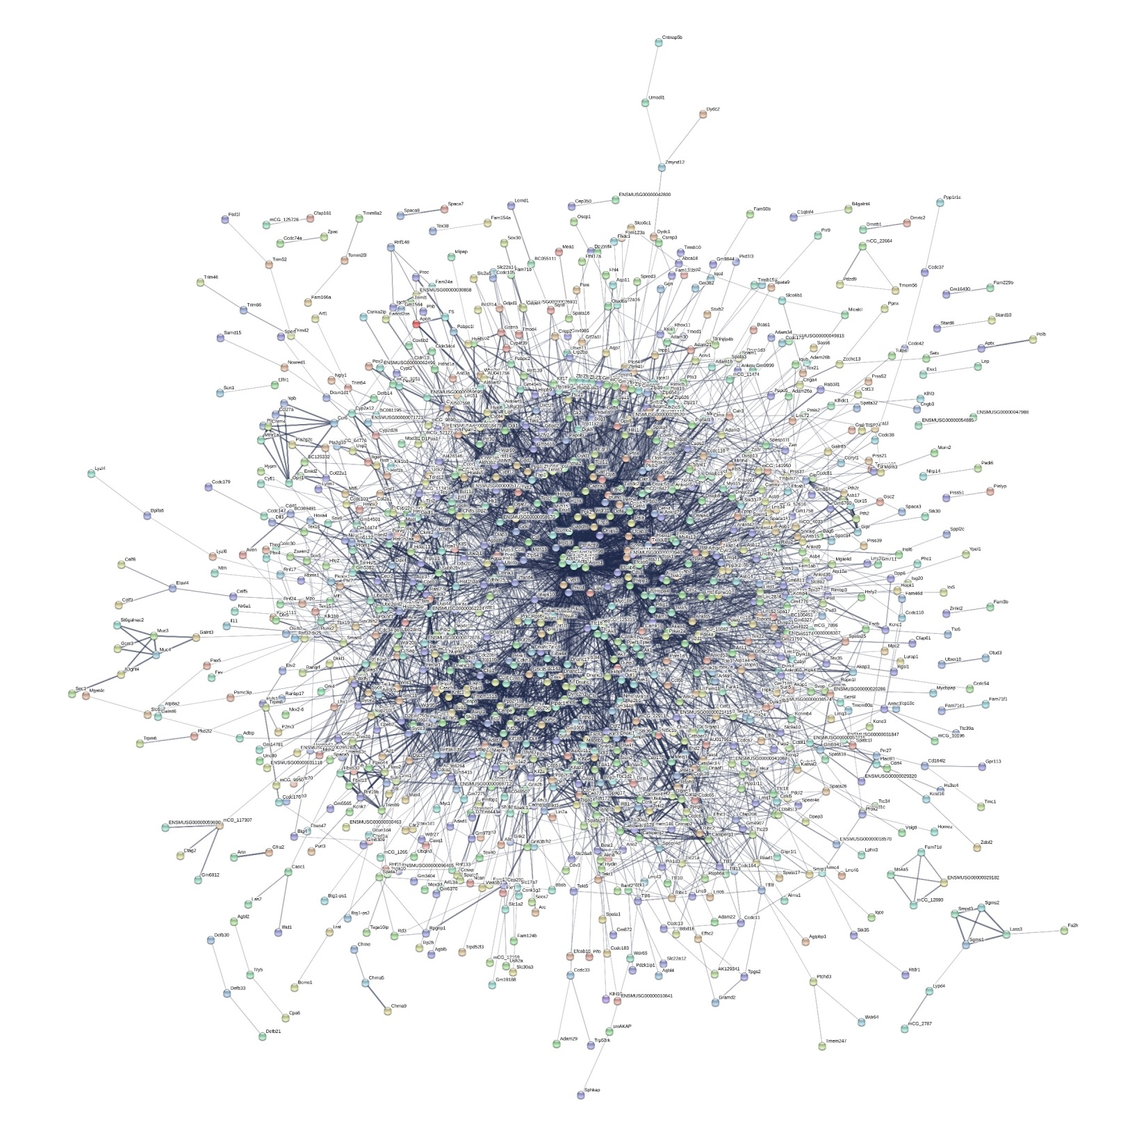
Additional File 12 Protein interaction networks associated with mouse germ cell-specific transcripts using the STRING database. Each circle represents a protein (node) and each line (edge) represents a protein-protein association. Only nodes which are connected are shown. The line colour and thickness indicate the type of interaction evidence and the strength of data support. A combination score >0.4 was set as the reliability threshold for network construction. The network contains 1915 nodes and 5542 edges.

