Slide 1
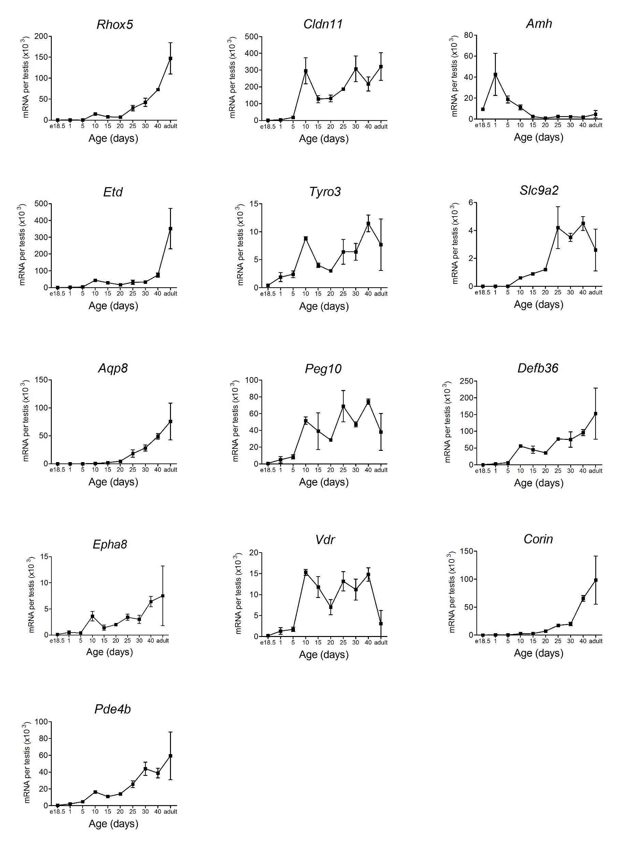
Additional File 6 Developmental changes in selected Sertoli cell-specific transcripts. Data shows mean ± SEM of 2-4 animals per group.

