Slide 1
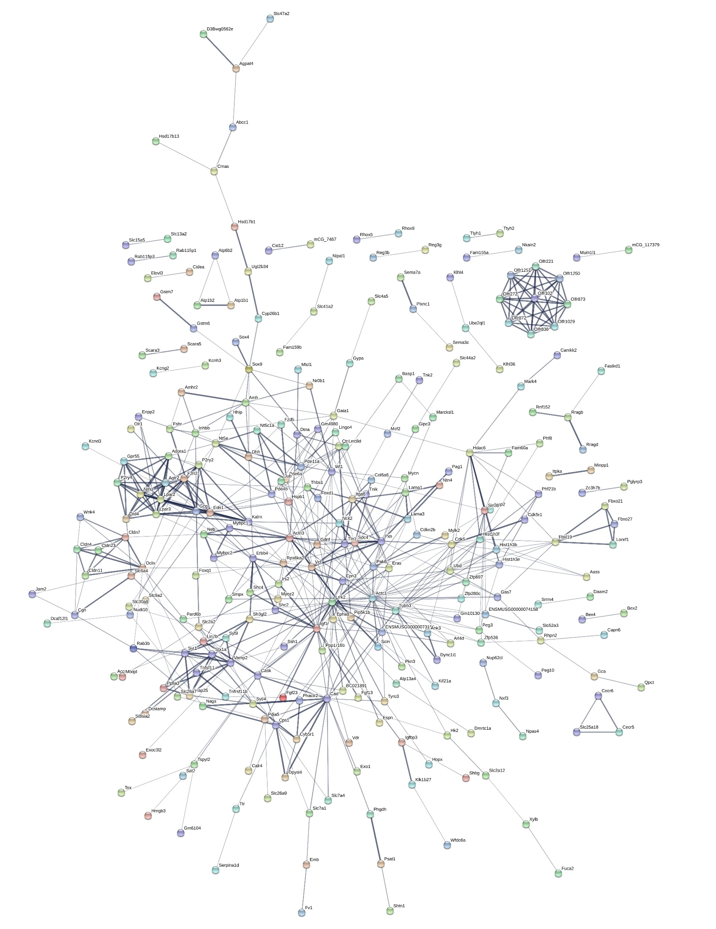
Additional File 7 Protein interaction networks associated with mouse Sertoli cell-specific transcripts using the STRING database. Each circle represents a protein (node) and each line (edge) represents a protein-protein association. Only nodes which are connected are shown. The line colour and thickness indicate the type of interaction evidence and the strength of data support. A combination score >0.4 was set as the reliability threshold for network construction. The network contains 509 nodes and 501 edges.

