Slide 1
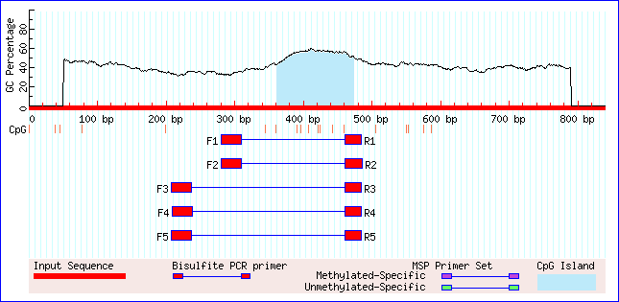
Notes:
Additional file 6. Figure S2. ADAMTS12 predicted CpG island using Methprimer.

