Slide 1
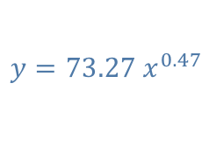

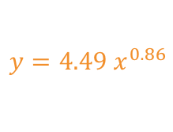
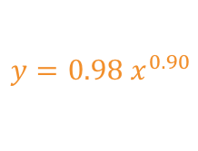

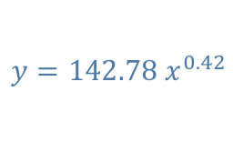
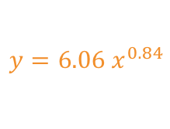
Supplementary Figure 6
y = Number of Plasmids Detected
x = Number of Input Plasmids
$$y=αx^{β}$$
a
b
c
CEP290 Locus
B2M Locus
TRAC Locus
different 𝛽 p-value = 0.06
different 𝛽 p-value = 6.9e-6
different 𝛽 p-value = 2.9e-6
$$y=0.98{ x}^{0.90}$$
$$y=6.06{ x}^{0.84}$$
$$y=4.49{ x}^{0.86}$$
$$y=22.98 x^{0.54}$$
$$y=142.78 x^{0.42}$$
$$y=73.27 x^{0.47}$$

