Slide 1
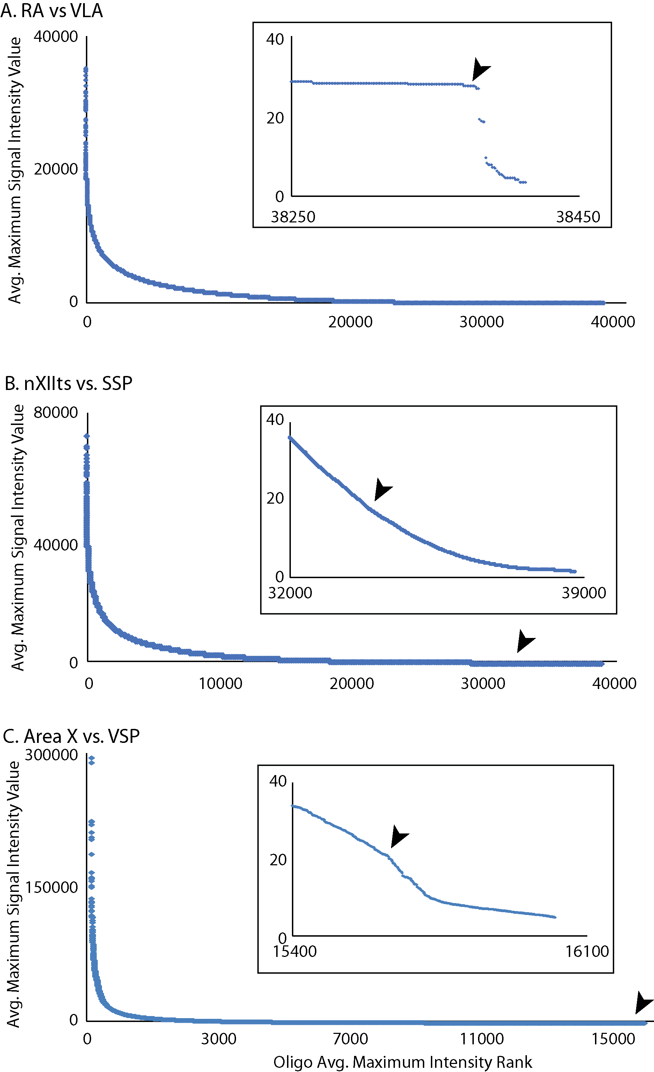
Figure S1

Slide 2
Figure S2
OPRL1

