Slide 1
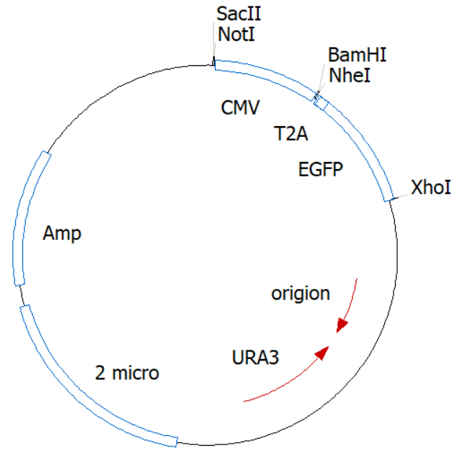
Fig. S1
JMB84-T2A-EGFP
Fig. S1 The map of JMB84-T2A-EGFP.

Slide 2
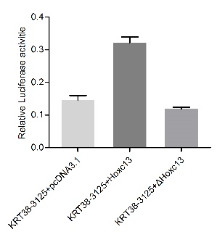
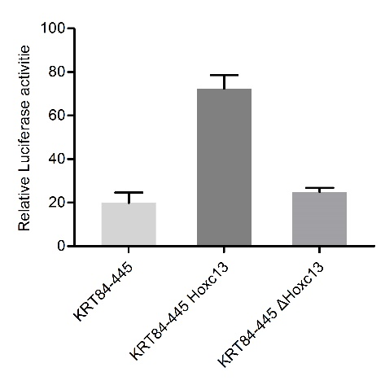
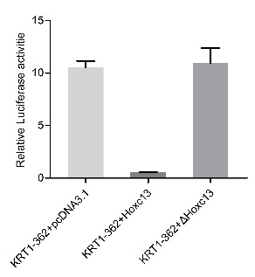
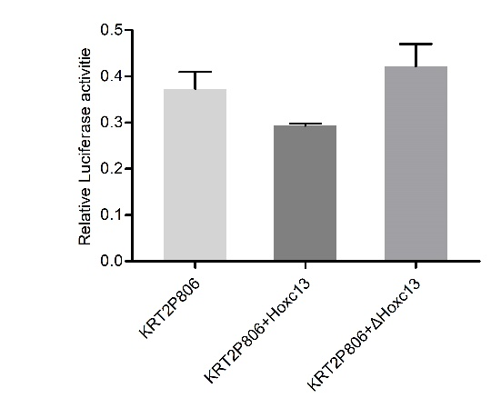
Fig. S2
*
*
*
*
*
*
*
Fig. S2 HOXC13 had an inconsistent regulation on the promoters of KRT1 and KRT2 compared with KRT84 and KRT38. (a-d) The regulatory role of HOXC13 on keratin promoters including KRT1, KRT2, KRT38 and KRT84. The corresponding KRT promoter-pGL3 basic vector, pRL-TK vector together with HOXC13 overexpression vector (wtHOXC13/ΔHOXC13) were co-transfected into 12-well HEK 293T cells, while the vector of ΔHOXC13 was used as a negative control. * P<0.05, **P<0.01.

Slide 3
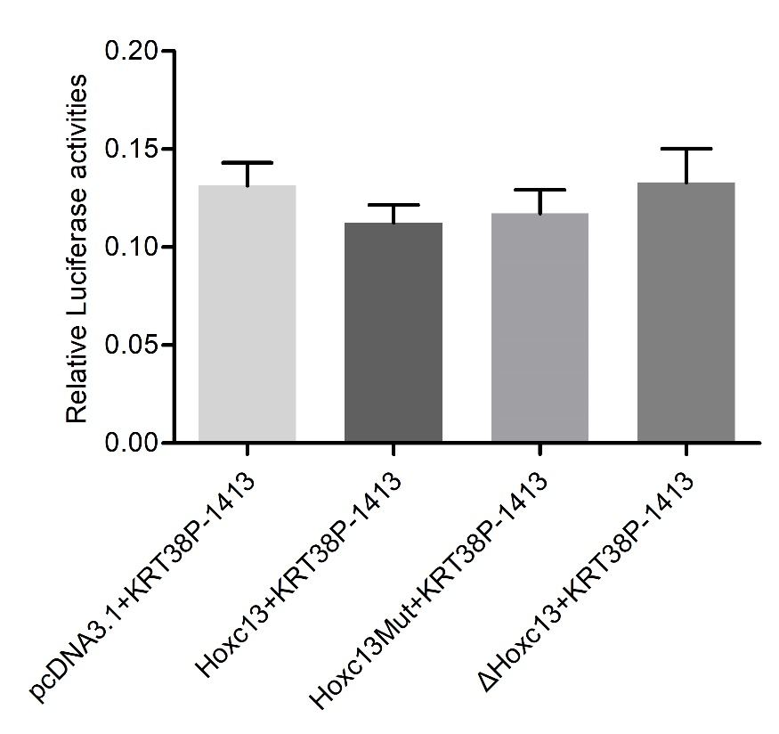
Fig. S3
Fig. S3 HOXC13 had no effect on the promoter of KRT38 (KRT38-1413). The vector of ΔHOXC13/ HOXC13 mut was used as a negative control.

Slide 4
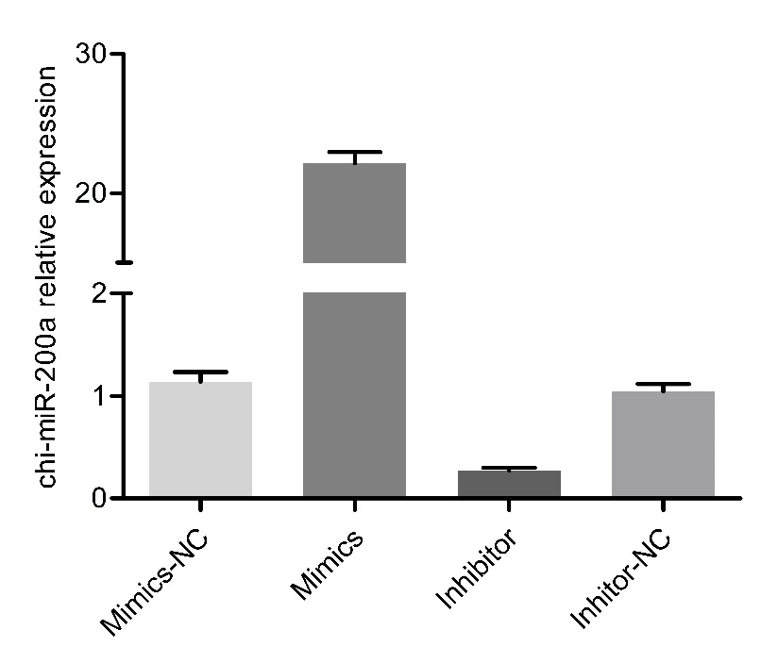
Fig. S4
*
*
*
*
Fig. S4 The relative expression of chi-miR-200a. The expression of chi-miR-200a was quantified relative to the expression level of U6 using the comparative cycle threshold (ΔCT) method. The data were expressed as the mean±1 SE (n=3). * P<0.05, **P<0.01.

Slide 5
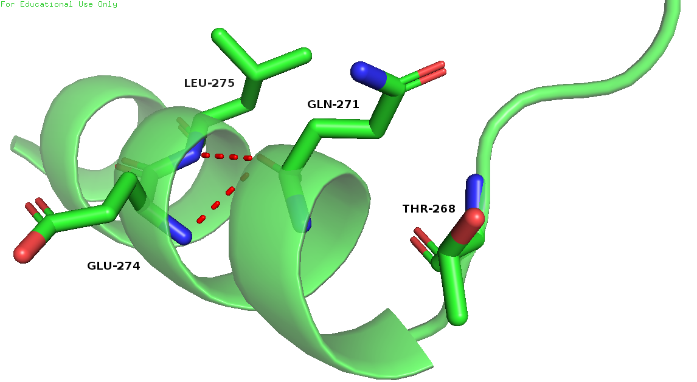
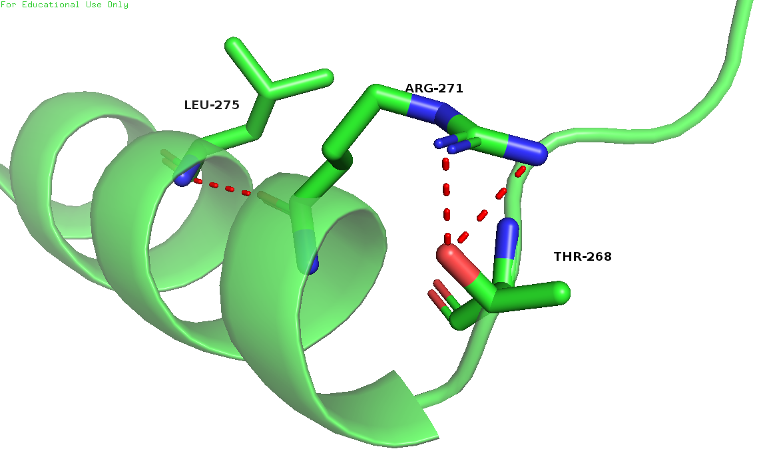
Fig. S5
Fig. S5 Prediction of tertiary structure on wide type of HOXC13 and mutational type of HOXC13 (HOXC13 812mut).

Slide 6
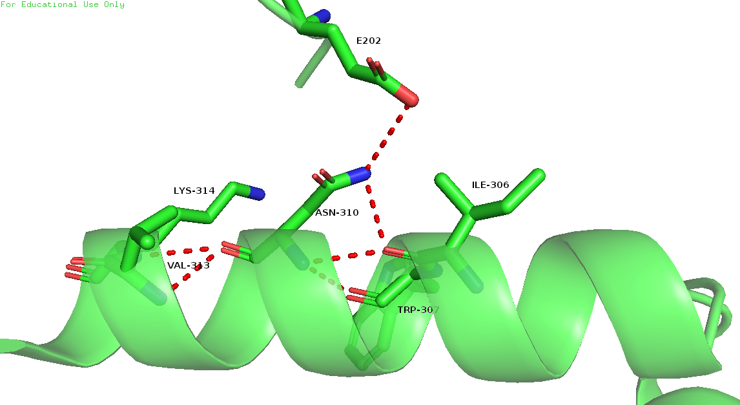
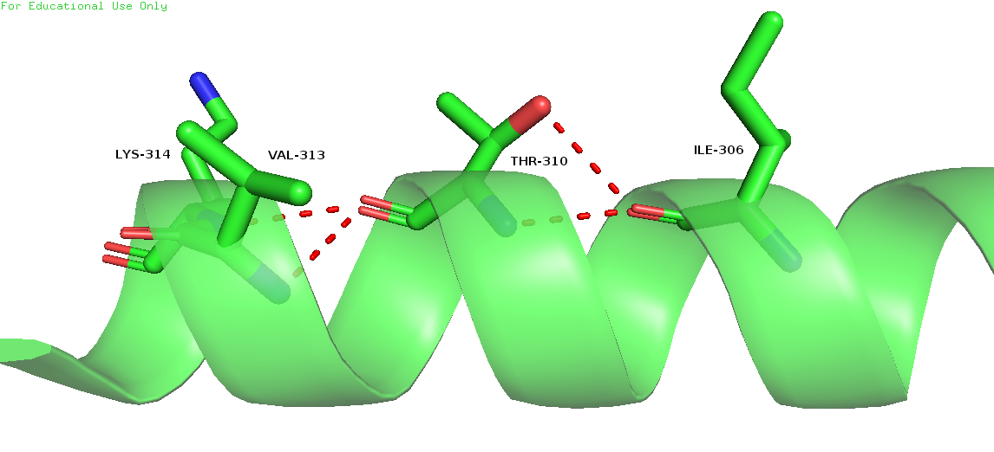
Fig. S6
Fig. S6 Prediction of tertiary structure on wide type of HOXC13 and mutational type of HOXC13 (HOXC13 929mut).

