Slide 1
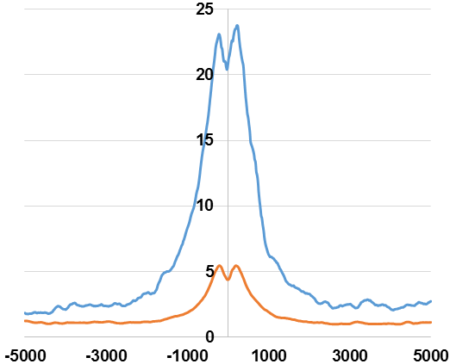
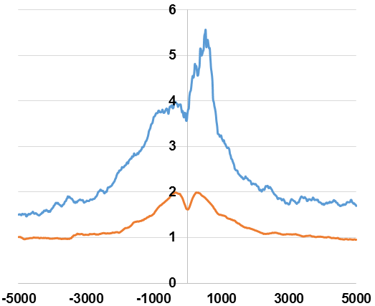
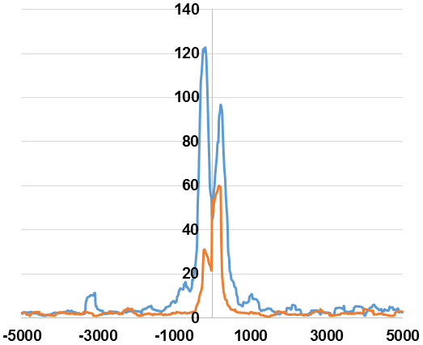
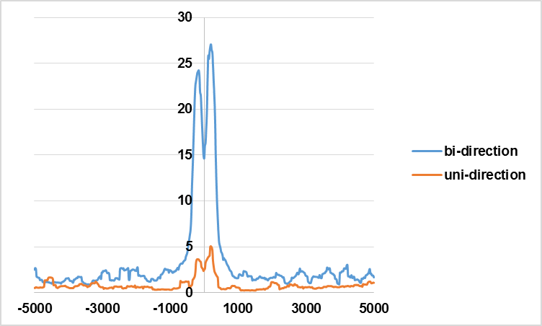
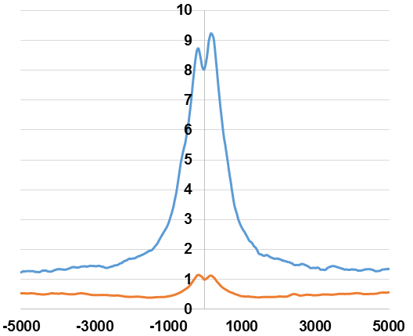
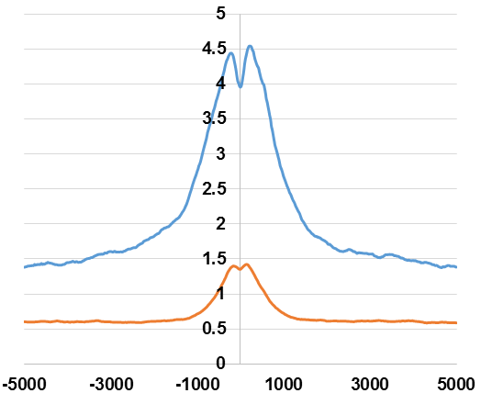
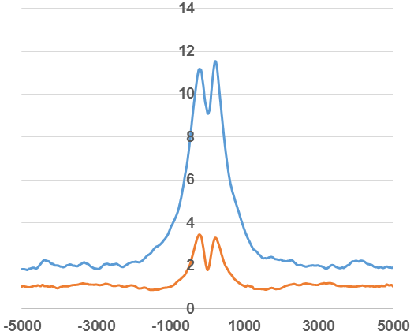
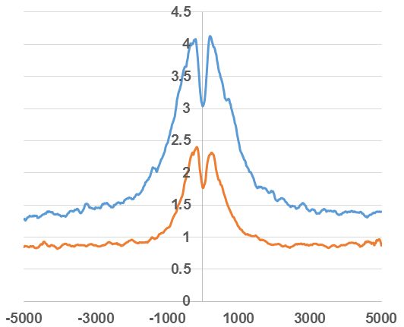
K562 GRO-seq
H3K27ac
H3K4me1
GRO-cap
Fragment per bp per peak
Distance to centers (bp)
K562 PRO-seq
H3K27ac
H3K4me1
GRO-cap
Fragment per bp per peak
Distance to centers (bp)
Mouse liver PRO-seq
H3K27ac
H3K4me1
Fragment per bp per peak
Distance to centers (bp)

