Slide 1
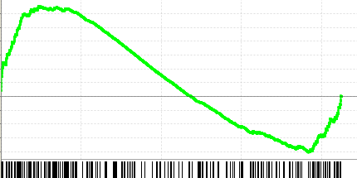
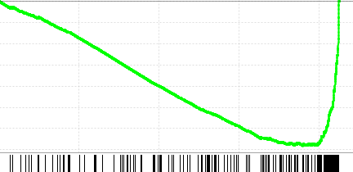
a
Polymerase density
b
gb up
892
gene body up regulated, P17
0.35
NES = 1.57
FDR = 0.0
Enrichment Score
0
- 0.2
gene body down regulated, P17
0
NES = -2.65
FDR = 0.0
gb down
1115
Enrichment Score
-0.4
- 0.7
gb up: up-regulated in gene body regions
gb down: down-regulated in gene body regions

