Slide 1
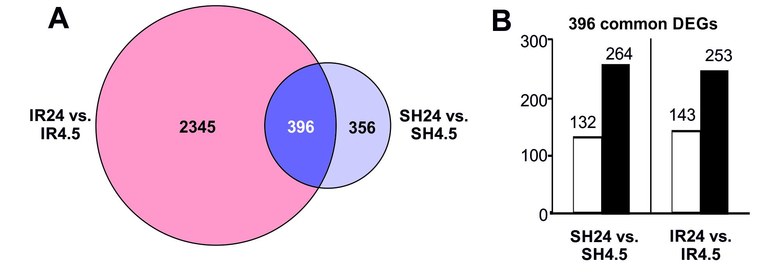
Fig. S1. RNA-Seq analysis of differentially expressed genes (DEGs) in tMCAO model conditions. There are RNA-Seq results in IR24 vs. IR4.5 and SH24 vs. SH4.5. A The numbers of DEGs overlapped in two pairwise comparisons: IR24 vs. IR4.5 and SH24 vs. SH4.5. B Diagrams showing DEGs that lie within the intersection of sets on the Venn diagrams A. The numbers of up- and down-regulated DEGs are indicated by white and black bars, respectively. The numbers placed above the bars indicate the number of DEGs. Genes with a change in expression >1.5-fold compared with the baseline value and with a Padj < 0.05 were selected for analysis.

