Slide 1
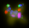
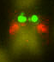
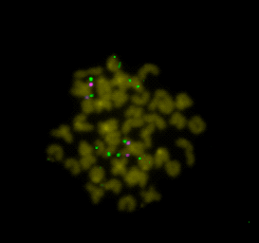
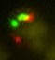
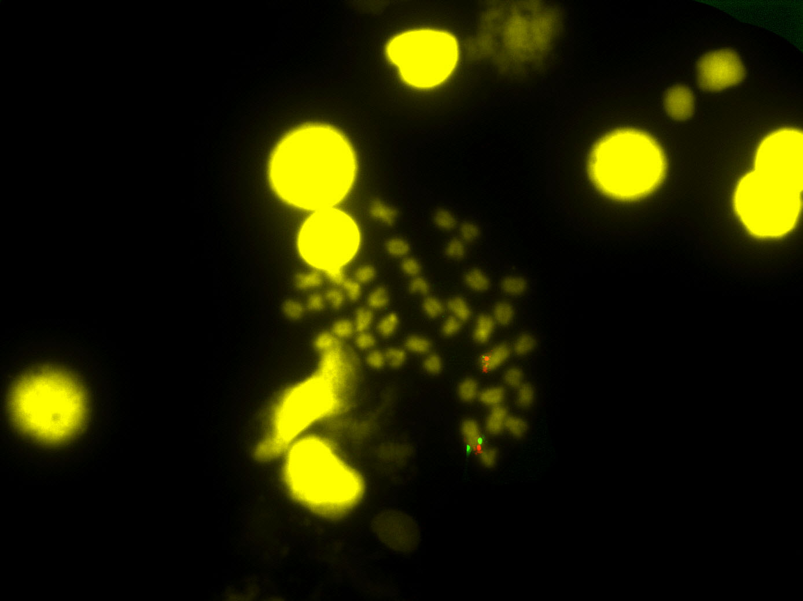
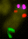
BMC Genomics
Evidence for a Robertsonian fusion in Solea senegalensis (Kaup, 1858) revealed by Zoo-FISH and comparative genome analysis
Aglaya García-Angulo¹, Manuel A. Merlo¹, Silvia Portela-Bens¹, María E. Rodríguez¹, Emilio García¹, Ahmed Al-Rikabi², Thomas Liehr², Laureana Rebordinos¹
Corresponding author: Laureana Rebordinos (laureana.rebordinos@uca.es). Área de Genética, Facultad de Ciencias del Mar y Ambientales, Universidad de Cádiz, 11510 Cádiz, Spain.
Additional file 1 Chromosome localization of the 13 BAC clones within the large metacentric chromsome of Solea senegalensis
BAC10L10
BAC13G1
BAC16E16
BAC5K5
BAC11O20
BAC48P7
BAC11O20
BAC12D22
BAC16E16
BAC5K5
BAC10L10
BAC73B7
BAC1C2
BAC12D22
BAC36D3
BAC52C17
BAC10L10
BAC36D3
BAC11O20
BAC73B7
BAC48P7
BAC48K7
BAC1C2
BAC56H24

