Slide 1
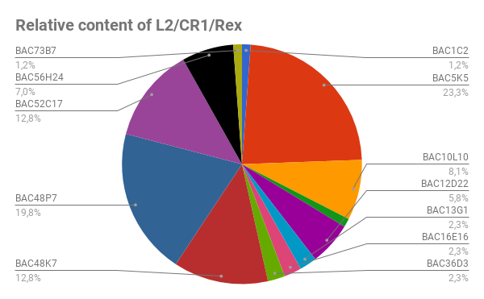
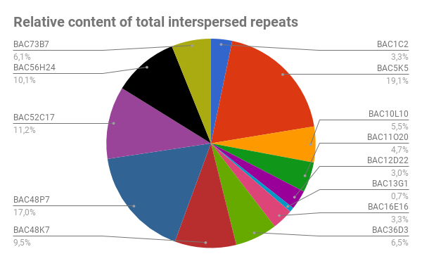
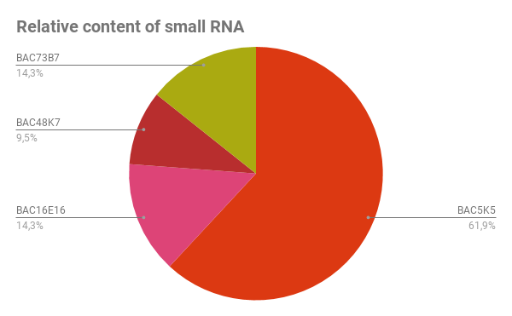
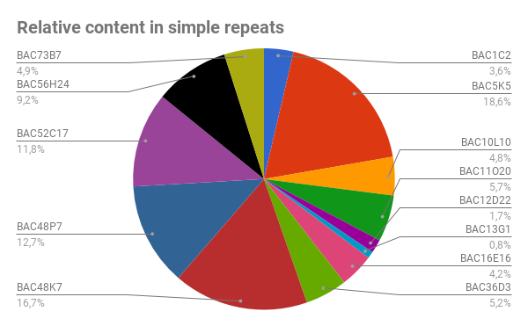
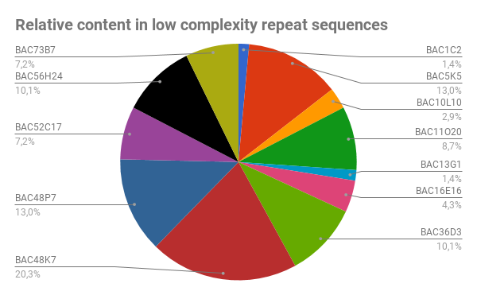
BMC Genomics
Evidence for a Robertsonian fusion in Solea senegalensis (Kaup, 1858) revealed by Zoo-FISH and comparative genome analysis
Aglaya García-Angulo¹, Manuel A. Merlo¹, Silvia Portela-Bens¹, María E. Rodríguez¹, Emilio García¹, Ahmed Al-Rikabi², Thomas Liehr², Laureana Rebordinos¹
Corresponding author: Laureana Rebordinos (laureana.rebordinos@uca.es). Área de Genética, Facultad de Ciencias del Mar y Ambientales, Universidad de Cádiz, 11510 Cádiz, Spain.
Additional file 3 Relative content in different repetitive elements within each BAC clone.

