Slide 1
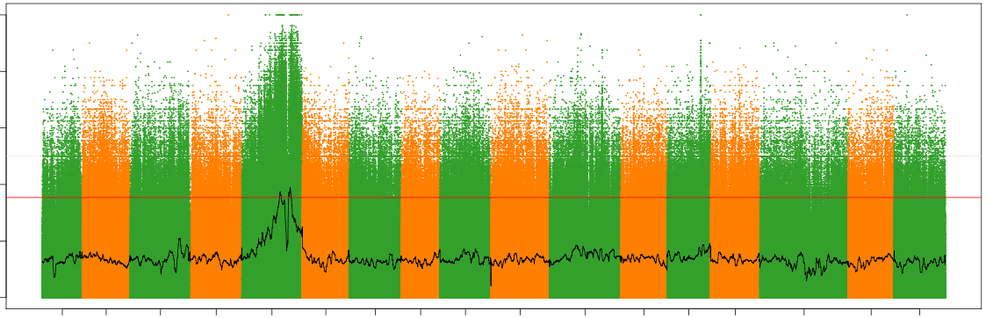
0.0 0.2 0.4 0.6 0.8 1.0
|∆(SNP-index)|
chr1 chr2 chr3 chr4 chr5 chr6 chr7 chr8 chr9 chr10 chr11 chr12 chr13 chr14 chr15 chr16 chr17
Chromosome

