Slide 1
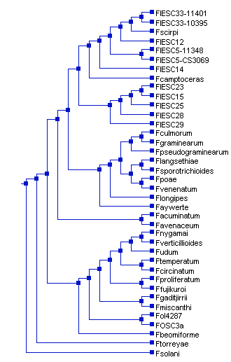
Species tree: inferred by majority rule consensus analysis of ML trees inferred from 30 housekeeping genes. The analysis was done using IQ-Tree

Slide 2
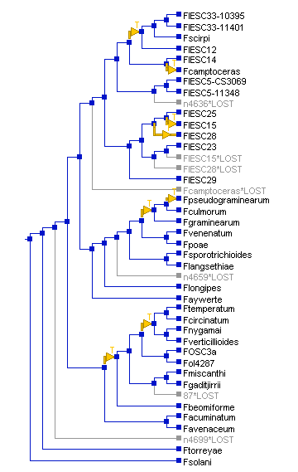
Reconciled NRPS1 tree

Slide 3
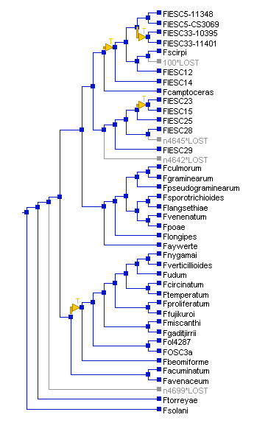
Reconciled NRPS2 tree

Slide 4
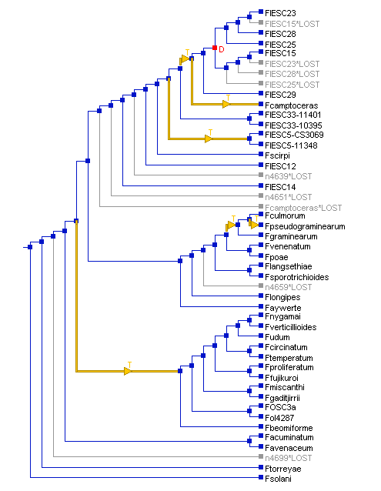
Reconciled NRPS3 tree

Slide 5
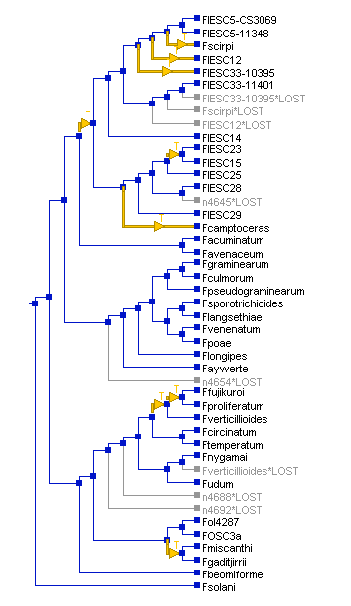
Reconciled NRPS4 tree

Slide 6
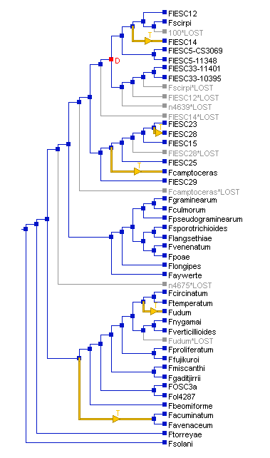
Reconciled NRPS6 tree

Slide 7
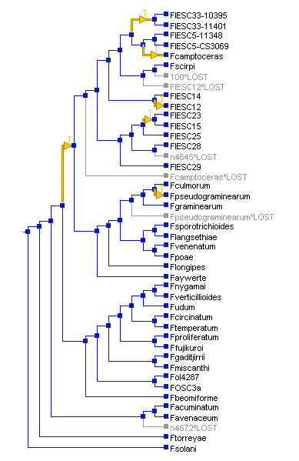
Reconciled NRPS10 tree

Slide 8
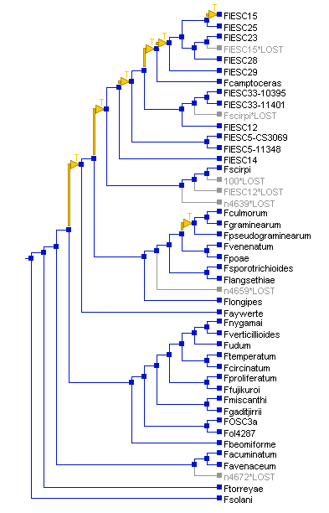
Reconciled NRPS11 tree

Slide 9
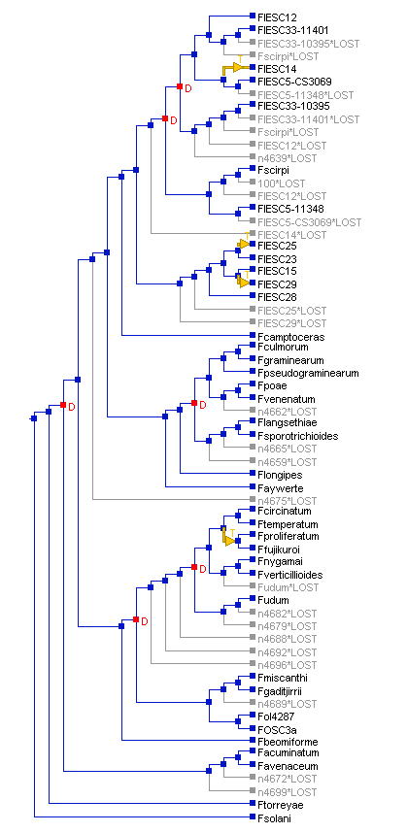
Reconciled NRPS12 tree
At default cost settings, no temporally feasible solutions were found. Therefore, the reconciliation analysis done using the following cost settings: Duplication 2; Transfer 5; and Loss 1.

Slide 10
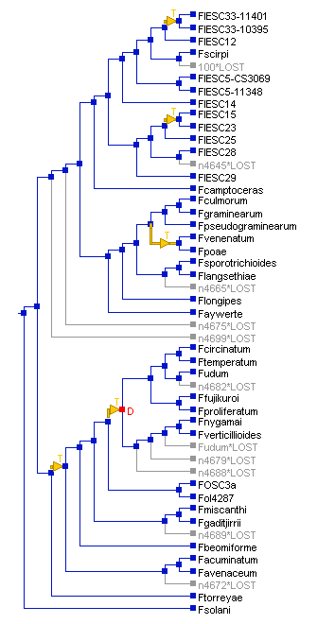
Reconciled NRPS13 tree

Slide 11
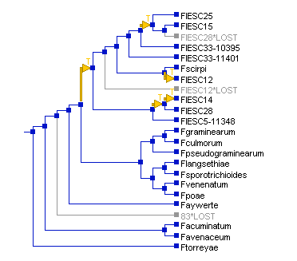
Reconciled NRPS14 tree

Slide 12
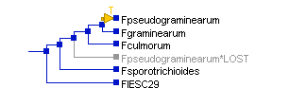
Reconciled NRPS15 tree

Slide 13
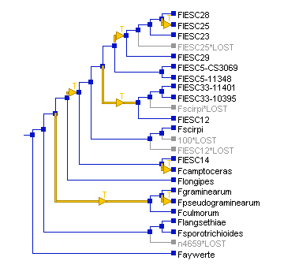
Reconciled NRPS16 tree

Slide 14
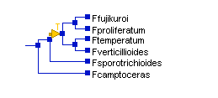
Reconciled NRPS17 tree

Slide 15
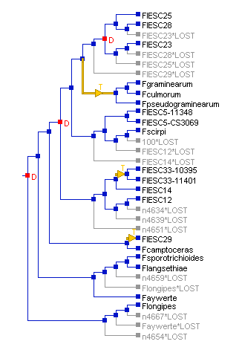
Reconciled NRPS19 tree
At default cost settings, no temporally feasible solutions were found. Therefore, the reconciliation analysis done using the following cost settings: Duplication 2; Transfer 5; and Loss 1.

Slide 16
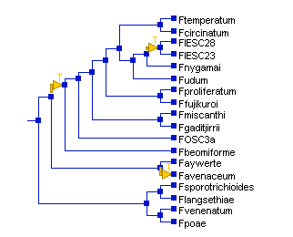
Reconciled NRPS22 tree

Slide 17
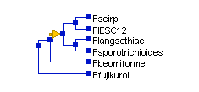
Reconciled NRPS31 tree

Slide 18
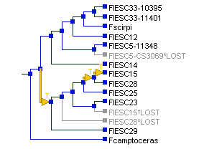
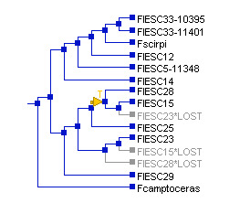
Reconciled NRPS33 tree

Slide 19
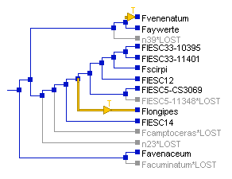
Reconciled NRPS34 tree

Slide 20
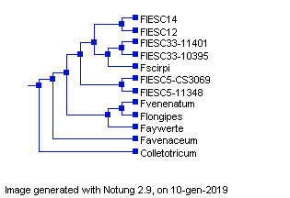
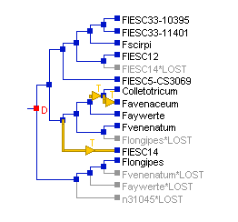
NRPS34
A second NOTUNG analysis for NRPS34 was done using the species tree shown below
Species tree
Reconciled NRPS34 tree

Slide 21
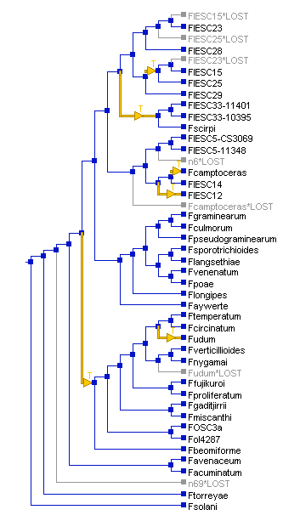
Reconciled PKS3 tree

Slide 22
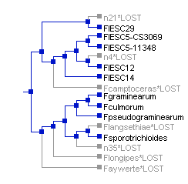
Reconciled PKS4 tree

Slide 23
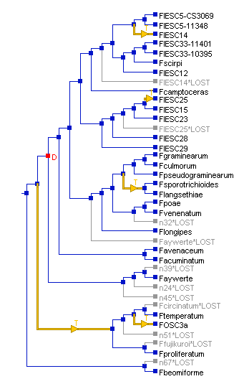
Reconciled PKS5 tree

Slide 24
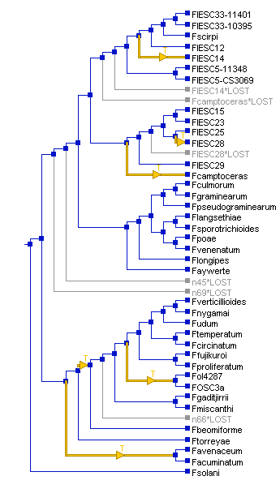
Reconciled PKS7 tree

Slide 25
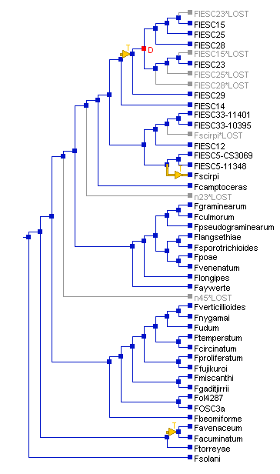
Reconciled PKS8 tree

Slide 26
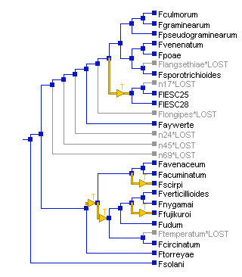
Reconciled PKS10 tree

Slide 27
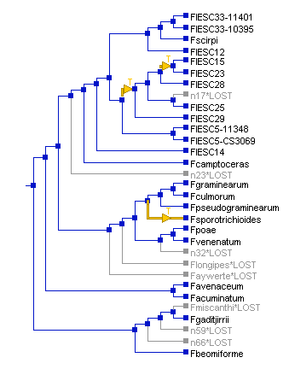
Reconciled PKS11 tree

Slide 28
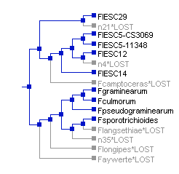
Reconciled PKS13 tree

Slide 29
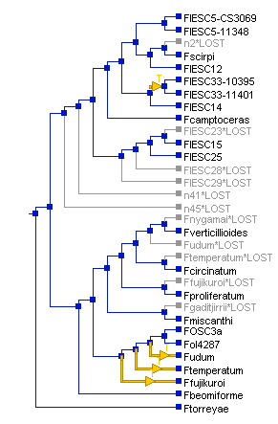
Reconciled PKS18 tree

Slide 30
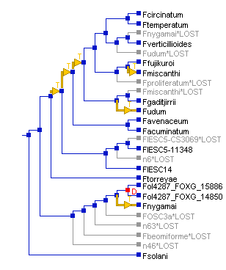
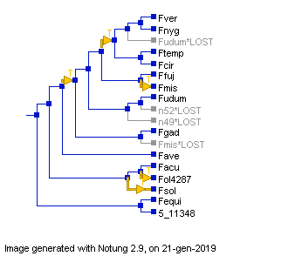
Reconciled PKS22 tree

Slide 31
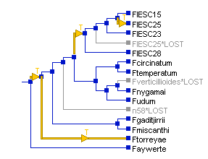
Reconciled PKS23 tree

Slide 32
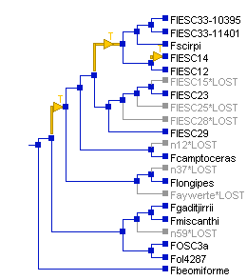
Reconciled PKS28 tree

Slide 33
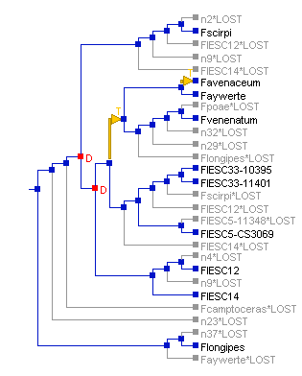
Reconciled PKS42 tree

Slide 34
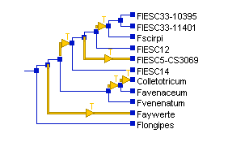
Reconciled PKS42 tree
A second NOTUNG analysis for NRPS34 was done using the species tree shown below.
Species tree
Reconciled PKS42 tree

Slide 35
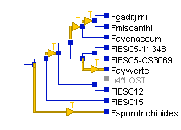
Reconciled PKS43 tree

Slide 36
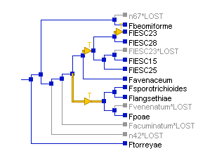
Reconciled PKS48 tree

Slide 37
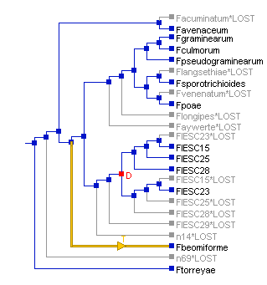
Reconciled PKS53 (and PKS14) tree

Slide 38
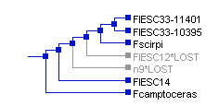
Reconciled PKS62 tree

Slide 39
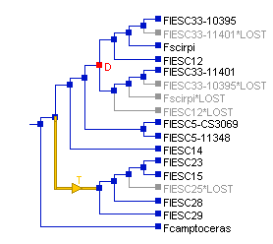
Reconciled PKS66 tree

Slide 40
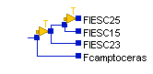
Reconciled PKS69 tree

