Slide 1
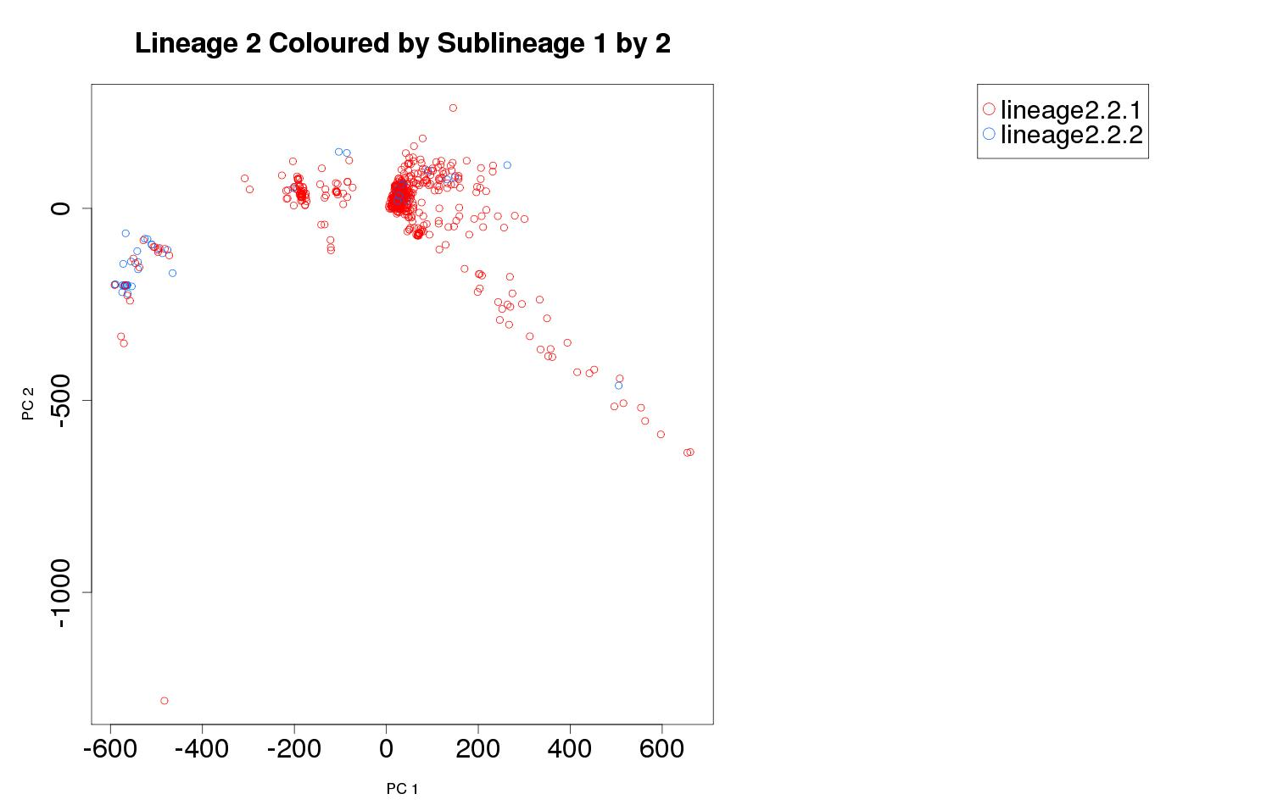
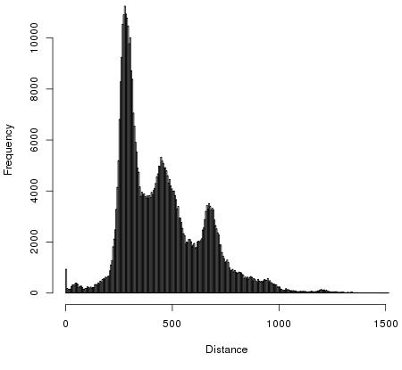
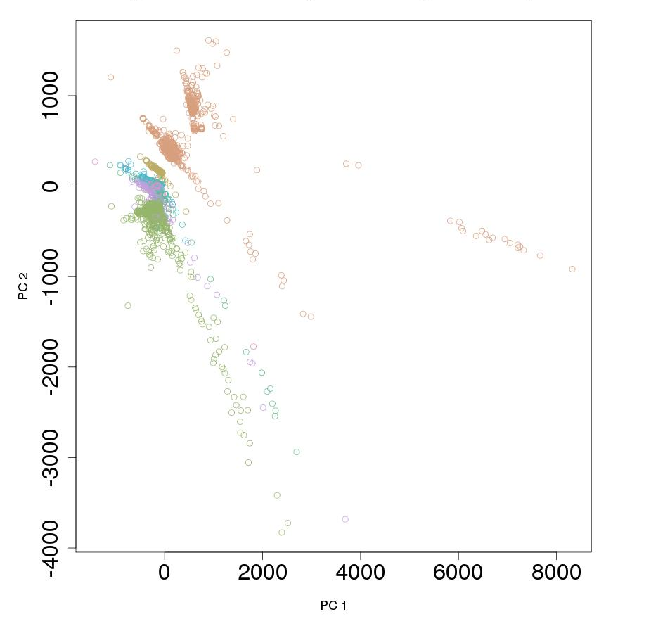
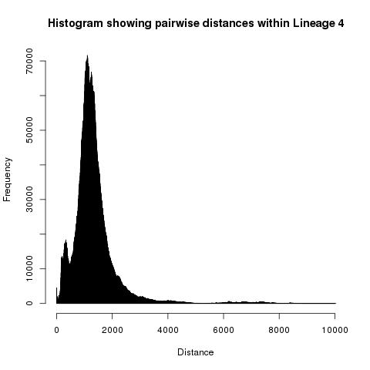
a
b
PC 2
Frequency
PC 1
Distance
c
d
PC 2
Frequency
PC 1
Distance
Population diversity within investigated strains.
a Principal component 1 (PC1) by principal component 2 (PC2) for lineage 2, The first 10 principal components account for 71.9% of the variation in lineage 2; b Distance plot for lineage 2 showing pairwise number of variant differences between samples; c Principal component 1 (PC1) by principal component 2 (PC2) for lineage 4, the first 10 principal components account for 88.9% of the variation in lineage 4. d Distance plot for lineage 2 showing pairwise number of variant differences between samples.

