Slide 1
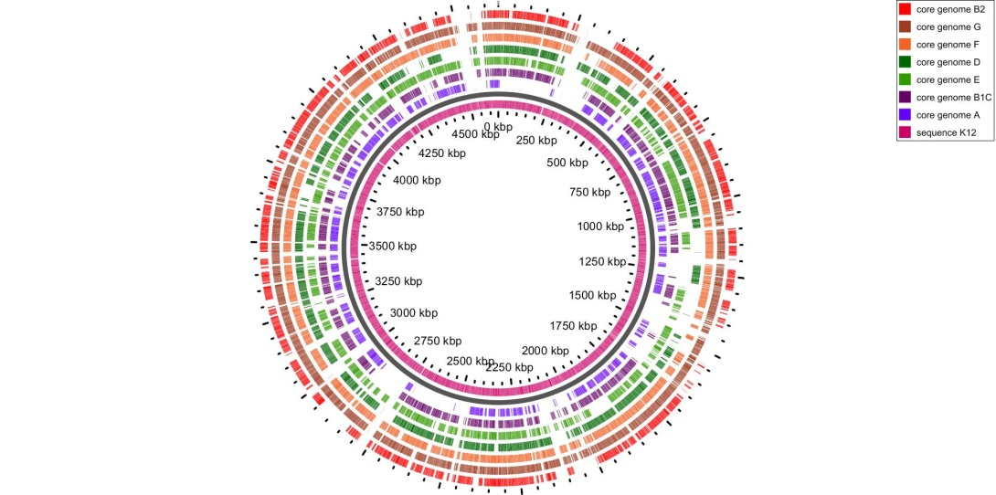
A)
E. coli genome
B)
core genome
accessory genome
Phylogroups E. coli specialization
Maximum E. coli expansion
Phylogroups E. coli differentiation
Phylogroups E. coli expansion
E. coli diversification
Phylogroups E. coli specialization
Ancestral E. coli
138
genes
740-2714 genes
834
genes
:
+
2,298
+
15,604 genes
core genome phylogroup B2
2,204
Escherichia
genus-core genome
(189 genes)
Phylogroup E. coli
core genome
(1,763-3,737 genes)
core genome phylogroup G
:
3,737
1,109
8,355 genes
+
+
core genome phylogroup F
:
2,688
+
3,804
+
8,471 genes
core genome phylogroup D
:
2,619
+
2,333
+
12,814 genes
E. coli
specie-core genome
(1,023 genes)
core genome phylogroup E
:
2,337
+
1,566
+
13,325 genes
minimal genome
(bacteria-core genome)
(51 genes)
core genome phylogroup B1
:
1,986
+
(*)
+
21,039 genes
core genome phylogroup A
:
1,763
+
(*)
+
20,950 genes
Figure S2. A) Distribution of E. coli genes used in the different evolutionary steps. E. coli genome was differentiated in core and accessory genome. The number of genes used in the different layers are shown. The layers related to the most ancestral events (core genome) are shown in soft colors, whereas the recent events (accessory genome) are shown in blue colors (sky, royal and navy blue). The sky blue oval corresponding to phylogroup-core genome which is a core genome for phylogroups but is not E. coli core genome senso strict. The royal blue oval correspond to core genome for the different sub-phylogroups (main lineages into each phylogroup) and nave blue oval corresponds to those genes inconsistently found (phylogroup-accessory genome). The genes belonging to phylogroup-accessory genome are contributing to opened pangenome in E. coli. The estimation of E. coli pangenome was inferred using the 327 complete sequences. ^{(*)}Currently, the members of phylogroups A and B1 could not classified in subphylogroups. B) Circular maps of core genome of different phylogroups. The inner ring corresponds to E. coli K2 used as reference strain. The successive rings correspond to the core genome for phylogroup A, phylogroup B1, phylogroup E, phylogroup D, phylogroup F, phylogroup G and phylogroup B2 in the most external ring.

