Slide 1
Fig. S1. Comparison of the IR border regions of the Asteraceae plastomes.
Tribe
Species (Genbank Acc.)
218-219 bp
60-61 bp
556-558 bp
35-72 bp
4431-4479 bp
556-558 bp
60-61 bp
8-11 bp
Anthemideae
Artemisia taxa
LSC : 82622-83061 bp
rps19
IRa : 24948-24985 bp
ψycf1
ndhF
SSC : 18267-18348 bp
ycf1
IRb : 24948-24985 bp
ψrps19
trnH
LSC
219 bp
60 bp
558 bp
61-75 bp
4506 bp
558 bp
60 bp
9 bp
A. frigida
(2)
LSC : 82740-82790 bp
rps19
IRa : 24951-24972 bp
ψycf1
ndhF
SSC : 18392-18411 bp
ycf1
IRb : 24951-24972 bp
ψrps19
trnH
LSC
212 bp
67 bp
558 bp
56 bp
4475-4476bp
558 bp
67 bp
3 bp
A. selengensis
(3)
LSC : 82920-82948 bp
rps19
IRa : 24964 bp
ψycf1
ndhF
SSC : 18367-18385 bp
ycf1
IRb : 24964 bp
ψrps19
trnH
LSC
219 bp
60 bp
556 bp
48 bp
4450bp
556 bp
60 bp
9 bp
Chrysanthemum boreale
(NC037388)
LSC : 82815 bp
rps19
IRa : 24958 bp
ψycf1
ndhF
SSC : 18281 bp
ycf1(ψ)
IRb : 24958 bp
ψrps19
trnH
LSC
219 bp
60 bp
564 bp
50 bp
4500bp
564 bp
60 bp
5 bp
Astereae
Diplostephium azureum
(NC034882)
LSC : 83941 bp
rps19
IRa : 25018 bp
ψycf1
ndhF
SSC : 18147 bp
ycf1
IRb : 25018 bp
ψrps19
trnH
LSC
183 bp
96 bp
576 bp
63 bp
4455 bp
576 bp
96 bp
8 bp
Heliantheae
Ambrosia trifida
(NC036810)
LSC : 83964 bp
rps19
IRa : 25091 bp
ψycf1
ndhF
SSC : 17894 bp
ycf1
IRb : 25091 bp
ψrps19
trnH
LSC
183 bp
96 bp
565 bp
35 bp
4475 bp
565 bp
100 bp
5 bp
LSC : 83619 bp
rps19
IRa : 25077 bp
ψycf1
ndhF
SSC : 18158 bp
ycf1
IRb : 25081 bp
ψrps19
trnH
LSC
Echinacea angustifolia
(NC034324)
177 bp
102 bp
576 bp
70 bp
4542 bp
576 bp
102 bp
0 bp
LSC : 83528 bp
rps19
IRa : 24634 bp
ψycf1
ndhF
SSC : 18308 bp
ycf1
IRb : 24634 bp
ψrps19
trnH
LSC
Helianthus annuus
(NC007977)
177 bp
102 bp
904 bp
65 bp
4220 bp
904 bp
102 bp
1 bp
Helenieae
Marshallia caespitosa
(NC042611)
LSC : 84010 bp
rps19
IRa : 25436 bp
ψycf1
ndhF
SSC : 17878 bp
ycf1
IRb : 25436 bp
ψrps19
trnH
LSC
223 bp
56 bp
566 bp
22 bp
4726 bp
566 bp
56 bp
4 bp
Cardueae
Atractylodes chinensis
(NC037484)
LSC : 84283 bp
rps19
IRa : 25147 bp
ψycf1
ndhF
SSC : 18681 bp
ycf1
IRb : 25147 bp
ψrps19
trnH
LSC
219 bp
60 bp
56 7bp
-16 bp
4749 bp
567 bp
60 bp
4 bp
Cynara humilis
(NC027113)
LSC : 83622 bp
rps19
IRa : 25156 bp
ψycf1
ndhF
SSC : 18651 bp
ycf1
IRb : 25156 bp
ψrps19
trnH
LSC
217 bp
62 bp
472 bp
4 bp
4544 bp
472 bp
62 bp
10 bp
Cichorieae
Cichorium intybus
(NC043842)
LSC : 84232 bp
rps19
IRa : 25091 bp
ψycf1
ndhF
SSC : 18561 bp
ycf1
IRb : 25091 bp
ψrps19
trnH
LSC
217 bp
62 bp
567 bp
13 bp
4512 bp
567 bp
62 bp
6 bp
Senecioneae
Dendrosenecio battiscombei
(NC036833)
LSC : 83368 bp
rps19
IRa : 24713 bp
ψycf1
ndhF
SSC : 17762 bp
ycf1
IRb : 24713 bp
ψrps19
trnH
LSC

Slide 2
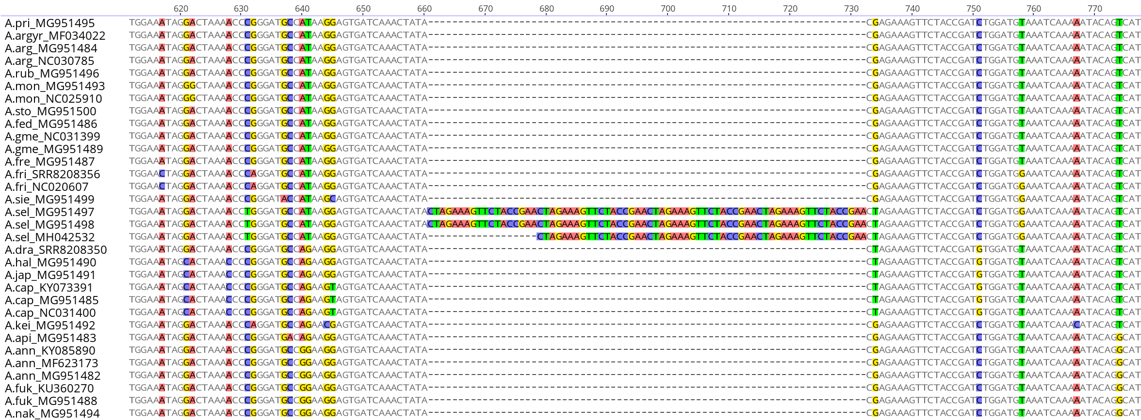
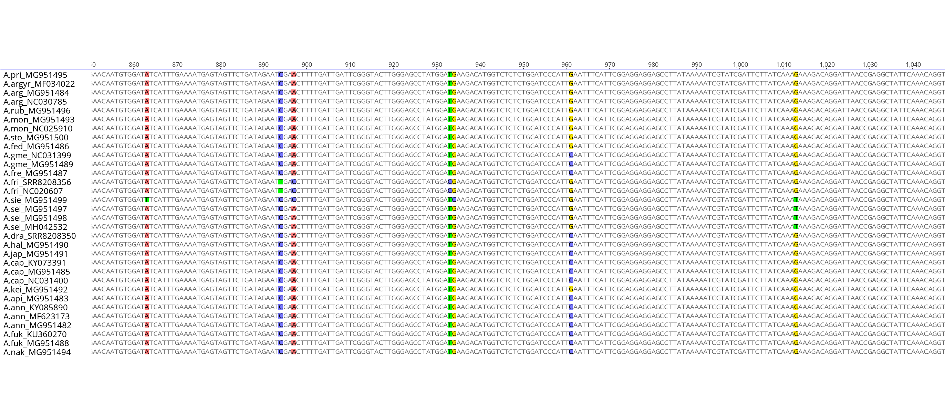
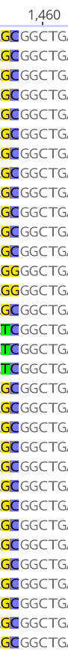
Fig. S2. Multiple alignments of accD coding sequences in the 32 Artemisia plastomes showing hotspots of nucleotide sequence diversity. Eight positively selected amino acid substitutions are indicated by red triangles. The core hotspot of 276 bp in length (616−963 bp over the gapped alignment) is indicated by arrows.
Taxa (accession)
Consensus
amino acids
G
N
R
T
K
T
R
D
A
I
R
S
D
Q
T
I
276 bp hot-spot region (616−963 bp)
R
E
S
S
T
D
L
D
V
N
Q
K
Y
S
H
I
E
Q
R
A
A

Slide 3
Fig. S3. A ML tree based on the whole plastomes of 32 Artemisia taxa. Bootstrap values are indicated on the nodes. Colored lines and braces at the right of the tree indicate section and subgenus names of Artemisia, respectively, that include taxa.
A.pri MG951495
Sect. Artemisia
100
A. argyrophylla MF034022
97
A.arg NC030785
39
76
A.arg MG951484
50
A.rub MG951496
100
A.mon MG951493
100
100
A.mon NC025910
A.sto MG951500
Subgenus
Artemisia
A.fed MG951486
100
100
A.gme NC031399
Sect. Abrotanum
100
A.gme MG951489
63
A.fre MG951487
84
A.sie MG951499
Sect. Absinthium
100
A.fri NC020607
100
A.fri SRR8208356
100
100
A.sel MG951497
A.sel MG951498
100
A.sel MH042532
A.dra SRR8208350
100
A.hal MG951490
Sect. Latilobus
100
A.jap MG951491
Subgenus
Dracunculus
100
100
A.cap KY073391
A.cap MG951485
Sect. Dracunculus
100
A.cap NC031400
A.kei MG951492
A.api MG951483
62
100
A.ann KY085890
96
A.ann MF623173
Subgenus
Artemisia
83
A.ann MG951482
100
A.fuk KU360270
100
A.fuk MG951488
A.nak MG951494
A.spa NC027434
0.0005

Slide 4
Fig. S4. A ML tree of ycf1 in the Asteraceae family. Taxa belonging to the same supertribe or subfamily are grouped.
Subfamily
Cichorioideae
Cichorieae
Subfamily
Carduoideae
Supertribe
Senecionodae
99
Cardueae (Cynareae)
100
100
96
Senecioneae
100
Supertribe
Helianthodae
87
100
100
38
Helenieae
100
97
Inuleae
100
100
100
100
92
100
Millerieae
Eupatorieae
Madieae
Gnaphalieae
100
100
100
82
100
51
100
100
75
100
66
Helentheae
100
100
37
90
100
56
Subfamily
Asteroideae
100
100
99
99
Supertribe
Asterodae
Anthemideae
100
Astereae
0.02

Slide 5
Fig. S5. A ML tree of accD in the Asteraceae family. Taxa belonging to the same supertribe or subfamily are grouped.
Subfamily
Cichorioideae
Cichorieae
Subfamily
Carduoideae
Cardueae
(Cynareae)
Anthemideae
Subfamily
Asteroideae
Supertribe
Senecionodae
90
Gnaphalieae
Senecioneae
100
100
100
65
100
96
100
Supertribe
Asterodae
100
100
100
42
43
88
89
97
75
53
Millerieae
Eupatorieae
Madieae
91
100
100
52
100
97
56
Helentheae
100
99
Astereae
Inuleae
97
Supertribe
Helianthodae
Helenieae
0.007

Slide 6
Fig. S6. Performances of accD and ycf1 in identifying the Asteraceae taxa using BLAST search. Hits with 100% identity were counted into two categories, unique hit and cross-hit to other species or tribe(s).

Slide 7
Fig. S7. A ML tree based on the accD-1k+ycf1b marker sequences of 32 Artemisia taxa. Bootstrap values are indicated on the nodes.
92
A.mon NC025910
A.mon MG951493
A.fed MG951486
A.arg MG951484
74
68
A.argyr MF034022
A.arg NC030785
A.pri MG951495
84
A.rub MG951496
A.sto MG951500
73
A.gme MG951489
A.gme NC031399
65
A.fre MG951487
59
100
A.fri SRR8208356
85
A.fri NC020607
A.sie MG951499
55
A.sel MG951497
100
A.sel MG951498
A.sel MH042532
A.dra SRR8208350
63
98
A.hal MG951490
94
A.jap MG951491
100
A.cap NC031400
81
69
A.cap MG951485
78
A.cap KY073391
A.kei MG951492
0
A.api MG951483
A.ann KY085890
A.ann MF623173
87
A.ann MG951482
A.fuk KU360270
89
A.fuk MG951488
A.nak MG951494
Aster spathulifolius (NC 027434)
0.005

