Slide 1
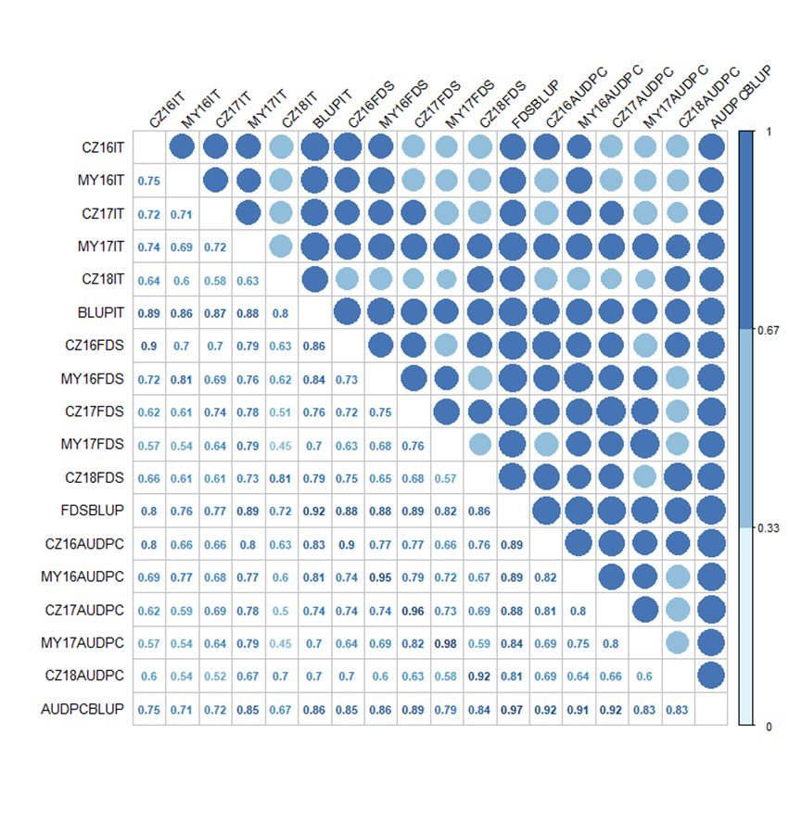
Additional file 2
Additional file 2 Pearson's correlation coefficients for infection type (IT), final disease severity (FDS) and area under the disease progress curve (AUDPC) against stripe rust evaluated among five environments during 2016 to 2018. Different environments were all correlated, Significant at P < 0.01.

