Slide 1
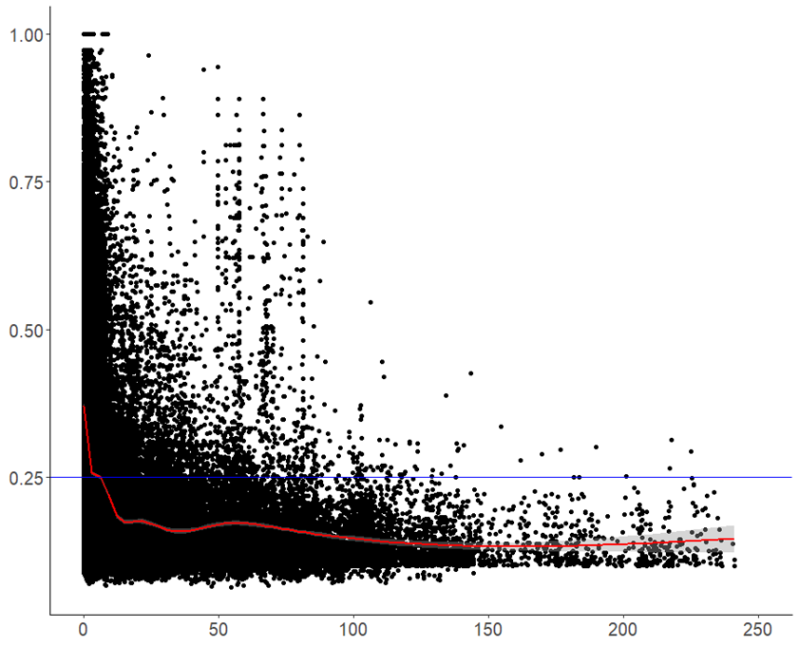
Additional file 4
Additional file 4 Genome-wide average linkage disequilibrium (LD) decay plot for 143 wheat landraces based on 5899 DArT markers. The scatter plots showing pairwise DArT markers LD r² value as a function of inter-marker genetic distances (cM).

