Slide 1
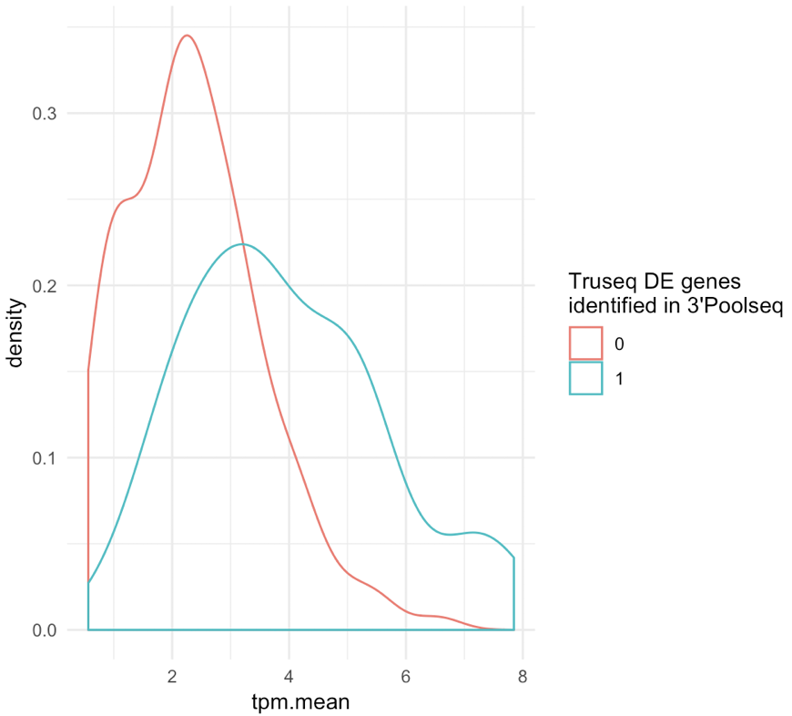
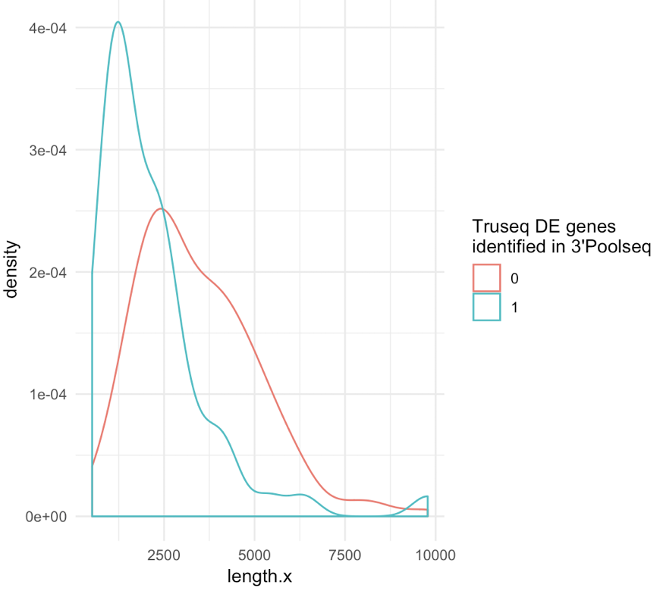
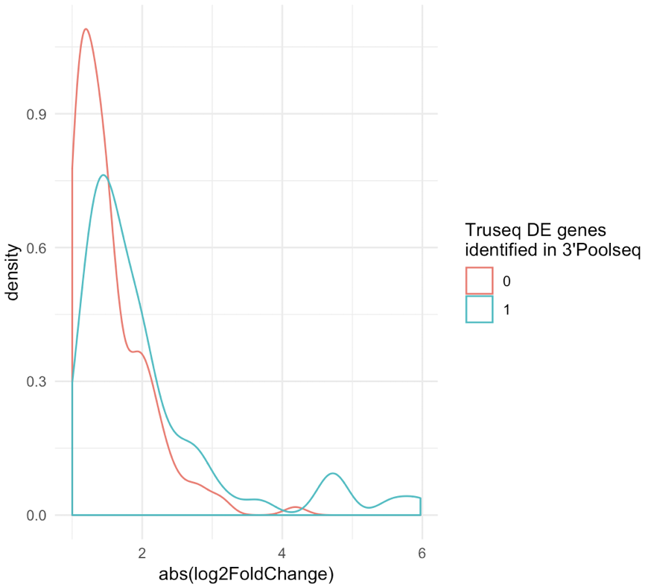
A.
Differentially Detected Genes
TruSeq
3’Pool-seq
TruSeq hits: qval<0.05, absolute(log₂FC >1)
3’Pool-seq: qval<0.1, absolute(log₂FC >1.5)
140
54
33
B.
Density
Density
Density
Mean TPM
Length (base-pairs)
Absolute (log₂ Fold-Change)

