Slide 1
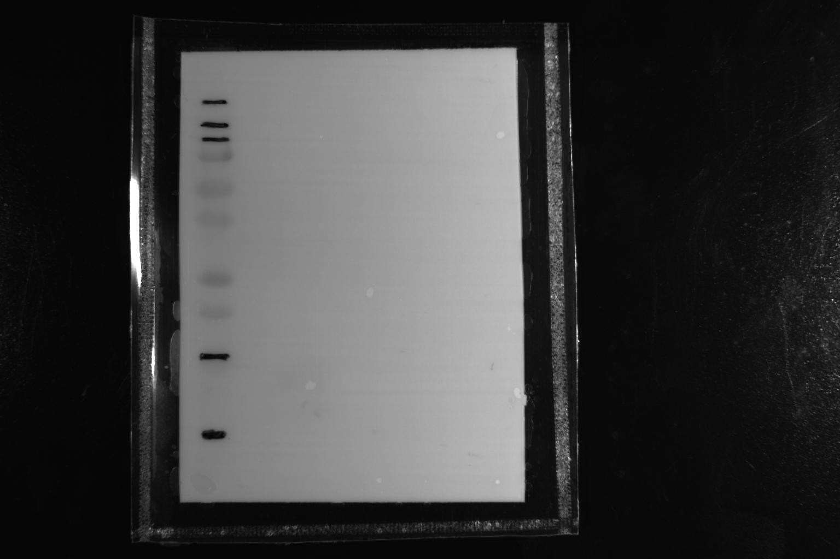
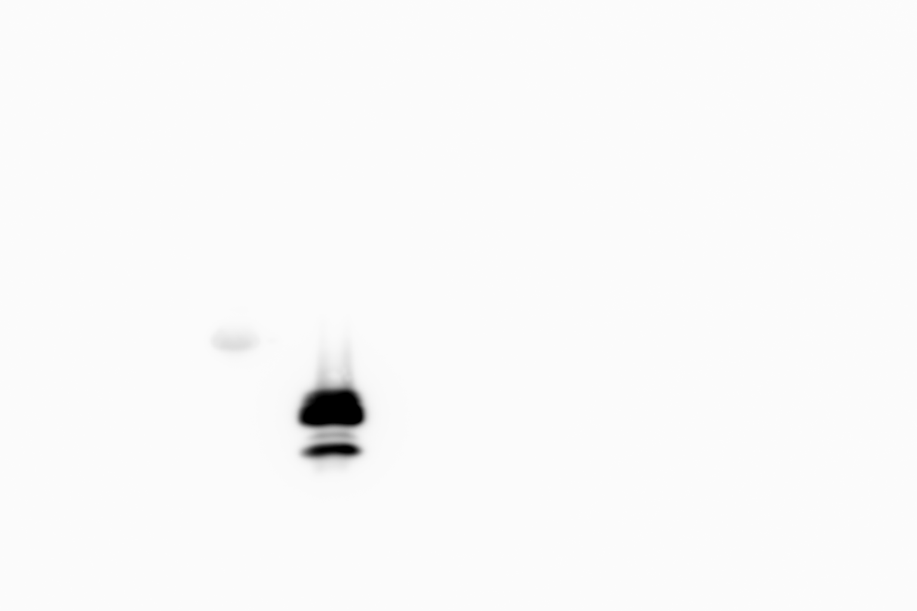
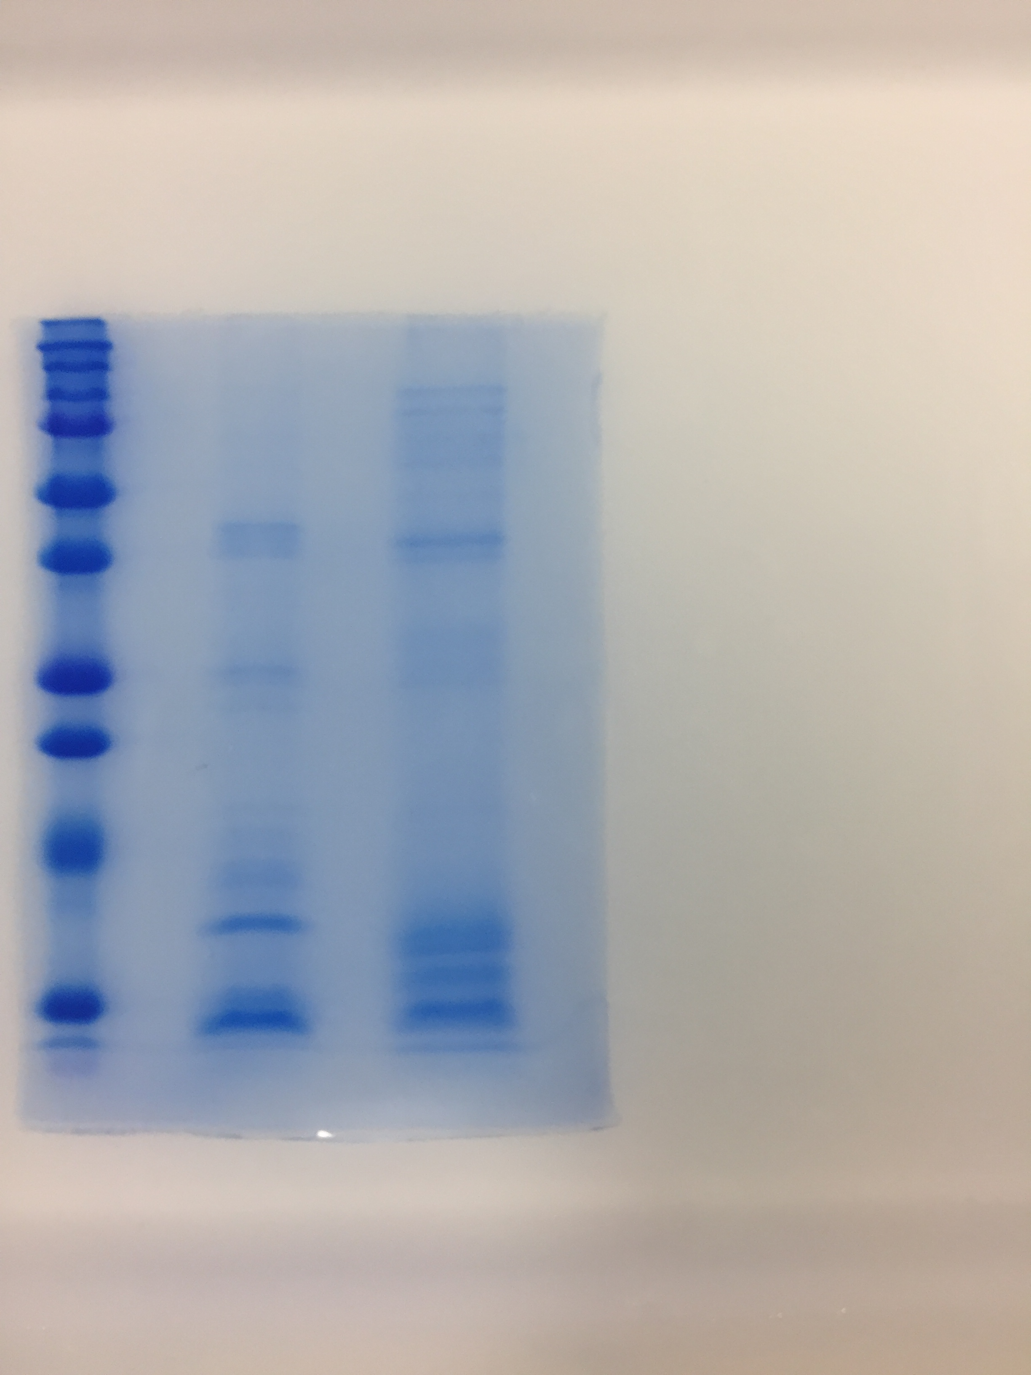
Additional File 11. Supplemental Figure 6.
(a)
(b)
(c)
(d)
kDa
Marker
C. latifolia
C. capitulata
kDa
Marker
C. latifolia
C. capitulata
kDa
Marker
C. latifolia
C. capitulata
kDa
Marker
C. latifolia
C. capitulata
250
250
250
150
150
150
100
100
100
75
75
75
50
50
50
37
37
37
25
25
25
20
20
20
20
15
NAS13kDa
15
NAS13kDa
15
NBS11kDa
NBS11kDa
10
10
10
Original pictures of Fig. 7. (a) CBB staining gel. (b) PVDF membrane after reaction under bright field. (c) Immunoblotting membrane reacted with ECL. The signals were detected at 428 nm with the exposure time of 20 s. (d) Overlay image of (b) and (c).

