Slide 1
Figure S1. Average linkage disequilibrium (r²) values plotted against intermarker distance for all chromosomes. X axis, distance between single nucleotide polymorphisms (SNPs); Y axis, r² values between SNPs.

Slide 2
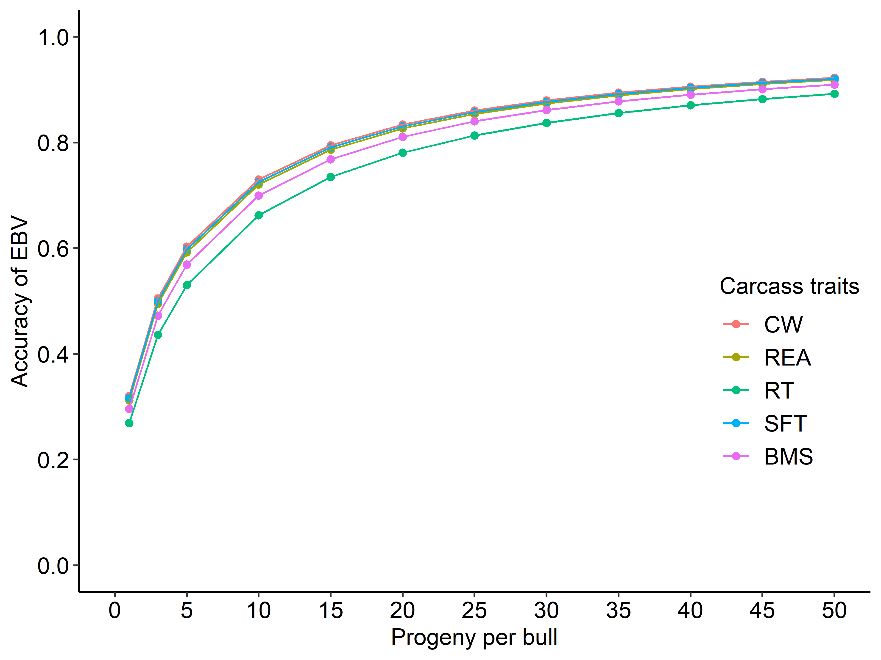
Figure S2. Accuracy of estimated breeding values (EBVs) for carcass traits with heritability estimates.
We calculated EBVs according to Mrode (2005). X axis, number of progenies per candidate bull. Y axis, accuracy of EBV calculated from numbers of progenies and heritability.

Slide 3
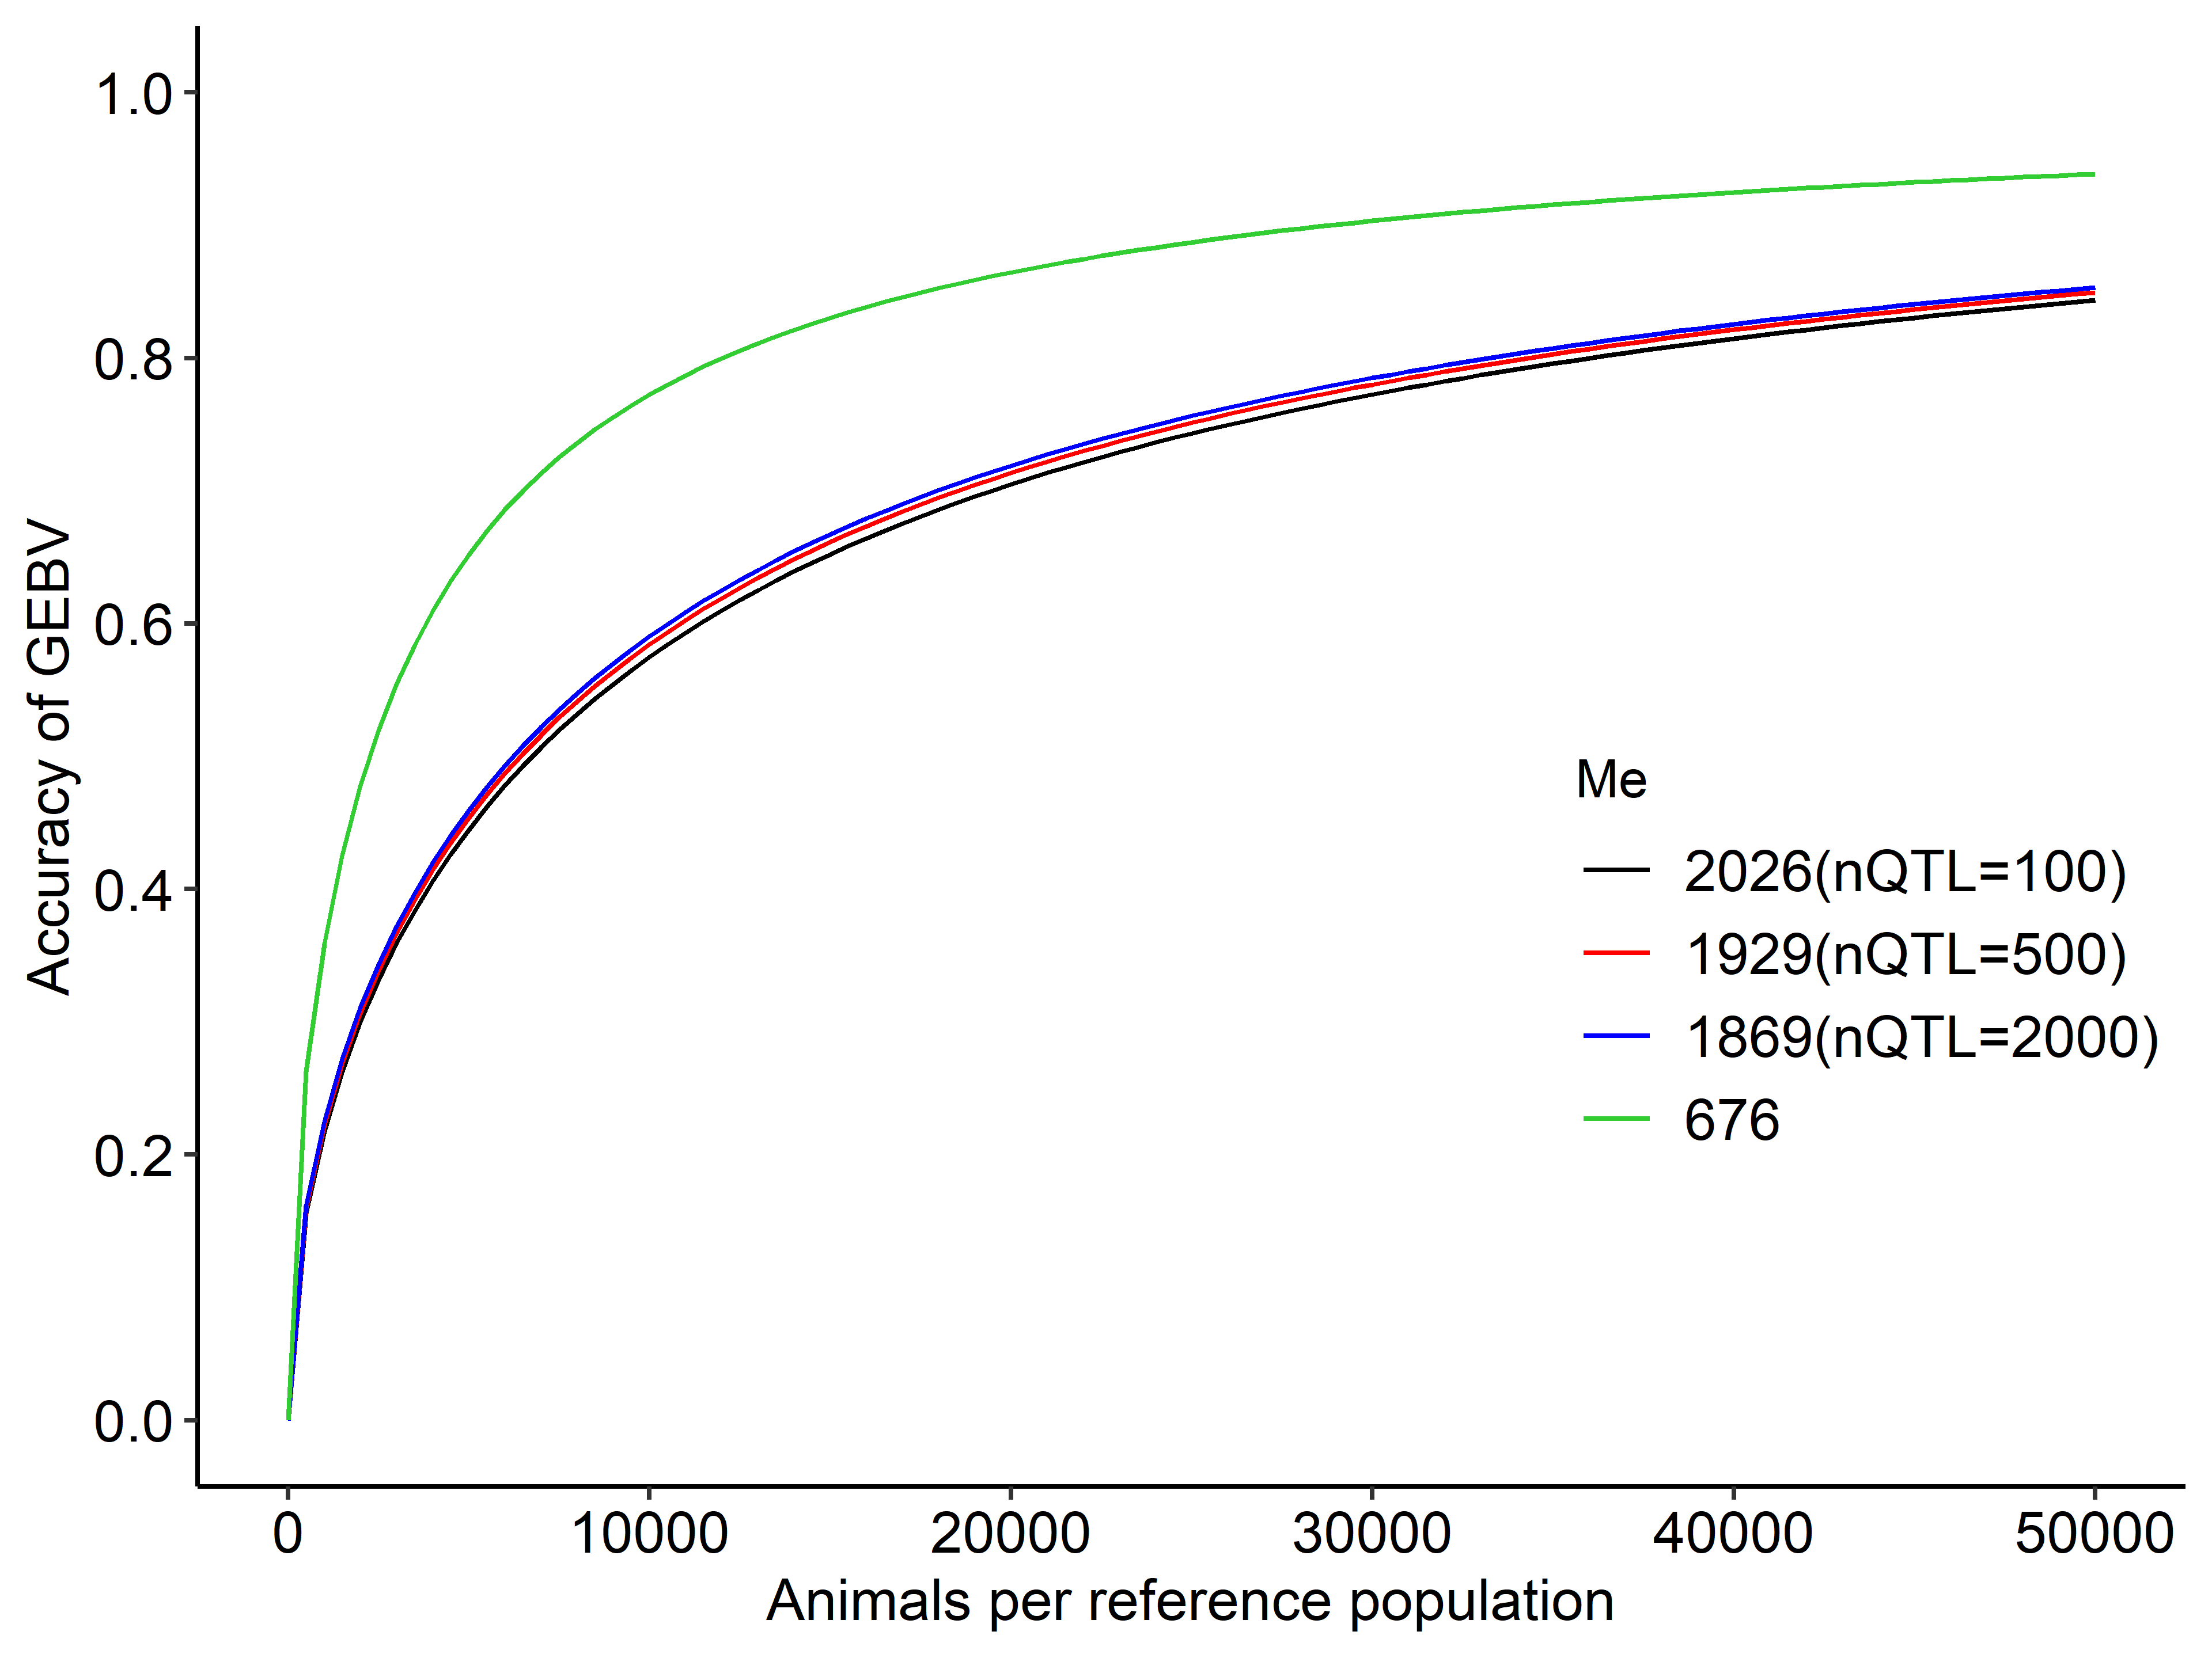
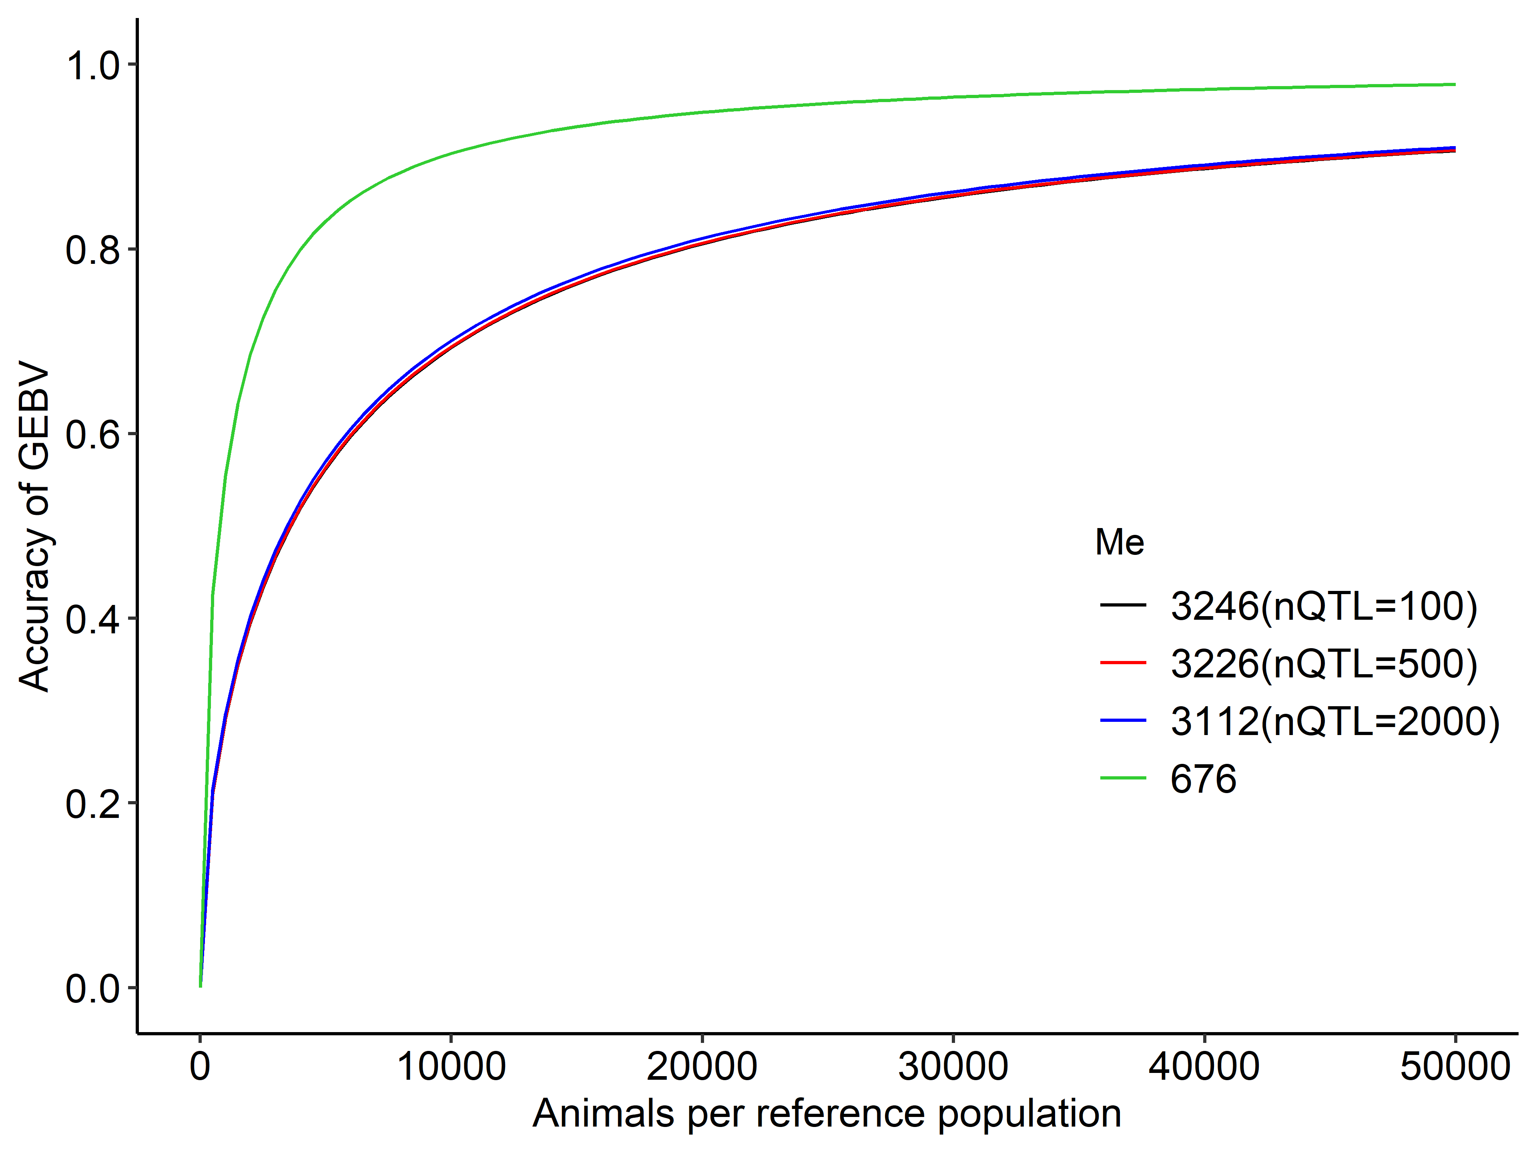
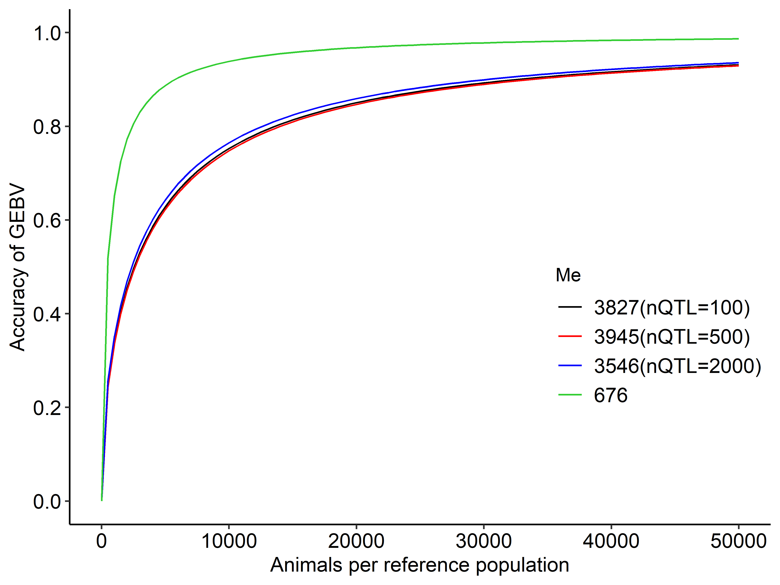
(a)
(b)
(c)
Figure S3. Expected accuracy of genomic estimated breeding values (GEBVs) for simulated traits based on the numbers of chromosome segments (M_{e}) estimated from cross-validation findings vs. those from effective population size.
X axis, number of animals per reference population. Y axis, expected accuracy of GEBVs for simulated traits with different values of Me per number of QTLs (nQTL) determined using formula developed herein (black, red, and blue curves) and from effective population size (green curve). Heritability: (a), 0.1; (b), 0.3; (c), 0.5.

Slide 4
Table S1. The numbers of chromosome segments (M_{e}) estimated by cross-validation from previous studies.
Breed | Estimated M_{e} | Reference
Brown- Swiss | 148.2-418.9 | Erbe et al., 2013
Holstein-Friesian | 904.9-2,821.9 | Erbe et al., 2013
Australian Red | 1,833 | van den Berg et al., 2019
Jersey | 2,416 | van den Berg et al., 2019
Holstein | 4,054-6,134 | van den Berg et al., 2019

